Slide 1
Construction management

Slide 2
Abstract
The Indian construction industry is known to be inefficient and highly resistant to change. Even with a changing market and increasing competition, there are no obvious signs of commensurate changes in methods and approach. Project management, on the other hand, seems to offer what is needed in terms of tools and techniques to raise industry standards. Little is known of the extent to which project management as a discipline exists in India. The aim of this paper, therefore, is to investigate the current level of application of project management and the obstacles that have prevented its introduction in the Indian construction industry. A small questionnaire survey is reported that was conducted in early 2007. Following a pilot study, the main survey instrument was emailed to more than 150 participants and organisations. This produced a sample of 51 respondents from four different construction industry disciplines i.e. architect, engineer, project personnel and building surveyor. The responses and suggestions provided by the returns are studied and reviewed.

Slide 3
These indicate that the Indian construction industry is growing and most of its consultants know of the existence project management. Barriers for the application of project management knowledge do exist, with 45% of the respondents indicating a high level of obstacles. A particular issue is the lack of encouragement from the construction organisations. A major difference was also observed between the public and private sectors, with many of the respondents claiming that project management is possible on a large scale in the private sector but not in the public sector. The reasons for this difference are government policies such as excessive bureaucracy, poor execution of projects, compromises on quality and standards, personal interests, low transparency and corruption. In addition, a large majority of respondents agreed that the construction industry lacks a structure or pattern; that tools such as project management can provide the structure needed; and with the help of this structure the industry should be able to overcome the problems involved in increased modernisation and transparency and be better prepared for future challenges.

Slide 4
Existing System
These indicate that the Indian construction industry is growing and most of its consultants know of the existence project management.
With competition growing both domestically and internationally and additions to existing demands, these issues need to be addressed to withstand increasing competition and to increase profits and efficiency.
Existence of bureaucracy, finance, politics, variations in government strategies, corruption, political influences, traditional government policies .
With more knowledge, encouragement from organisations and if the industry professionals work on the principle of continuous improvement, more parameters can be added to the existing list and this may eventually raise standards in the industry

Slide 5
Disadvantage of Existing System
A particular issue is the lack of encouragement from the construction organisations.
With competition growing both domestically and internationally and additions to existing demands, these issues need to be addressed to withstand increasing competition and to increase profits and efficiency.
From the data analysis it can be concluded that there is a realisation in the industry of these issues and a motivation to change the way things have been viewed in the past.
Opinions of project management, its impacts, benefits and possible adverse effects.

Slide 6
PROPOSED SYSTEM :
The importance of gaining as much information as possible about the proposed contract and site cannot be over emphasized.
The contract documentation and tender drawings will provide a useful starting point but most Estimators will need to visit the proposed site to get a ‘feel’ for the contract and the environment in which the work will take place.
The purpose of controlling is to ensure that everything occurs in conformities with the standards.
It is that part of managerial function which actuates the organizational methods to work efficiently for achievement of organizational purposes.

Slide 7
ADVANTAGE
There is a very high need to make changes in current practice and make it more efficient by the use of tools and methods such as project management.
With competition growing both domestically and internationally and additions to existing demands, these issues need to be addressed to withstand increasing competition and to increase profits and efficiency.
Any improvements, developments or recent changes in the approach towards increasing productivity and efficiency in the industry .
These include profit, efficiency, cost, time, quality, safety, satisfaction of users and clients, satisfaction of team members, and structure or pattern while executing projects.

Slide 8
TITTLE | AUTHOR | DESCRIPTION
The construction sector in Asian economies | Chiang, Y.H., Anson, M., Raftery, J. 2005, | This paper critically examines the changing relations between construction and economic development in selected less developed countries (LDCs) in the light of new development dynamics.
A practical use of key success factors to improve the effectiveness of project management | Clarke, A., 1999, | The problems addressed here are based on observations from an aerospace engineering company.

Slide 9
TITTLE | AUTHOR | DESCRIPTION
Factors affecting cost performance: evidence from Indian construction projects | Iyer, K.C., Jha, K.N., 2005, | This paper presents the findings of a questionnaire survey conducted on the factors affecting cost performance of Indian construction projects.
Construction productivity in developing global regions | Koehn, E., Jagushte, S.A., 2005, | The development of local educational centers, the use of expatriates as a training mechanism, and the use of computers are suggested as possible means of alleviating the problem of educating local managers.

Slide 10
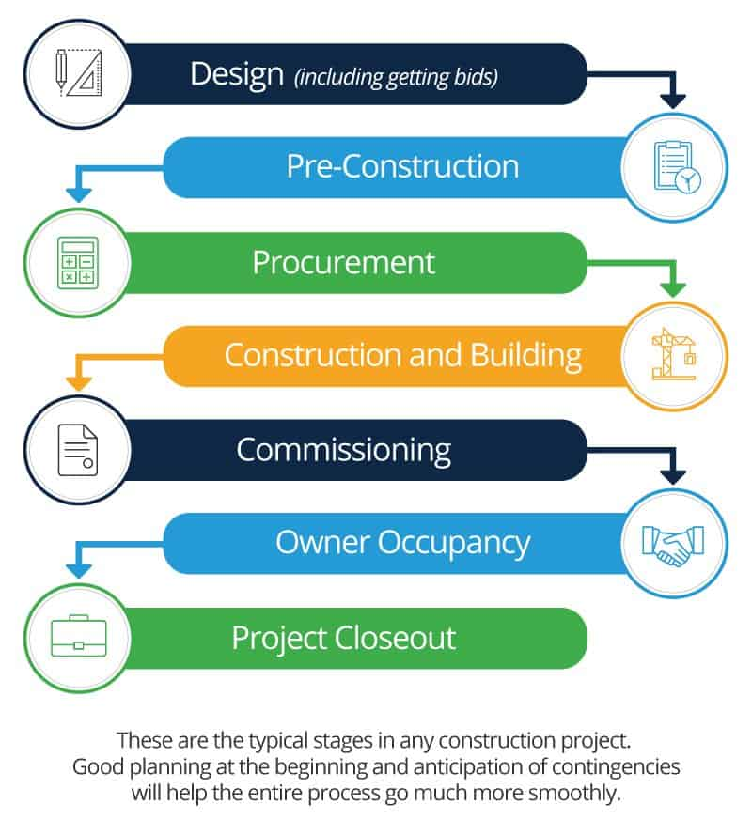
Block Diagram

Slide 11
SOFTWARE REQUIREMENTS:
Operating System : Windows 10
Platform : DOT NET TECHNOLOGY
Front End : ASP.Net 4.0
Back End : SQL SERVER 2014

Slide 12
HARDWARE REQUIREMENTS:
Keyboard
Mouse
Hard disk 500GB
Ram 4 Gb

Slide 13
CONCLUTION
There is already some knowledge and understanding of project management, its methods and benefits (transparency and increased productivity and efficiency with the modernisation of the industry) and how project management can improve standards. Due to the growing economy and demand, interest of foreign investors in India and ongoing major developments in India with more to come, the Indian construction industry is booming and there is a good balance of turnover and interaction among different professions. The qualities that project management offers (transparency, flexibility and modernisation) should change the image of the industry and also be appreciated by everyone including clients, stakeholders and end users. There is growing awareness of the drawbacks of current methods and practices while, and at the same time, there is a realisation of future challenges and milestones for the industry. A new generation of professionals is making an effort to put project management into practice, but the implementation of project management faces obstacles due to the traditional and labour intensive nature of the industry. For successful implementation of project management, there needs to be encouragement and support from construction organisations, such as training of existing staff and new recruitments on the basis of project management knowledge.

Slide 14
REFERENCE
Ahuja, V., 2007, IT enhanced communication protocols for building project management by small and medium enterprises in the Indian construction industry. Unpublished PhD thesis, Queensland University of Technology.
Cavana, R., Delahaye, B., Sekaran, U., 2000, Applied business research: qualitative and quantitative methods, John Wiley and Sons publications, New York.
Chiang, Y.H., Anson, M., Raftery, J. 2005, The construction sector in Asian economies. Spon Press: London and New York.
Clarke, A., 1999, A practical use of key success factors to improve the effectiveness of project management, International Journal of Project Management, 17(3):139-45.
Indian Child, 2007, Population of India, http://www.indianchild.com/population_of_india.htm (accessed 25 March 2008)

Slide 15
Iyer, K.C., Jha, K.N., 2005, Factors affecting cost performance: evidence from Indian construction projects, International Journal of Project Management, 23(4):283-95.
Koehn, E., Ganapathiraju, V.R., 1996, Productivity of construction in developing areas: India, Transactions of AACE International, ABI/INFORM Global pg. PRD31.
Koehn, E., Jagushte, S.A., 2005, Construction productivity in developing global regions, AACE International Transactions, ABI/INFORM Global pg. IN31.
Sreepuram, P., Rao, A.K., 2006, Build organization capabilities to utilize IT. In Swarup, P.R. and Kumar, B. Ed. Proceedings of the World Conference for Design and Construction, INCITE/ITCSED 2006, New Delhi, India, November 2006, Vol. 4.
Koehn, E., Ahmed, S.A., Jayanti, S., 2000, Variation in construction productivity: developing countries, AACE International Transactions, ABI/INFORM Global. pg. I4A.

