Slide 1
Advanced security implementation in vote processing system

Slide 2
Abstract
Due to their tight schedule nobody is going to the polls these days. There are numerous causes, some need to go to the polls, many of us may have to wait for long periods because of their strict schedules. So we created a voting system on the Internet. But there are some disadvantages to this system. Attackers legally receive customer passwords and use secret passwords to major sites. Consider a corporate voting system based on the web, electing a president or secretary or key managers of the organization once a year. This survey presents a secure verifiable online voting system, which allows voters to vote secretly in the public system to benefit from early voting and it will very useful in pandemic like Covid-19.

Slide 3
The proposed system is intended to universally support the election process by using the unique identification and biometric features of the elector. A digital witness is provided to a voter by the system to check if the voting is recorded as it intends and to check whether all the registered votes are recorded. Under the well-known elliptic curve of the Daffie - Hellman hypotheses, the privacy of the proposed system is achieved. In the current system, every elector must collect and cast his or her vote at one point on election day. We will use an alternative system called cryptography in this method. Here we split the unique image into two, four, placed in separate databases. We get the original picture at any point these two offers are interwoven. It is used as a secret password when we get the original image. This system is very useful and suitable for remote voting online. This system is an electronic system so it is possible to assess it on the web via any valid personal space on the planet.

Slide 4
Existing System
The existence of ballots in a digital form from end to end has a number of potential advantages over traditional paper-centred voting systems.
The existence of people that have special abilities and/or privileges in the systems used.
The digital envelope protects the confidentiality and integrity of the ballot, as it is created by using a public (encryption) key for which the private (decryption) key does not exist.
Moreover, as the ballots collected during the ballot casting period can only be decrypted with a non-existent key, this also ensures the secrecy of intermediate results (an important issue if the election takes place over several time zones or in the case of extended periods of voting).

Slide 5
Disadvantage of Existing System
This paper modified coercion resistance problem, Blockchain, Online Voting process, Developing a Secure Solution for online Election process information and To solve coercion resistance problem to solve using cryptographic algorithms.
The suggested method and system are based on ECDL and GDH problems and use elliptic curve cryptography.
The security of the systems is focused on the discrete logarithm problem (DLP) and integer factorization problems, and they are based on the standard RSA public-key cryptosystem (IFP).
People with an internet connection at home can vote at the polls without any problems.

Slide 6
PROPOSED SYSTEM :
We propose a security architecture for electronic voting that replicates the conventional security measures found in traditional elections.
We propose a new paradigm that permits a secure and trustworthy use of such complex proprietary DRE devices or remote voting platforms that offer the advantages of usability, flexibility, and support for multiple languages and for the disabled.
In our proposed security architecture, all the unique ballot identifiers are published at the end of the election, electronically and/or in newspapers or official bulletins.
The objective of such printer is to create a physical record of each vote, verifiable by voters in real-time, and useful for recount purposes.

Slide 7
ADVANTAGE
Implementing and comparing the performance of our proposed online voting system to the corresponding machine cycle schemes obtained through simulation.
We consider estimation of the operational machine cycles (for example, private and public operations based on curve and pairing, RSA operations on elliptic).
Develop voting plans to make more efficient voting services available with ICT resources than traditional paper-based voting methods.
Various forms of electronic voting, especially as additional methods of voting for remote voting, political parties, candidates, the electoral administration, and most importantly to improve the efficiency and promise of the democratic process to the electorate have attracted considerable attention.

Slide 8
TITTLE | AUTHOR | DESCRIPTION
Visual Cryptography in Internet Voting System | Rajendra A B and Sheshadri H S, | It has the flexibility to allow casting of vote from any remote place, even when key stakeholders of election process are not available at workplace.
Visual cryptography | M. Naor and A. Shamir (1994), | Visual Cryptography is a special encryption technique to hide information in images in such a way that it can be decrypted by the human vision if the correct key image is used.

Slide 9
TITTLE | AUTHOR | DESCRIPTION
Safeguarding Cryptographic Keys | G. R. Blakley (1970), | A typical cryptosystem will have several volatile copies of an important key in protected memory locations where they will very probably evaporate if any tampering or probing occurs.
Handbook of Applied Cryptography | A. Menezes, P. Van Oorschot and S. Vanstone (1997), | It remains the standard means for securing electronic commerce for many financial institutions around the world.

Slide 10
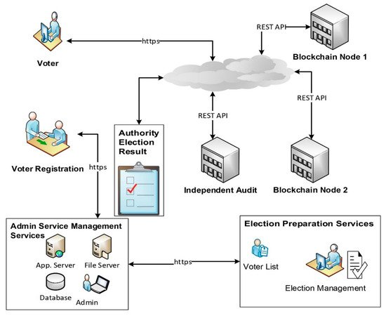
Block Diagram

Slide 11
SOFTWARE REQUIREMENTS:
Operating System : Windows 10
Platform : DOT NET TECHNOLOGY
Front End : ASP.Net 4.0
Back End : SQL SERVER 2014

Slide 12
HARDWARE REQUIREMENTS:
Keyboard
Mouse
Hard disk 500GB
Ram 4 Gb

Slide 13
CONCLUTION
The cryptographic online voting system overcomes restrictions on the traditional voting system. This system offers more safety and takes a while. There is also no chance of voting fraud. There is a significant reduction in the money spent on security. This method aims primarily to provide full privacy to voters and to ensure that the online voting system is coordinated optimally. The fundamental idea of this system is to use a strong voting authentication security mechanism. Visual encryption encrypts information and can decrypt it without mathematical calculations. People with an internet connection at home can vote at the polls without any problems. Visual cryptography is used to conduct elections fairly easily and efficiently using these internet-based voting systems since voters can vote from the point of view in which they operate using the online voting system. Various advantages include low costs and increased voting attendance online voting. Online voting offers This online voting system takes careful account of safety and human factors, and in particular, ensures that the electorate has reliable and intuitive indications on the validity of the vote. The system we proposed to provide voters with mutual authentication and choosing with visual encryption.

Slide 14
REFERENCE
[1] Ollmann G. The Phishing Guide Understanding & Preventing Phishing Attacks, NGS Software Insight Security Research.
[2] M. Naor and A. Shamir (1994), Visual cryptography, in Proc. Eurocrypt, pp. 1–12.
[3] A. Shamir (1979), .How to Share a Secret, Communication ACM, vol. 22, pp.612-613.
[4] G. R. Blakley (1970), .Safeguarding Cryptographic Keys. Proceedings of AFIPS Conference, vol. 48, pp. 313- 317.
[5] A. Menezes, P. Van Oorschot and S. Vanstone (1997), .Handbook of Applied Cryptography, CRC Press, Boca Raton, FL, 1997.

Slide 15
[6] Sumit Jagtap, Smitesh Vichare, AlpaVaidya, Mangesh Jogd and, Prof. ShivaniSthapak, “VC Technology in Internet Voting System”, published in 4, April 2016.
[7] Rajendra A B and Sheshadri H S," Visual Cryptography in Internet VotingSystem”.
[8] Pallavi V Chavan, Dr. Mohammad Atique, and Dr. Anjali R Mahajan, "An Intelligent System for Secured Authentication using Hierarchical Visual Cryptography-Review”, published in 2011.
[9] Anderson C. (2006). How to Rig a Democracy: A Timeline of ElectronicVoting in the United States. The Independent. Retrieved November 28, 2006, from: http://www.indypendent.org/?p=608
[10] Bellis, M. (2007). The History of Voting Machines. Retrieved November 9, 2006, from: http://inventors.about.com/library/weekly/aa111300b.htm

