Slide 1
Eproject tendering using email gateway system

Slide 2
Abstract
Tendering processes are considered to be a suitable mechanism for governments to fairly assign contracts for construction projects and procurement. The demand for efficiencies to be created in the process has resulted in a significant number of governments implementing e-tendering systems. E-tendering systems generally involve the submission of tender offer documents to a secure system hosted by the government (principal). An electronic environment presents obvious opportunities for collusion between principal and certain tenderers, fraud by tenderers and a minefield of legal uncertainties for fuelling protracted disputes. Critical examination of the security and legal requirements for e-tendering systems does not appear in the current literature. This paper identifies key security and legal issues to be addressed in the design of e-tendering systems, which may be included in e-procurement software, and proposes a new e-tendering architecture, using distributed trusted third parties which may be suitable for secure large scale operations such as the construction industry.

Slide 3
Existing System
The existing architecture of popular-tendering system are introduced. Then a new architecture for a highly secure E-tendering system is proposed.
The new architecture uses encrypted iris pattern as biometric attribute for authentication of tenderers participating in a tender.
Iris authentication necessitates the existence of standardized iris image capture and encryption software along with the web camera that is built in the recent computer systems.
Tenderers place their trust in the access control system employed by the principal to ensure that collusion or internal malfeasance by the principal’s users is difficult.

Slide 4
Disadvantage of Existing System
It minimises the reliance on one party thus reducing the chance of collusion and single point failure problems. Also, the documents for each tendering project are not stored on a third party system.
This paper seeks to identify key security and legal issues to be addressed in the design of secure and legally compliant e-tendering systems.
When these documents are kept and maintained electronically, legal issues arise as to how the contents and integrity of those documents can be proven in court.
The same security issues and mechanisms such as secure communication, authentication and non-repudiation, access control and evidential integrity are relevant in this electronic tendering system.

Slide 5
PROPOSED SYSTEM :
The proposed architecture uses Shamir threshold crypto system for securing the e-tender box and imposes BellLaPadula security model on the access rights of parties involved in the e-tendering system.
In the previous electronic tendering system, digital signatures were proposed as a technical means to ensure the non-repudiation of precontract communications.
In our proposed architecture DTTP is improved by using Biometric information for authentication, bell-LaPadula security model and shamir threshold crypto system for securing e-tender Box and other tendering documents.
In the proposed architecture, Biometric system is used for authentication .

Slide 6
ADVANTAGE
The demand for efficiencies to be created in the process has resulted in a significant number of governments implementing e-tendering systems.
E-tendering systems generally involve the submission of tender offer documents to a secure system hosted by the government (principal).
While an e-tendering system will be more efficient and cost-effective, the shift to an electronic environment presents several legal hurdles, in part because the law that governs electronic transactions is under-developed and lags behind the technology.
However, as the tendering process is governed largely by contract law (as supplemented by constructions protocols or standards in some jurisdictions) many of the various gaps in the law may be remedied by explicit and detailed conditions of tender.

Slide 7
TITTLE | AUTHOR | DESCRIPTION
Integrated contract management | Boulmakoul A. and Salle M. (2002). | The size of management can range from one person in a small organization to hundreds or thousands of managers in multinational companies
New directions in cryptography | Diffie W. and Hellman M. E. (1976). | It also discusses how the theories of communication and computation are beginning to provide the tools to solve cryptographic problems of long standing.

Slide 8
TITTLE | AUTHOR | DESCRIPTION
A public key cryptosystem and a signature scheme based on discrete logarithms | ElGamal T. (1985). | A new signature scheme is proposed, together with an implementation of the Diffie-Hellman key distribution scheme that achieves a public key cryptosystem.
A method for obtaining digital signatures and public-key cryptosystems | Brussells. Rivest R., Shamir A. and Adleman L. (1978). | An encryption method is presented with the novel property that publicly revealing an encryption key does not thereby reveal the corresponding decryption key.

Slide 9
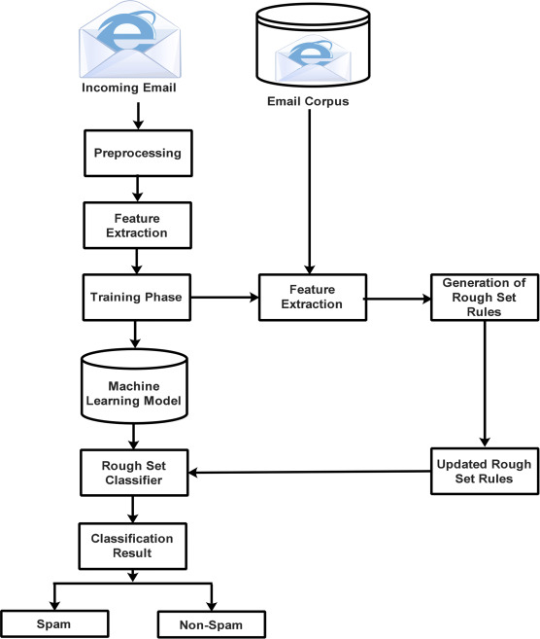
Block Diagram

Slide 10
SOFTWARE REQUIREMENTS:
Operating System : Windows 10
Platform : DOT NET TECHNOLOGY
Front End : ASP.Net 4.0
Back End : SQL SERVER 2014

Slide 11
HARDWARE REQUIREMENTS:
Keyboard
Mouse
Hard disk 500GB
Ram 4 Gb

Slide 12
CONCLUTION
This Article has identified a number of legal and security requirements for the implementation of an e-tendering system. The application of these requirements to three (3) security architectures is considered. The third architecture proposed is a DTTP architecture which may be suitable for large scale operations. The DTTP architecture needs to be investigated in more detail. Specific cryptographic protocols and mechanisms need to be developed to ensure security, particularly secure time issues. Legal aspects of the e-tendering process also need to be given careful consideration in the implementation of an e-tendering system. Contract terms and conditions for e-tendering need to support and compliment security mechanisms, while also resolving any legal uncertainties arising from an electronic environment.

Slide 13
REFERENCE
Adams C., Cain P., Pinkas D. and Zuccherato R. (2001). Internet x.509 public key infrastructure time stamp protocols (TSP), RFC3161, The Internet Engineering Task Force.
Angelov S. and Grefen P. (2002). A conceptual framework for B2B electronic contracting, Collaborative Business Ecosystems and Virtual Enterprises - Proceedings 3rd IFIP Working Conference on Infrastructures for Virtual Enterprises; Sesimbra, Portugal; 143-150.
Boulmakoul A. and Salle M. (2002). Integrated contract management, Proceedings of the 9th Workshop of the HP OpenView University Association Online Conference.
Dierks T. and Allen C. (1999). The TLS protocol version 1.0, RFC 2246, The Internet Engineering Task Force.
Diffie W. and Hellman M. E. (1976). New directions in cryptography, IEEE Transactions on Information Theory, IT-22, 644–654.

Slide 14
ElGamal T. (1985). A public key cryptosystem and a signature scheme based on discrete logarithms, IEEE Transactions on Information Theory, 31(4), 469–472.
Haber S. and Stornetta, W. S. (1991). How to time-stamp a digital document, Journal of Cryptology, 3(2), 99– 111. ISO15408 (1999).
ITSEC (1991). Information technology security evaluation criteria (ITSEC), Commission of the European Communities, Version 1.2,
Brussells. Rivest R., Shamir A. and Adleman L. (1978). A method for obtaining digital signatures and public-key cryptosystems, Communications of the ACM, 21, 120–126.
Shamir A. (1979). How to share a secret, Communications of the ACM, 22, 612–613.

