Slide 1
Salary Management System

Slide 2
Abstract
The purpose of developing this software project is to fully automate salary system for an organization sweden sports academy. This software is capable of calculating monthly salaries, tax and social security of employees of that organization. On the basis of certain formulas it will generate files as an output such as bank files and salary slips etc. The system is also capable of calculating tax payable by the organization and social security. The tax file is generated for the tax office. All the data such as, employee information, salaries, social security and tax will be stored in database as a track record.

Slide 3
Existing System
The system can be developed in such a way that its existing features can be modified to better versions.
Through the learning of programming language and basic courses during university time, existing programming software can be used to write suitable procurement management module.
This software is built to eliminate and in some cases reduce the hardships faced by the existing system. Moreover this system is designed for particular need of the company to carry out its operations in a smooth and effective manner.
This web application can maintain and view computerised records without getting redundant entries.

Slide 4
Disadvantage of Existing System
The security logs, handles the security issues, checks the application logs, handles the error massages of the application, handles the database errors and web server problems etc.
The criteria set for goals is to generate files, deliver on time, performance and efficiency issues of the system.
As “enterprise website” has huge impact on China’s media, so there are a lot of relevant researches, and this paper mainly discusses opportunities and challenges in this industry that enterprises are faced with in corporate culture, timely activities, enterprises’ services, users’ services, planning and promotion of enterprises’ brand image as well as countermeasures that enterprises take.

Slide 5
PROPOSED SYSTEM :
The purpose of this document is to describe the functionality and specifications of the design of a web application for Managing Employees and their payroll.
The expected audiences of this document are the developers and the admin of the web application. Now with the help of this system the admin has the information on his finger tips and can easily prepare a good record based on their requirements.
This will be an additional advantage and management of power based on their free time from his normal duty.
It is cost effective as the user control the web application himself and does not go for professional service.

Slide 6
ADVANTAGE
To measure the performance and efficiency of the system we will put load by inserting input by the number of users.
There are several reasons of its popularity among other freely available open source database systems such as availability, reliability, scalability, speed, security, performance.
This layer is independent of other tiers due to which the performance and scalability of the system increases.
It is a load, stress and performance testing tool for web sites and web applications.
It also provides stability, compatibility (platform independence), working efficiently with a variety of web servers.

Slide 7
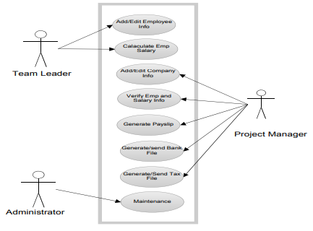
Block Diagram

Slide 8
SOFTWARE REQUIREMENTS:
Operating System : Windows 10
Platform : DOT NET TECHNOLOGY
Front End : ASP.Net 4.0
Back End : SQL SERVER 2014

Slide 9
HARDWARE REQUIREMENTS:
Keyboard
Mouse
Hard disk 500GB
Ram 4 Gb

Slide 10
CONCLUTION
The criteria set for goals is to generate files, deliver on time, performance and efficiency issues of the system. The major goal we have achieved is to generate the bank files/invoices for the banks with salary information so that the banks are able to transfer the salaries of the employees into their accounts. After developing the system, we calculated the salary and generated a bank file. The bank file was then sent to the bank and was practically done successful

