Slide 1
Cloud Computing with PHP – Using Amazon S3 with the Zend Framework

Slide 2
Abstract
The purpose of this thesis was to show how to use Zend Framework to connect PHP applications to the cloud.To find out how easy it is for developers with basic knowledge of the Zend Framework, to incorporate cloud computing in their applications. In order to do this, a blog application was developed using the Zend Framework and the upload files functionality was connected to the cloud using the Zend_Service_Amazon_S3 class. The development work was carried out on a personal computer. Notepad ++ was used as the editing software and Microsoft Word 2007 was used for documentation. Zend Framework 1.11.2 was the framework used for developing the blog application. Apache server was used for the web server. Amazon S3 web service was used to connect the application and for storage.

Slide 3
Existing System
PHP language was considered the most powerful and popular scripting language due to its ease of use. Another scripting language, Ruby, had been in existence for a while but not as many people were using it because it was not as fast, easy to learn or as convenient as PHP.
Multiple views can exist for a single model for different purposes.
Most of these frameworks provide libraries for database access, templating frameworks, session management and code reuse.
The Zend Framework (ZF) is a good example of a web framework that will be discussed here since it was used in this paper

Slide 4
Disadvantage of Existing System
The current blog application developed, an end-user will be able to create a new blog, login and logout, view and add posts.
The comment and upload files functionalities are still in development. This can be attributed to local server problems and file configuration issues.
Poor documentation for the beginners.
Updating the framework should be done manually by the developer.
Failure to update the security patches can lead to serious security risks

Slide 5
PROPOSED SYSTEM :
The purpose of this thesis was to show how to use Zend Framework to connect PHP applications to the cloud.
The purpose of this purpose is to show how to connect an application to the cloud using the Amazon S3 service. This paper will mainly deal with developing a blog application using the Zend Framework.
The purpose was to connect the upload function to Amazon S3 so that the end-user could be able to upload pictures or links relevant to the blog being posted.
It would usually contain HTML, CSS, JavaScript and images. The Controller receives inputs from the user and instructs the model and viewport to perform actions based on that input.

Slide 6
ADVANTAGE
Free for development and distribution.
Fully object-oriented PHP class library.
Extreme simplicity and a “use-at-will” architecture.
MVC architecture which is an essential feature for building web applications.
Authentication, authorization and session management.
Supports data adapters for all major databases.
AJAX support.
Compatibility with many web services.
RSS and Atom syndication support

Slide 7
TITTLE | AUTHOR | DESCRIPTION
Cloud Computing For Dummies | Hurwitz J, Bloor R, Kaufman M, Halper F. | The easy way to understand and implement cloud computing technology written by a team of experts Cloud computing can be difficult to understand at first, but the cost-saving possibilities are great and many companies are getting on board.
How Cloud Computing Works | Jonathan Strickland. | It is less about the machine you use at home or on the move and more about what is happening on computers many miles away.

Slide 8
TITTLE | AUTHOR | DESCRIPTION
Handbook of Cloud Computing | Borko Furht, Armando Escalante, editors. | The scope of this book includes comprehensive coverage to all aspects of cloud computing-basic terminologies, cloud models, cloud security, resource allocation, simulators and mobile cloud computing.
A history of cloud computing | Arif Mohamed. | Cloud computing has the potential to eliminate the requirements for setting up of high cost infrastructure for IT-based solutions and services that industry uses.

Slide 9
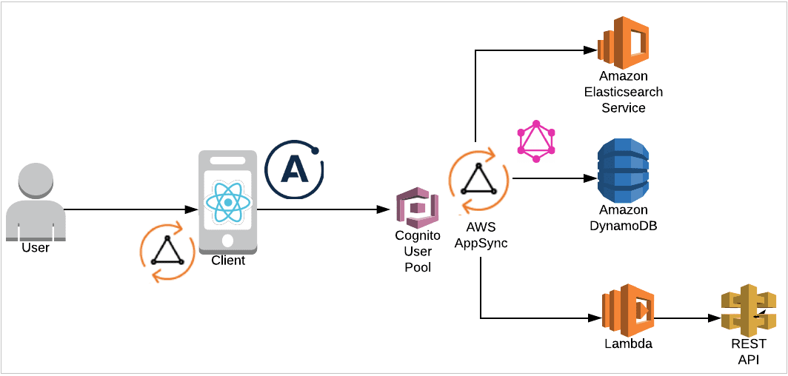
Block Diagram

Slide 10
SOFTWARE REQUIREMENTS:
Operating System : Windows 10
Platform : DOT NET TECHNOLOGY
Front End : ASP.Net 4.0
Back End : SQL SERVER 2014

Slide 11
HARDWARE REQUIREMENTS:
Keyboard
Mouse
Hard disk 500GB
Ram 4 Gb

Slide 12
CONCLUTION
This project was aimed at finding out if a developer with a basic PHP knowledge could take advantage of the cloud services by connecting an application to the cloud using the Zend Framework and Amazon S3 services. The focus was on the upload files feature that was connected to a bucket in the Amazon S3 service. The project showed that, while setting and opening an S3 account is fairly simple and direct, configuring the Zend Framework is quite brain-racking for a beginner. An installer package will be a good improvement, so the developer does not have to worry about file locations. The Zend Framework also lacks clear concise documentation and therefore it takes time to learn and understand it.

Slide 13
REFERENCE
1. Hurwitz J, Bloor R, Kaufman M, Halper F. Cloud Computing For Dummies. NJ: Wiley Publishing, Inc; 2010.
2. Borko Furht, Armando Escalante, editors. Handbook of Cloud Computing. London: Springer; 2010
3. Jonathan Strickland. How Cloud Computing Works [online]. 2008. URL:http://communication.howstuffworks.com/cloud-computing.htm. Accessed 8 th January 2011.
4. Doug Tidwell. Cloud Computing with PHP, part 1: Using Amazon S3 with the Zend Framework [online]. Developer Works; 22nd September 2009. URL: http://www.ibm.com/developerworks/opensource/library/os-php-cloud1/. Accessed 9th January 2011.
5. Jason Gilmore W. Easy PHP Websites with the Zend Framework. 1373 Grandview Avenue, Columbus, Ohio: W.J Gilmore, LLC;2009.

Slide 14
6. Jeff Barr. Host Your Web Site in the Cloud: Amazon Web Services Made Easy. Seattle, USA: Amazon Web Services, LLC; 2010.
7. Arif Mohamed. A history of cloud computing [online]. ComputerWeekly.com; 27th September 2009. URL: http://www.computerweekly.com/Articles/2009/06/10/235429/A-history-ofcloud-computing.htm. Accessed 14th December 2010
8. Amazon Simple Storage Service [online]. Amazon Web Service LLC. URL: http://aws.amazon.com/s3/. Accessed 8th January 2011
9. Armando P. Beginning Zend Framework. Spring Street, NY: Apress; 2009.
10. Nicholas C. Understanding the Zend Framework, part 1: The basics [online]. Developer Works; 27th June 2006.

