Slide 1
Student Information System using PHP and MYSQL4

Slide 2
Abstract
Student Information Management System can be used by education institutes to maintain the records of students easily. Achieving this objective is difficult using a manual system as the information is scattered, can be redundant and collecting relevant information may be very time consuming. All these problems are solved using this project.

Slide 3
Existing System
The system developed in this paper uses a cloud based multi-channel technology to implement and design a robust and dynamic cross platform software as a services (SaaS) application for students’ information management system (SIMS).
The system runs on a network of infrastructure as a service (IaaS) for the purpose of overcoming the lapses associated with the existing systems developed for managing students’ information.
The system was developed so that students and staff can be enlightened, exposed and obliged with modern modes in managing and sharing of information and to improve the state of social culture of Nigerian students and staff by providing a medium for information processing and publication.

Slide 4
Disadvantage of Existing System
The system was built with the capability to resolve issues on manual documentation of information on staff and students, share information simultaneously among multiple users and perform its tasks without delay or deadlock.
Such user's operating authority is relatively low, they can only query their own information, if you encounter an error message the problem can be feedback to the administrator.
Current college students in the study of information management problems and improve, based on the use of technology and VbScript ASP programming language to implement the Student Information Management System Design and Implementation.

Slide 5
PROPOSED SYSTEM :
The developed system was designed to resolve the probability of students having conflict in the timetables among different courses they attend and tackle formal complexities of the course enrolment process through the use of virtual academic adviser which has a recommender system for the purpose of recommending for the students among others.
The system was well equipped with a manager that keeps track of both staff and students information for purpose of guiding against their loss.
This is a module in the portal that serve as a repository for books and handouts made available to students, staff and lecturers for the purpose of learning and research.

Slide 6
ADVANTAGE
Some performance requirements and constraints are also given and deal with other Non-Functional Requirements.
The proposed system that we are going to develop will be used as the Chief performance system for providing help to the organization in managing the whole database of the student studying in the organisation.
The overall system design objective is to provide an efficient, modular design that will reduce the system’s complexity, facilitate change and result in an easy implementation.
Student information management system lead to a better organization structure since the information management of the students is well structured and also lead to better as well as efficient utilization of resources.

Slide 7
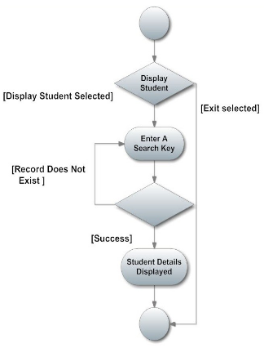
Block Diagram

Slide 8
SOFTWARE REQUIREMENTS:
Operating System : Windows 10
Platform : DOT NET TECHNOLOGY
Front End : ASP.Net 4.0
Back End : SQL SERVER 2014

Slide 9
HARDWARE REQUIREMENTS:
Keyboard
Mouse
Hard disk 500GB
Ram 4 Gb

Slide 10
CONCLUTION
Hence we can conclude that the design phase of the SIMS give us the information of all the processes used in the project and their relation.

