Slide 1
Pharmacy Management System in PHP + MySQL

Slide 2
Abstract
Pharmacy management system is one of the most essential tools that are mostly used in medical store in Tanzania; it is mostly used to manage pharmacy related activities such as medical inventory, record keeping, sales management as well as managing the drug stock and information of the expired medicines. Many pharmacies in Tanzania are still operating manually; they don’t have adequate software to manage their daily activities. It needs the pharmacist assistant to check the expired date of the medicine twice a week, and it can take a lot of time to find out whether certain medicine are out of stock. In this project we tried to develop a computerised and web based Pharmacy management system.

Slide 3
Our main intention is to allow this application to be used in most retailing pharmacies in Tanzania, where a small point of customization will be required to each pharmacy in the implementation period. This system is designed to overcome all challenges related to the management of medicine that were used to be handled locally and manually. Pharmacy management system has its own significance to the retail pharmacy shops in Tanzania. Using this system, it will help us to records all transaction made at the daily sales, recognise all debtors, customers, employees, balance stock, etc. It will manage all activities around the shop that increases productivity and maximize profit, it will also minimizing the risk of getting loss because all transactions are recorded to the system.

Slide 4
Existing System
The person who has access to this part of the system can insert new medicine, update existed one and check the medicines quantities.
We insert new medicine, update an existed one and check the medicines quantities.
The database built using SQL Server contains the pharmacy information related to the medicines, patient information….etc. the GUI frames ease the use of the proposed system by unskilled users.
A Pharmacology is the branch of biology deals with the properties of chemicals and interests with the study of use, action, side effect of drug.

Slide 5
Disadvantage of Existing System
It is the process of identifying problems, opportunities, and objectives.
This phase required the analysts to look honestly at what is occurring in a business. Then, together with other organizational members, the analyst pinpoints problems.
The analyst was able able to see whether some aspect of information systems applications can help the business reach its objectives by addressing specific problems or opportunities.
The output of this phase is a feasibility report containing a problem definition and summarizing the objectives.
It is a process of collecting factual data, understand the processes involved, identifying problems and recommending feasible suggestions for improving the system functioning.

Slide 6
PROPOSED SYSTEM :
In this paper, a hospital e-pharmacy system is proposed in order to facilitate the job, outdo the mentioned problems.
The proposed system is equipped with alarm that alerts the admin about all medicines which are reached the minimum quantity and medicines that expired.
The proposed system managing as most as possible the whole job of hospital pharmacy.
The GUI frames are used for controlling the work of the proposed system, while the database is for saving the related information.
The proposed system was tested in terms of registration function by entering new records for inpatient and outpatient, release and update function.

Slide 7
ADVANTAGE
Improving performance and efficiency in pharmacy shops is a major goal of Pharmacy Management System.
The overall objective of this project is to establish a System for pharmacy shops so as to improve the performance and efficiency of pharmacy shops management.
If a major change to a system has been needed, a new project was being sated to carry out the change.
Pharmacy management system is designed to improve the accuracy, enhance safety and efficiency in the pharmaceutical store.
Pharmacy management System is a very effective tool for an organization to be efficient in business management.

Slide 8
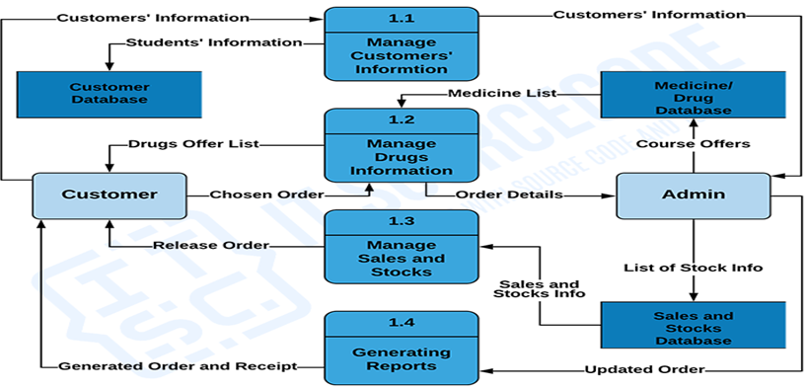
Block Diagram

Slide 9
SOFTWARE REQUIREMENTS:
Operating System : Windows 10
Platform : DOT NET TECHNOLOGY
Front End : ASP.Net 4.0
Back End : SQL SERVER 2014

Slide 10
HARDWARE REQUIREMENTS:
Keyboard
Mouse
Hard disk 500GB
Ram 4 Gb

Slide 11
CONCLUTION
Today management is one of the most essential features of all form. Management provides sophistication to perform any kind of task in a particular form. This is pharmacy management system; it is used to manage most pharmacy related activities in the pharmacy. The primary aim of is to improve accuracy and enhance safety and efficiency in the pharmaceutical store. In this project we can also include BAR CODE facility using the bar code reader, which will detect the expiry date and the other information about the related medicines. We may also concluded that by using pharmacy software, processing both new prescriptions and refills can be done quickly and simply with just a few keystrokes or mouse clicks with new, easy to learn and use Graphical User Interface (GUI) pharmacy management solution. That due to automation where the pharmacist does his or her work much faster, a switch from product oriented to patient oriented which is one of the most important keys in pharmaceutical care. In other words that the pharmacist will have more time in counseling his/her customers, where the goal of patient counseling is one of the important solution to avoid medication error.

Slide 12
REFERENCE
[1]Library Learning http://www.usg.edu/galileo/skills/unit04/primer04_01 .phtml
[2] Search sql server http://searchsqlserver.techtarget.com/definition/datab ase-management-system
[3] Library Learning http://www.usg.edu/galileo/skills/unit04/primer04_01 .phtml
[4] merriam-webster http://www.merriamwebster.com/dictionary/database
[5] Everything http://everything.explained.today/Entity%E2%80%93 relationship_ model

