Slide 1
Books and Library Lending Management in PHP

Slide 2
Abstract
Library management, its operation has never been easy to run effectively manually, lending of books, records of returned books, books in the library, its shift and many more. This research work will dwell more on developing and implementing a comprehensive library management system capable of handling the library operation, like book lending, retrieval/return, staffs/students registration, book registration, update, search and delete. I used the Entity-Relationship model to design a database that will store and organize the library's data. I also created the database using SQL and populated it with some sample Data. In order to archive this research work, a sophisticated program language was chosen – VB.Net using visual studio 2012 ultimate development environment to implement the work. At the end of the research work the system was tested and its corresponding outcome was as expected, and all security issues was checked and considered for security measures. I conclude that library management software is a powerful and effective tools to be used in every library for effective management.

Slide 3
Existing System
If the number does not exist, indicated that the book doesn’t exist; If the book exists for the next operation.
Hospital required library management system was not only to meet the demand of the existing management, in order to meet future development needs, but also can meet the requirements of future development.
Through the cases of various types of existed books management system, the readers could view the library book for detailed information.
If the reader already regurgitate as a user, books management system management system’s official was registered users could see the personal information could also be to change your personal information.

Slide 4
Disadvantage of Existing System
In the existing system all the transaction of books are done manually, So taking more time for a transaction like borrowing a book or returning a book and also for searching of members and books.
Another major problem is on preparing the list of books borrowed and the available books in the library will take more time, currently it is doing as a one day process for verifying all records.
So after conducting the feasibility study a decision to make the manual Library management system to be computerized one was taken to consideration.

Slide 5
PROPOSED SYSTEM :
Its purpose is to use cases and the logical process of establishing document which details the work of the users of the system and the system itself.
This purpose, these are classified, catalogued, entries filed in library catalogue and books shelved on display racks or in the stacks.
The purpose of the Administration Section is to promote those activities which relate to library administration and management issues in general.
This section maintains the records of office files, diary and dispatch, library budget proposals, budgetary allocations, accounts of library expenditure, stock registers, and such other purposeful records.

Slide 6
ADVANTAGE
It includes system and process of controlling, control techniques, control of overall performance, and effective managing.
The library management means efficient and effective management of material (information sources), machinery, men (human resource), technology and money to meet the objectives of the library.
A specially designed circulation counter is used for doing circulation work.
The items used by users are to be re-stored (reshelved) in their proper position on the shelf.
The books are the knowledge containers, readers are the knowledge seekers, and staff means the facilitators or providers of various library services to the users, the knowledge seekers.

Slide 7
TITTLE | AUTHOR | DESCRIPTION
Database fundamentals and applications | S.F. Liu, | A database is a persistent, logically coherent collection of inherently meaningful data, relevant to some aspects of the real world.
Visual Basic and SQL Server database application system development | B. Wu, D.L. Lu. | When you design your application in multiple layers, as you should, this project type helps you to develop and manage the database layer closest to the database and the database itself.

Slide 8
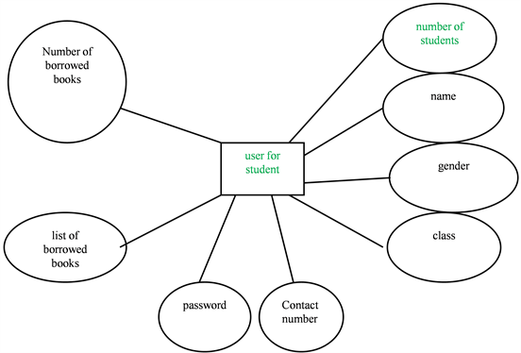
Block Diagram

Slide 9
SOFTWARE REQUIREMENTS:
Operating System : Windows 10
Platform : DOT NET TECHNOLOGY
Front End : ASP.Net 4.0
Back End : SQL SERVER 2014

Slide 10
HARDWARE REQUIREMENTS:
Keyboard
Mouse
Hard disk 500GB
Ram 4 Gb

Slide 11
CONCLUTION
The system was realized by structured analysis and development methods. System run well at present, although the system function was simpler, its implementation was a relief to librarians working pressure had reached the expected goal.

Slide 12
REFERENCE
[1] H.C. Tao. Software engineering, Beijing: economic science press, pp. 292-311, 2004.
[2] L.N. Lu. Software engineer. Beijing: Economic Science Press, pp, 27-96, 1999.
[3] Z.H. Hao, F. Liu, Visual Basic 6.0 Programming Article. Beijing: Publishing House of Electronics Industry, pp.145-201, 2004.
[4] S.F. Liu, Database fundamentals and applications. Beijing: The Central Radio and Television University Press, pp.27-43, 2003.
[5] B. Wu, D.L. Lu. Visual Basic and SQL Server database application system development. Beijing: China Machine Press, pp.39-51, 2014.

