Slide 1
Sales management system

Slide 2
Abstract
Sales management is a key function which helps small and medium size enterprises (SMEs) in monitoring and tracking stock and co-ordinating transaction processing. The efficiency of sales management dependends on effective tools and facilities, especially mordern information and communication technologies. Despite this, majority of businesses in developing countries, especially those in remote areas do not take full advantage of these technologies due to challenges related to the design of these technologies. This paper presents the design and development of a tailor-made computerized sales management system for SMEs in Northern Ghana.The object-oriented methodology is employed with UML, VB.NET and Microsoft Access Database for the design and development of the system which is flexible and tailor-made for SMEs in the region.

Slide 3
Existing System
Existing inventory management also does not provide any means in detecting expired date for food based products such as milk, bread, flour and etc.
Basic information about existing Sales and Inventory System and how to develop inventory tracking system in general.
When first dealing with industrial projects, it was decided to use the existing guidelines for discounts because other activities, such as planning, were relying on it.
The research showed that it is difficult to change all dimensions at once and therefore only Sales Force Management and Sales Planning & Steering are optimised.

Slide 4
Disadvantage of Existing System
It is important that the wide spread of information and communication technologies (ICT) should enable every willing business to find an appropriate solution to its particular problems among the various solutions provided.
While a few of the SMEs find the existing sales management systems (SMS) to be problem-free and a key to their continuous growth, most of them quit using these systems after a while for various reasons.
While some businesses have had their problems solved by using computerized systems, others have to bear high cost if they wish to meet their sales target with the systems they wish to or are currently implementing.

Slide 5
PROPOSED SYSTEM :
The design of the appropriate Sales Planning & Steering system is one of the core elements of the proposed Sales Management System.
The proposed methodology for data collection resulted in a large amount of data, as with most qualitative approaches.
The optimal price setting approach is aligned with the proposed incentive system and thus uses the contribution margin in project and the discount on the list price in standard business as steering parameters.
It is unreasonable to suspect no problems with the Sales Management System after implementing the proposed measures, because not all areas are optimised.

Slide 6
ADVANTAGE
Based on these requirements and the generalised prerequisites of the case company, a Sales Management framework was created, including an incentive system suggestion, a price setting approach and eleven key performance indicators (KPIs).
However, the bigger the price decisions become, the more important it is to focus on the overall company performance, an area where top management has more knowledge.
This leads to a wrong or at least inconsistent picture of reality because performance in sales is measured based on the discount ratio.
The findings from the study are not yet implemented in a practical situation, and it would be interesting to evaluate their acceptance and effect on sales performance, for example, using action research.

Slide 7
TITTLE | AUTHOR | DESCRIPTION
The Policy Environment for Promoting Small and Medium-Sized Enterprises in Ghana and Malawi | D. Kayanula and P. Quartey, | The dynamic role of small and medium scale enterprises(SMEs) in developing countries have been highly emphasised.
Sales and Sales Management | R. D. Hisrich and R. W. Jackson, | The incontrovertibly interlinked relationship between selling and sales management is then explained and the notion of more sophisticated marketing thought is described as having its roots in sales.

Slide 8
TITTLE | AUTHOR | DESCRIPTION
A student Guide To Object-Oriented Development | J. Carol & Doake Britton, | A Student Guide to Object-Oriented Development is an introductory text that follows the software development process, from requirements capture to implementation, using an object-oriented approach.
Sales Management | R. K. Srivastava, E. C. DeRun, and K. S. Fam, | In field sales management, the structure consists of the unit manager, district manager, regional manager, general manager and vice president of sales.

Slide 9
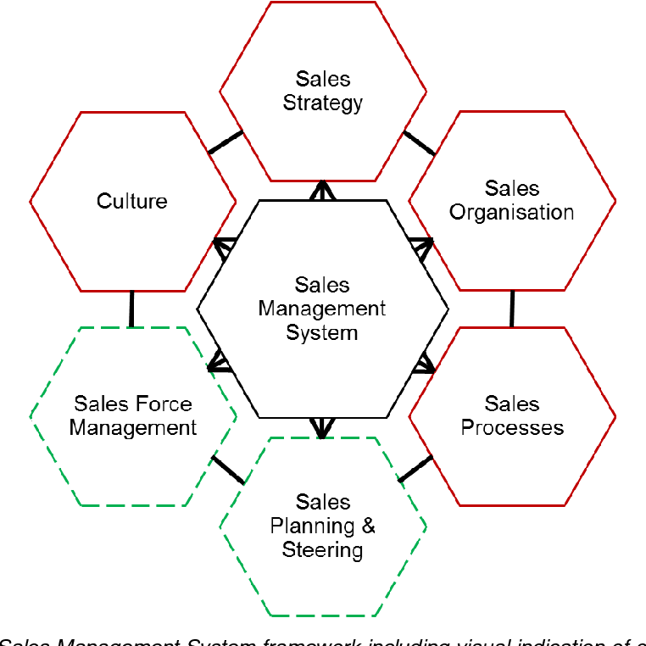
Block Diagram

Slide 10
SOFTWARE REQUIREMENTS:
Operating System : Windows 10
Platform : DOT NET TECHNOLOGY
Front End : ASP.Net 4.0
Back End : SQL SERVER 2014

Slide 11
HARDWARE REQUIREMENTS:
Keyboard
Mouse
Hard disk 500GB
Ram 4 Gb

Slide 12
CONCLUTION
The success of any system is dependent on its usage. It is therefore hoped that the system will be used under conditions that satisfy its requirements. Given the required maintenance, the system will help facilitate sales management by tracking and storing relevant data needed for effective sales management.

Slide 13
REFERENCE
[1] D. Kayanula and P. Quartey, “The Policy Environment for Promoting Small and Medium-Sized Enterprises in Ghana and Malawi,” Manchester, UK: Institute for Development Policy and Management, University of Manchester., 2000.
[2] NBSSI, Supporting Micro & Small Scale Enterprises, A Handbook on Enterprise Development Part 1. NBSSI, Print Solutions, Accra, 1990.
[3] R. K. Srivastava, E. C. DeRun, and K. S. Fam, Sales Management. Anurag jain for excel books, New Delhi 110028, 2008.

Slide 14
[4] “American Marketing Association Dictionary Available: https://www.ama.org/resources/Pages/Dictionary.aspx?dLetter=S.” .
[5] R. D. Hisrich and R. W. Jackson, Sales and Sales Management. Barons Education Series, inc., New York 117782, 1993., 1993.
[6] “Sales Management, IILM Institute of higher Education, available:www.iilm.edu/iim-onlinesales%20management%20Selflearning%20manual.pdf.” .
[7] J. Carol & Doake Britton, A student Guide To Object-Oriented Development. Oxford: Elsevier, 2005.

