Slide 1
Hospital management system

Slide 2
Abstract
Every cooperate organization, institution or government agency requires data and good quality information to function effectively. It is not an over statement to say that many organizations, institutions or government agencies have become critically dependent on the use of database system for their successes especially in the hospital. Data collected from various sources for example telephone, fax, verbal messages, mails e.t.c. are used in decision making, planning and control of operations in management of clients, personnel and recourses. This project therefore aims at developing an improved hospital information management system using a function-oriented design. The poor efficiency of the present manual management system in hospitals today results from the inordinate length of time it takes to search for and locate patient folders and the ineffective filling system adopted. In this project the Oracle database is the database server where the data is sent to and retrieved from while Active Server Pages (.net programming language) is the client which provides the user interface design and the forms used by the doctors, staff and nurses during administration in the office, laboratory, wards, pharmacy, X-ray e.t.c.

Slide 3
Existing System
These hospitals have joined investor-owned corporations because they need additional financial resources to maintain their existence in an increasingly competitive industry.
It states all the effort that has been made so far to computerize the existing system.
The existing manual system has a lot of problems that are facing it like data redundancy, data manipulation, data collection, and data storage and data security.
Upgrading of the software does not and will not require taking down of the existing running application modules.

Slide 4
Disadvantage of Existing System
These hospitals normally provide quality care for routine medical and surgical problems.
In manual system, lots of problems are encountered in trying to store large amount of information.
The aim is to solve most of the problems encountered in the hospital using the old and manual system of medical administration.
It gives the background information of the project and discusses the problems, scope and objective of the project.
Most organizations in this information age are faced with the problem of managing information effectively.

Slide 5
PROPOSED SYSTEM :
The level of accuracy in the proposed automated system will be higher. All operations would be done correctly and accurately. In practice, errors are not completely eliminated, they are reduced.
The reliability of the proposed system will be high as information is stored properly and securely.
In the proposed system utmost care would be taken to ensure that no information is repeated anywhere, in storage .
The main objective of the proposed system is to provide for a quick and efficient retrieval of information.
The improvement envisaged is the proposed electronic records management system or data base management system.

Slide 6
ADVANTAGE
Many different performance measures or success factors were applied in the studies reviewed.
Among the effect variables were costs, changes in time spent by patients and health care personnel, changes in care process, database usage, performance of users of the system, patient outcomes, job satisfaction, and the number of medical tests ordered.
To avoid performance degradation, the data dictionary should have sufficient capacity to cache the data.
This type of database poses a number of problems that affect the efficient utilization of data available in an organization.

Slide 7
TITTLE | AUTHOR | DESCRIPTION
Sensors have expanding opportunities for use in wearable devices for health monitoring | Adrain P. | These statistics indicate the significant and intensive impact of environmental factors on human health.
Benefits of Connecting RFID and Lean principles in Health Care | F.A. Correa, M.J. Gil, and L.B. Redin, | The performance management process in health care is far behind compared to the manufacturing and service industries.

Slide 8
TITTLE | AUTHOR | DESCRIPTION
Health Care Information Technology: Progressand Barriers | Hersh, William. | These include cost, technical issues, system interoperability, concerns about privacy and confidentiality, and lack of a well-trained clinician informatics workforce to lead the process.
Electronic Health Records: Synthesizing Recent Evidence and Current Policy | Moreno, Lorenzo. | Although EHRs have the potential to improve quality of care, reduce medical errors, and lower administrative costs, incorporating them into clinical practice will require large investments in new technology, in addition to changes in existing systems and processes.

Slide 9
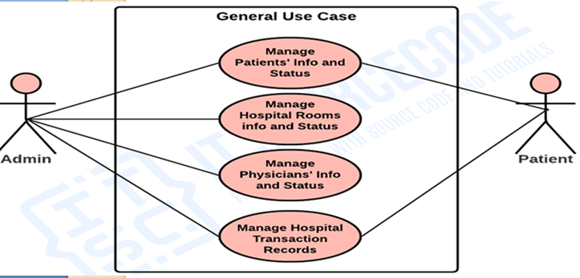
Block Diagram

Slide 10
SOFTWARE REQUIREMENTS:
Operating System : Windows 10
Platform : DOT NET TECHNOLOGY
Front End : ASP.Net 4.0
Back End : SQL SERVER 2014

Slide 11
HARDWARE REQUIREMENTS:
Keyboard
Mouse
Hard disk 500GB
Ram 4 Gb

Slide 12
CONCLUTION
In designing the computerized system, a survey of the existing system was made. A complete design of a database application for searching and locating patient folders has been carried out. The computerized automated hospital management system will provide better services for the nurses and doctors such as reduction in time taken to find a folder, accuracy and timeliness of record preparation e.t.c. In the implementation of this project much has been done to eliminate data redundancy, inconsistency and improve on the integrity of the data stored in the system. The software model used is the waterfall model. Structured design was also employed in the design stage. The security of the computerized system was also employed to avoid unauthorized person or persons having access to data.

Slide 13
REFERENCE
Adrain P. “Sensors have expanding opportunities for use in wearable devices for health monitoring”, 2005.
B. Glover and H. Bhatt, “RFID Essentials”, O’ Reilly Media, Inc. 1005 Gravenstein Highway North, Sebastopol, CA 95472, Jan 2006, pp. 54- 169.
Carol, Ruth. “EHRs, the Doctor Will See You Now.” Journal of AHIMA 76, no. 4 (2005): 24-28.
Erika Fischer- Lichte; the transformative power of Performance: A new aesthetics, Routledge 2008,
F.A. Correa, M.J. Gil, and L.B. Redin, “ Benefits of Connecting RFID and Lean principles in Health Care,” Working paper 05-4, Business Economics Series 10, 2005.

Slide 14
Goodman EC. A methodology for the ‘user-sensitive implementation’ of information systems in the pharmaceutical industry: a case study. Int J Inform Manag 1998;18:121–38.
Hersh, William. “Health Care Information Technology: Progressand Barriers.” Journal of the American Medical Association 292, no. 18 (2004): 2273- 2274.
Institute of Medicine. “Key Capabilities of an Electronic Health Record System,” 2003. Available at http://books.nap.edu/html/ehr/NI000427.pdf (accessed June 26, 2004).
Kaplan B. Addressing organizational issues to the evaluation of medical systems. JAMIA 1997;4:94–101. [PMC free article] [PubMed]
Moreno, Lorenzo. “Electronic Health Records: Synthesizing Recent Evidence and Current Policy.” 2003

