Slide 1
Ranked key word search

Slide 2
Abstract
In today’sera a new generation of technology is transforming the world of computing. Advances in internet based data storage, processing and services collectively known as cloud computing have emerged to complement the traditional model of running software and storing data on personal devices or on premise networks. Today cloud computing provide high computing hardware infrastructure, software infrastructure which running on the all platforms and it is highly scalable. Cloud computing enable customer to pay only for the computing storage and power they need, when they need it. It offers organizations greater choice and flexibility while also driving efficiency gains and lowering over all IT costs. Now a days large amount of data is outsourced on cloud server so that Data privacy is major issue in cloud computing because of cloud data server is not fully trusted there for data is encrypted and then stored on cloud. Based on the user’s requirement retrieving data from cloud servers is one of the challenging issues. Retrieving the data and processing the query over cloud server is very difficult. Many searching techniques are used for retrieving the data from cloudservers. In this paper two data retrieval techniques secure ranked search and multi keyword ranked search is explained.

Slide 3
Existing System
To achieve more practical performance, we then propose a definition for ranked searchable symmetric encryption, and give an efficient design by properly utilizing the existing cryptographic primitive, order-preserving symmetric encryption (OPSE).
In short, lacking of effective mechanisms to ensure the file retrieval accuracy is a significant drawback of existing searchable encryption schemes in the context of Cloud Computing.
Ranked keyword search: to explore different mechanisms for designing effective ranked search schemes based on the existing searchable encryption framework.
We first give a basic scheme and show that by following the same existing searchable encryption framework, it is very inefficient to achieve ranked search.

Slide 4
Disadvantage of Existing System
The large number of data users and huge amount of outsourced data files in cloud, this problem is particularly challenging as it is extremely difficult to meet also the practical requirements of performance, system usability, and high-level user searching experiences.
Data privacy is major issue in cloud computing because of cloud data server is not fully trusted there for data is encrypted and then stored on cloud.
Based on the user’s requirement retrieving data from cloud servers is one of the challenging issues.
It provides effective protocol, which fulfills the secure ranked search functionality with little relevance score information leakage against keyword privacy.

Slide 5
PROPOSED SYSTEM :
Thorough analysis shows that our proposed solution enjoys “as-strong-aspossible” security guarantee compared to previous SSE schemes, while correctly realizing the goal of ranked keyword search.
The similar framework of previously proposed searchable symmetric encryption scheme and adapt the framework for our ranked searchable encryption system.
The performance of our scheme is evaluated regarding the effectiveness and efficiency of our proposed one-to-many order-preserving mapping, as well as the overall performance of our RSSE scheme, including the cost of index construction as well as the time necessary for searches.

Slide 6
ADVANTAGE
Cloud computing provide elastic services, high performance and scalable data storage to a large and everyday increasing number of users.
It offers organizations greater choice and flexibility while also driving efficiency gains and lowering over all IT costs.
The combination of both keyword search along with concept search produce the relevant search result which greatly improve the efficiency of search.
The features of this method are, multi-keyword ranked search, privacypreserving, high efficiency is eliminating unnecessary traffic and improve search accuracy.

Slide 7
TITTLE | AUTHOR | DESCRIPTION
Draft nist working definition of cloud computing | P. Mell and T. Grance (2010). | To the consumer, the capabilities available for provisioning often appear to be unlimited and can be purchased in any quantity at any time.
Cryptographic cloud storage | S. Kamara and K. Lauter (2010). | We consider the problem of building a secure cloud storage service on top of a public cloud in- frastructure where the service provider is not completely trusted by the customer.

Slide 8
TITTLE | AUTHOR | DESCRIPTION
Security guidance for critical areas of focus in cloud computing | Cloud security Alliance (2009). | It describes and defines cloud computing, sets our baseline terminology, and details the overall logical and architectural frameworks used in the rest of the document.
A view of cloud computing | M. Armbrust, April (2010). | Developers with innovative ideas for new Internet services no longer require the large capital outlays in hardware to deploy their service or the human expense to operate it.

Slide 9
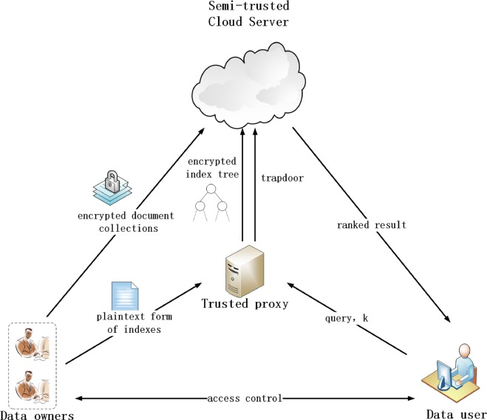
Block Diagram

Slide 10
SOFTWARE REQUIREMENTS:
Operating System : Windows 10
Platform : DOT NET TECHNOLOGY
Front End : ASP.Net 4.0
Back End : SQL SERVER 2014

Slide 11
HARDWARE REQUIREMENTS:
Keyboard
Mouse
Hard disk 500GB
Ram 4 Gb

Slide 12
CONCLUTION
After the study above two methods are ranked search and multiple keyword ranked search conclude that multi keyword ranked search is better. Multi keyword rank search is enabling semantic keyword search with more accuracy and efficiently because here multiple keywords is used for searching the data files so the frequency of keyword and rank is increased compare to ranked search.

Slide 13
REFERENCE
P. Mell and T. Grance (2010). “Draft nist working definition of cloud computing”, Referenced on jan. 23rd, Online at http://csrc.nist.gov/groups/SNS/cloudcomputing/ind ex.html
M. Armbrust, A. Fox, R. Griffith, A. D. Joseph, R. H. Katz, A. Konwinski, G. Lee, D. A. Patterson, A. Rabkin, I. Stoica, and M. Zaharia (2009). “Above the clouds: A Berkeley view of cloud computing”, University of California, Berkeley, Tech. Rep. UCB-EECS-2009-28.
S. Kamara and K. Lauter (2010). “Cryptographic cloud storage”, in proceeding of financial cryptography: workshop on real-life cryptography protocol.
Cloud security Alliance (2009). “Security guidance for critical areas of focus in cloud computing”

Slide 14
M. Armbrust, April (2010). “A view of cloud computing”, Communications of the ACM, vol. 53, no. 4,pp. 50-58.
C. Wang, N. Cao, K. Ren, and W. Lou, Aug. (2012). “Enabling Secure and Efficient Ranked Keyword Search over Outsourced Cloud Data”, Proc. IEEE , Parallel and Distributed Systems.
C. Wang, N. Cao, J. Li, K. Ren, and W. Lou (2010). “Secure Ranked Keyword Search over Encrypted Cloud Data,” Proc. IEEE 30th Int’l Conf. Distributed Computing Systems (ICDCS ’10).
Ning Caoy, Cong Wangz, Ming Liy, KuiRenz, and WenjingLouy (2013). “Privacy-Preserving Multikeyword Ranked Search over Encrypted Cloud Data” Proc. IEEE Symp. Security and privacy.

