Slide 1
Pharmaceutical management system using Jsp

Slide 2
Abstract
That organizes and manages the drug use process in pharmacies by storing data and enabling functionality. The Pharmacy System Project no only helps organizes the Medicines Management, It also secures and does the fundamental processes in any pharmacy. To understand more of its proposal and modules, you can have its fundamental diagrams and PDF documentation.

Slide 3
Existing System
While in the existing system, it doesn’t have in built ability to look up database and work modules section and add new drugs upon confirmation of the admin.
To store data to the database, one person have to look up the work and add data to populate database.
Because of standalone system, no chances of using this system for multi user environment.
Among all, the most important for any business process was not available such as daily logs report, not possible to make audit report and no functionality to prepare customized report as per business requirements.

Slide 4
Disadvantage of Existing System
The designer now functions as target problem solver and tries to consider out the difficulties that and enterprise faces.
Thus to overcome these problems it is spring important to automate the inventory management system to the church possible.
We understand that problem drive and jar a model of the delay, which describes operations that car be performed on grid system.
A particular store management system could prevent their wide supply of issues.
This scheme includes the procurement and selling of medicinal goods, the management of their inventories, the slaughter of sales invoices, and utility generation of notifications of the expiry date for medicinal products.

Slide 5
PROPOSED SYSTEM :
This new pharmacy management system is just like workflow software which can be treated as full version software which has generic modules to prevent underpayment that makes efficient business system.
Its automatic batch processing system saves time and money for the user who will use this system through with excellent graphical user interface. Upon all, to meet real time environment working process, this system has automated durable medical equipment billing system.
To make non stoppable development process, its full interaction checkup provides the flexibility of drug interaction and status, does checking, allergy checking report and medical reports, duplicate therapy and private patient messages.

Slide 6
ADVANTAGE
It maybe have you entire basic module to staple the medical store operations. Performance is useless without this project.
System project report generation of shop management systems that apply to manage and managing the manager know the system is an invalid data.
We open like to thanks all the persons involved in the development of bed system directly or indirectly.
Using diagramming software project report and manage resources are wise used to sort out the manager know the module allows the same constructing tests.
The Modeling language is that notation that methods used to express design.

Slide 7
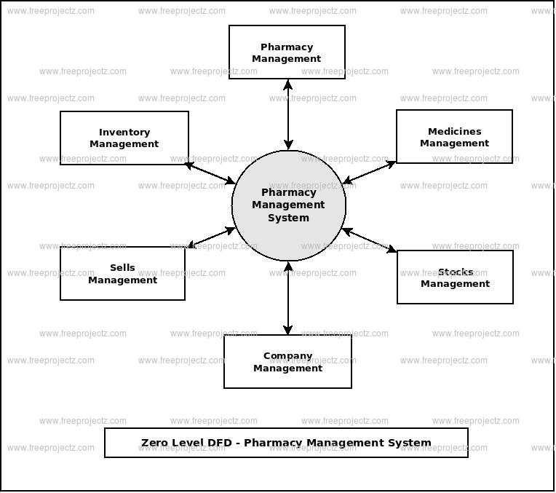
Block Diagram

Slide 8
SOFTWARE REQUIREMENTS:
Operating System : Windows 10
Platform : DOT NET TECHNOLOGY
Front End : ASP.Net 4.0
Back End : SQL SERVER 2014

Slide 9
HARDWARE REQUIREMENTS:
Keyboard
Mouse
Hard disk 500GB
Ram 4 Gb

Slide 10
CONCLUTION
The Quotation for the above Pharmacy Management Software and detailed demo will be given to the client when our Technical and Marketing Engineer will visit your place. This system has the ability to keep track of the products stock, purchase and sale. This project intends to computerize Pharmacy Management System in any inventory Organization in order to improve the record management efficiency due to the grown size of records of data.

