Slide 1
Online library management system

Slide 2
Abstract
The paper titled Library Management System is Library management software for monitoring and controlling the transactions in a library .The paper "Library Management System" is developed in java which mainly focuses on basic operations in a library like adding new member, new books, and updating new information, searching books and members and facility to borrow and return books. "Library Management System" is a windows application written for 32-bit Windows operating systems, designed to help users maintain and organize library. This software is easy to use for both beginners and advanced users.

Slide 3
Existing System
System Analysis is a detailed study of the various operations performed by a system and their relationships within and outside of the system.
Here the key question is- what all problems exist in the present system what must be done to solve the problem Analysis begins when a user or manager begins a study of the program using existing system.

Slide 4
Disadvantage of Existing System
In our existing system all the transaction of books are done manually, So taking more time for a transaction like borrowing a book or returning a book and also for searching of members and books.
Another major disadvantage is that to preparing the list of books borrowed and the available books in the library will take more time, currently it is doing as a one day process for verifying all records.
So after conducting the feasibility study we decided to make the manual Library management system to be computerized.

Slide 5
PROPOSED SYSTEM :
Proposed system is an automated Library Management System.
Through our software user can add members, add books, search members, search books, update information, edit information, borrow and return books in quick time.

Slide 6
ADVANTAGE
User friendly interface
Fast access to database
Less error
More Storage Capacity
Search facility
Look and Feel Environment

Slide 7
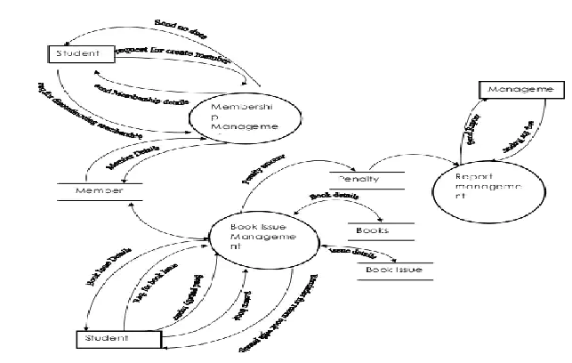
Block Diagram

Slide 8
SOFTWARE REQUIREMENTS:
Operating System : Windows 10
Platform : DOT NET TECHNOLOGY
Front End : ASP.Net 4.0
Back End : SQL SERVER 2014

Slide 9
HARDWARE REQUIREMENTS:
Keyboard
Mouse
Hard disk 500GB
Ram 4 Gb

Slide 10
CONCLUTION
This paper is only a humble venture to satisfy the needs in a made within a limited time frame at the beginning of the software paper and should be updated regularly as the paper progresses requirements of the organization.

