Slide 1
Online banking system using jsp

Slide 2
Abstract
The purpose of this project is to develop an on-line banking system that provides customers with the facility to check their accounts and do transactions on-line. The system will provide all the banks facilities to its customers when their authentications [user id and password] match, including viewing account information, performing transfers, giving the customer an option of changing address, paying bills on-line, password retrieval, performing transactions, viewing transactions and the locations the bank and its branches. The system should also support an online enrollment facility for credit card customers and should allow customers to view their personnel accounts and to pay bills online from their account.

Slide 3
The system should assign a unique transaction number to every transaction that a user makes. It should also generate credit card numbers automatically when administrator, insert credit card customer’s information. The Administrator will administer both normal bank account and credit card bank accounts. The administrator should have the ability to perform various operations like creating a normal bank account for the customer and performing functions like transfers, withdrawals and deposits when the customers want teller transactions. The administrator also has the privilege to close the customer’s account on the request of the bank customer. The customer should be able to access his/her account from anywhere just by inputting the correct user-id and password. All this process will take place on a secure channel using SSL technology.

Slide 4
Existing System
In event of a customer forgetting the Login password, provision has been made to provide password through a secure passage. Administrator is responsible for adding customers without affecting existing customers
This list is a tentative, since it may be discovered during development that additional features are required or some existing features may prove to be unworkable or impractical due to time limitations.
Where the administrator can perform operations for both new customers and existing customers.
The existing hardware and software will fulfill the requirement of the proposed system.

Slide 5
Disadvantage of Existing System
The security issues are wonderful, and it allows the customer to view their transactions, pay bills online, ATM/branch locator and provide calculators and educators that will help customers to determine savings, mortgages and loan amounts.
There will be a special field in the database, which will allow the administrator to keep track of the customers who have already been issued their cards.
A wide variety of online banking applications are available in the market, which in turn help the bank to function smoothly without reducing the quality of service.
Many banks had migrated from paper based banking system to electronic / online banking.

Slide 6
PROPOSED SYSTEM :
Economic Feasibility Economic feasibility analysis is most frequently used technique for evaluating the effectiveness of the proposed system.
The proposed computerized system is economically feasible, if the benefit in the long run compensates the cost incurred in the designing and implementation of the system.
This determination typically examines the probability of the project being accepted by the group directly affected by the proposed change in system.
The development of the proposed system does not result in too much extra expenditure.

Slide 7
ADVANTAGE
The security feature is the best; it gains the trust of the customer and allows them to do their transitions in an efficient and secure manner. However, the interface is very complicated for novice users.
The interface for administrator will be both very user friendly and efficient. The data gets stored in the database instantly when the administrator hits the submit button.
A more efficient approach would be to utilize Model View Controller 2 architecture, which makes application reusable, robust, and more object-oriented.
The administrator will be allowed to put a hold on the credit card account for security reasons, like lost/stolen credit card and this facility will protect customer information from getting misused by others.

Slide 8
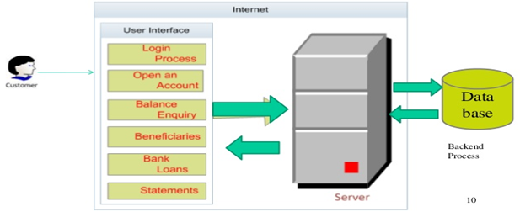
Block Diagram

Slide 9
SOFTWARE REQUIREMENTS:
Operating System : Windows 10
Platform : DOT NET TECHNOLOGY
Front End : ASP.Net 4.0
Back End : SQL SERVER 2014

Slide 10
HARDWARE REQUIREMENTS:
Keyboard
Mouse
Hard disk 500GB
Ram 4 Gb

Slide 11
CONCLUTION
This paper shows, how Distributed applications like online Banking, can easily be developed using Enterprises Java Technologies and its distributed architectures [PageCentric, Page-View, and Model 1]. A more efficient approach would be to utilize Model View Controller 2 architecture, which makes application reusable, robust, and more object-oriented. J2EE, as distributed component architecture, is the right solution in developing web applications.

Slide 12
REFERENCE
1. Online banking of National City bank www.Nationalcity.com
2. Online banking of Bank one www.BankOne.com
3. Online banking of TCF bank www.TCF.com
4. Falkner Jayson, Galbraith Ben, Irani Romin, Kochmer Casey, Moidoo Meeraj Kunnumputath, Punduranga Sathya Narayana, Perrumal Krishnaraj, Timney John. Beginning JSP web Development (Wrox Press. 2001)
5. http://jakarta.apache.org/tomcat/tomcat-4.0-doc/ssl-howto.html
6. http://java.sun.com
7. http://jguru.com

