Slide 1
An Intelligent Transaction Migration Scheme for RAFT-based Private Blockchain in Internet of Things Applications

Slide 2
Abstract
The integration of multi-access edge computing (MEC) and RAFT consensus makes it feasible to deploy blockchain on trustful base stations and gateways to provide efficient and tamper-proof edge data services for Internet of Things (IoT) applications. However, reducing the latency of storing data on blockchain remains a challenge, especially when an anomaly-triggered data flow in a certain area exceeds the block generation speed. This letter proposes an intelligent transaction migration scheme for RAFT-based private blockchain in IoT applications to migrate transactions in busy areas to idle regions intelligently. Simulation results show that the proposed scheme can apparently reduce the latency in high data flow circumstances.

Slide 3
Existing System
The consensus algorithm is used to achieve consensus between nodes for alteration or modification of existing ledgers, only to append them into a new block at the end of the chain within the Blockchain.
But this method of distributed network would be efficient in converting existing webs to be decentralized and allow legacy centralized networks to exists in a decentralized manner.
There are no existing communication standards for IoT between different types of smart devices.
CCN is able to improve the existing method of routing and forwarding from TCP/IP due to the named data.

Slide 4
Disadvantage of Existing System
A few works focus on addressing issues in blockchain network with RAFT consensus.
To the best of our knowledge, none of the literature has addressed the issue of how to reduce latency for IoT applications in RAFT-based private blockchain network .
This includes the need for minimal cost hardware implementation, minimal power usage, and minimal latency. In response to these problems, lightweight cryptographic primitives have been proposed in this model.
To address this problem, we propose that peer networks can elect other nodes as their blockchain server.

Slide 5
PROPOSED SYSTEM :
With the current trend of pursuing the decentralized Internet, many methods have been proposed to achieve decentralization considering different aspects of the current Internet model ranging from infrastructure and protocols to services and applications.
While there are several current works proposed to adapt and apply Blockchain based architecture for IoT, and interconnected devices on edge networks, there is a considerable lack of research to propose and apply Blockchain for the core networks of Internet and its protocols, applications and services.
Some decentralization approaches have already proposed in current literature to resolve Internet flaws originated from centralization.

Slide 6
ADVANTAGE
The random scheme provides the average performance for all the possible schemes since each action of this scheme can be selected with equal probability after training enough times.
It proves that static schemes cannot help improve the performance, even if they can migrate transactions from busy areas.
There are quite a few consensus algorithms available for blockchain that support high throughput; however, they require extremely high-performance for the network.
The framework describes the implementation, design and performance of Hyperledger Fabric blockchain for smart hospitals.
Raft based consensus algorithms have high throughput but low network scalability, and therefore, it has extremely high-performance requirements for the network.

Slide 7
TITTLE | AUTHOR | DESCRIPTION
Blockchain-enabled data collection and sharing for industrial IoT with deep reinforcement learning | C. H. Liu, Q. Lin, and S. Wen, | In this scheme, DRL is used to achieve the maximum amount of collected data, and the blockchain technology is used to ensure security and reliability of data sharing.
Blockchain meets cloud computing: a survey | K. Gai, J. Guo, L. Zhu, and S. Yu, | Blockchain technology has been deemed to be an ideal choice for strengthening existing computing systems in varied manners.

Slide 8
TITTLE | AUTHOR | DESCRIPTION
Federated deep reinforcement learning for internet of things with decentralized cooperative edge caching | X. Wang, C. Wang, X. Li, V. C. M. Leung, and T. Taleb, | Edge caching is an emerging technology for addressing massive content access in mobile networks to support rapidly growing Internet of Things (IoT) services and applications.
Performance modeling and analysis of a hyperledger-based system using gspn | P. Yuan, K. Zheng, X. Xiong, K. Zhang, and L. Lei, | In this paper, we propose a model to analyze the performance of a Hyperledger-based system by using Generalized Stochastic Petri Nets (GSPN).

Slide 9
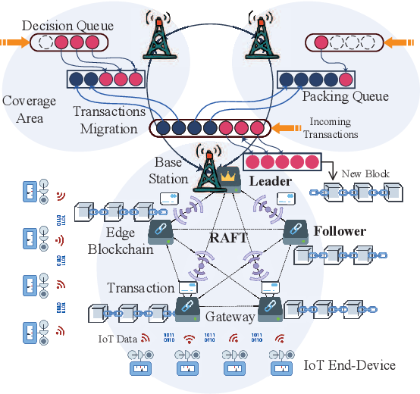
Block Diagram

Slide 10
SOFTWARE REQUIREMENTS:
Operating System : Windows 10
Platform : DOT NET TECHNOLOGY
Front End : ASP.Net 4.0
Back End : SQL SERVER 2014

Slide 11
HARDWARE REQUIREMENTS:
Keyboard
Mouse
Hard disk 500GB
Ram 4 Gb

Slide 12
CONCLUTION
In this letter, a reinforcement-learning-based scheme that can migrate transactions intelligently between clusters has been proposed for RAFT-based private blockchain in IoT application. The scheme can minimize the latency of storing IoT data on chain by balancing the workload among all clusters. DDPG algorithm with an action refinement is proposed to obtain optimal transaction migration policy on consideration of dynamic status of the environment. Simulation results show that the proposed scheme can reduce at most 58% latency when the system undergoes an anomaly in some sensing area, compared to baselines.

Slide 13
REFERENCE
[1] C. H. Liu, Q. Lin, and S. Wen, “Blockchain-enabled data collection and sharing for industrial IoT with deep reinforcement learning,” IEEE Transactions on Industrial Informatics, vol. 15, no. 6, pp. 3516–3526, 2019.
[2] K. Gai, J. Guo, L. Zhu, and S. Yu, “Blockchain meets cloud computing: a survey,” IEEE Communications Surveys and Tutorials, vol. 22, no. 3, pp. 2009–2030, 2020.
[3] X. Wang, C. Wang, X. Li, V. C. M. Leung, and T. Taleb, “Federated deep reinforcement learning for internet of things with decentralized cooperative edge caching,” IEEE Internet of Things Journal, vol. 7, no. 10, pp. 9441–9455, 2020.
[4] P. Yuan, K. Zheng, X. Xiong, K. Zhang, and L. Lei, “Performance modeling and analysis of a hyperledger-based system using gspn,” Computer Communications, vol. 153, pp. 117–124, 2020.
[5] M. Liu, F. R. Yu, Y. Teng, V. C. M. Leung, and M. Song, “Computation offloading and content caching in wireless blockchain networks with mobile edge computing,” IEEE Transactions on Vehicular Technology, vol. 67, no. 11, pp. 11 008–11 021, 2018.

Slide 14
[6] A. Rovira-Sugranes and A. Razi, “Optimizing the age of information for blockchain technology with applications to IoT sensors,” IEEE Communications Letters, vol. 24, no. 1, pp. 183–187, 2020.
[7] C. Benza¨ıd and T. Taleb, “AI for beyond 5G networks: A cyber-security defense or offense enabler?” IEEE Network, vol. 34, no. 6, pp. 140–147, 2020.
[8] D. Yu, W. Li, H. Xu, and L. Zhang, “Low reliable and low latency communications for mission critical distributed industrial Internet of things,” IEEE Communications Letters, vol. 25, no. 1, pp. 313–317, 2021.
[9] H. Xu, L. Zhang, Y. Liu, and B. Cao, “RAFT based wireless blockchain networks in the presence of malicious jamming,” IEEE Wireless Communications Letters, vol. 9, no. 6, pp. 817–821, 2020.
[10] T. P. Lillicrap, J. J. Hunt, A. Pritzel, N. Heess, T. Erez, Y. Tassa, D. Silver, and D. Wierstra, “Continuous control with deep reinforcement learning,” arXiv e-prints:1509.02971, pp. 1–10, Sep. 2015.

