Slide 1
FABRICATION OF SOLAR BOX SHIFTING MECHANISM

Slide 2
ABSTRACT
The Project report espouses the humble efforts of team which is more inspired than equipped. It covers the design aspects of “Solar Box Shifting Mechanism”. Box Shifting Mechanism is a small project for shifting of the boxes for the industrial purpose, used mainly in the packaging and filling department. A great many manufacturers of fancy wrapped or covered cardboard boxes used for packaging candies, cakes, and other confections, cosmetics and other articles are equipped with the so called quad staying machines by means of which a box blank is folded or set-up into boxlike form. These set-up boxes are transferred by means of a conveyor to an operator, who picks up the boxes and places and centers them on wrappers with which the boxes are to be covered.

Slide 3
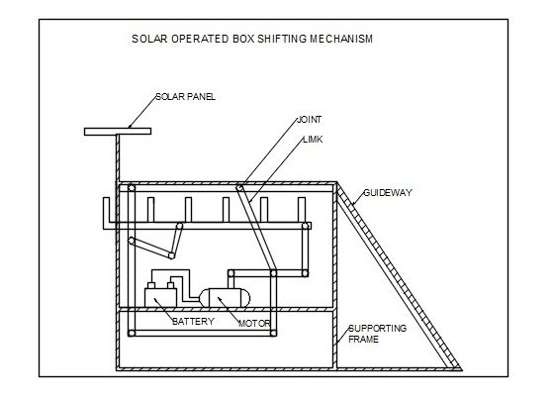
Block Diagram

Slide 4
ADVANTAGES
The advantage of this system over the conveyer system is that the system has a time delay between the moving packages and this delay can be used to introduce alterations in the packages or move the packages for any other purpose.
The main advantage is that it can transfer box with much more efficiency than the conveyer belt system in all aspects.
The advantage being that when in transit any alterations needed in packages can be done without much effort Objective is to supersede the conventional conveyers by mechanical conveyers in order to compensate for the comparative low efficiency and high maintenance cost of the conventional ones.

Slide 5
DISADVANTAGES
If the fixed pivot is equidistant from the moving pivots, output link movement will equal input link movement, but it will act in the opposite direction.

Slide 6
CONCLUSION
Our main aim behind the designing of this project is reached successfully and having some limitations. The process of transporting or shifting of products from one place to another was to be maintained by conveyors was modified with a box transfer mechanism using the kinematic links and motor which has successfully run by solar power. In future this project can be developed in the area of Material handling and Packaging unit for mass production.

