Slide 1
DESIGN AND FABRICATION CHARCOAL MIXING AND GRINDING MACHINE

Slide 2
ABSTRACT
Here were fabricating the charcoal mixing and grinding machine. It is used for mixing the charcoal finely for the several purposes. Here were developing this concept for the main reason is, reducing the manual effort and also increasing the productivity. This project is made done by these components, motor, belt, pulley, bearings and the hopper. The all components fixed on the frame. First were transmitting the rotational power from the motor to the plate merged with the crusher through the belt and pulley arrangement. The hopper is mounted on the crushing arrangement to put the charcoal inside for the mixing operation. When the motor is switched ON, the crusher tends to rotate the charcoal is put inside from the top by through the hopper. So the mixing and grinding process will be done by this principle of the working.

Slide 3
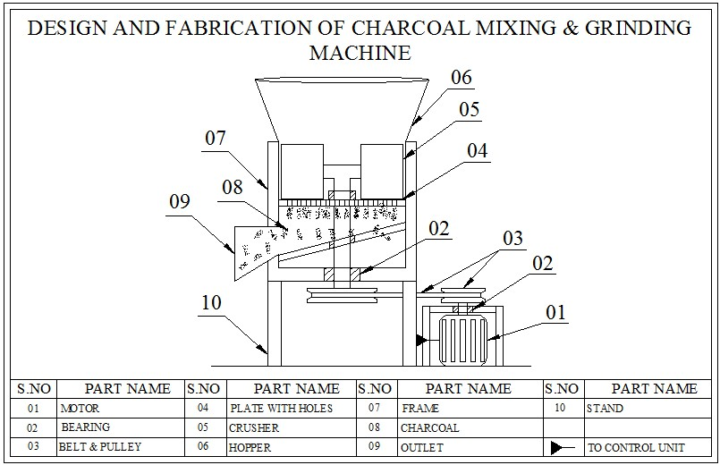
Block Diagram

Slide 4
ADVANTAGES
The natural lignin in the wood binds the particles of wood together to form a solid. Burning a wood briquette is far more efficient than burning firewood.
This machine efficiently produces briquettes by compressing the grinded dry waste.

Slide 5
DISADVANTAGES
The main disadvantage of densification is the relatively high cost of input energy, which is needed for the production of pellets and briquettes.
This dominance of fossil fuels needs to be addressed in order to address the triple problem of global warming, climate change and GHG emissions while ensuring energy security, energy equity and accessibility and environmental sustainability.

