Slide 1
CAM OPERATED HAMMER, BENDING MACHINE

Slide 2
ABSTRACT
The project “CAM HAMMER” being compact and Portable, handy equipment, which is skillful and is having some thing different from the ancient conventional hammering process. Most of the material is made available by our college. The sub-components we could easily manufacture in our college work- shop. It’s manufacturing price is also less. This project gives us knowledge, experience , skill and new ideas of manufacturing.
It is a working project and having guarantee of success. This project is the equipment useful to improve the quality of the gear being manufactured and can be made in less time, hence we have selected this project.

Slide 3
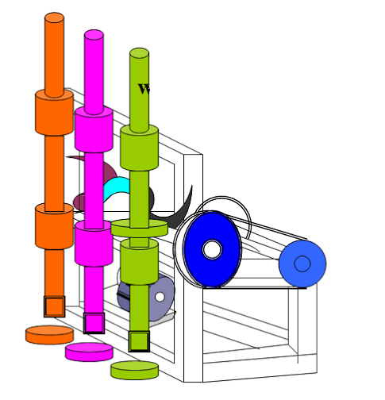
Block Diagram

Slide 4
ADVANTAGES
Compact in size.
Easy to operate.
Skilled labor may or may not be required.
Simple in construction.
Maintenance cost low and easy.
Electrical power may or may not be required.
Time consumption during operation is less.
Different operation can performed in this machine.
Heavy laborious effort is not required while operate by manually.

Slide 5
DISADVANTAGES
Speed of the machine is high so it can deliver vibration

