Slide 1
GEARLESS POWER TRANSMISSION

Slide 2
ABSTRACT
Introduced gearless power transmission arrangement used for skew shafts. In this transmission system no. of pins or links used must be odd..3,5,7,9.....& centers of any two pins or links whole must not be on that line which represents the diameter of the shaft.
If more pins or links used motion will be smoother,but increase in no. of pins or links not at the cost of strength of the shaft. Pins or links are fixed (may be permanent of temporary) in the drilled holes at the both shaft ends due to which motion is transferred.

Slide 3
The dimensions of the pins or links and angle for the pins are All given very precisely, holes drilled very accurately.
Proposed arrangement used for skew shafts at any angle & if there is a need we can change the angle between shafts during motion or during intermittent motion with any profile of shafts having rotational motion along its own axis.
The Working of this arrangement is very smooth & use very effectively with a very minimum amount of power losses.

Slide 4
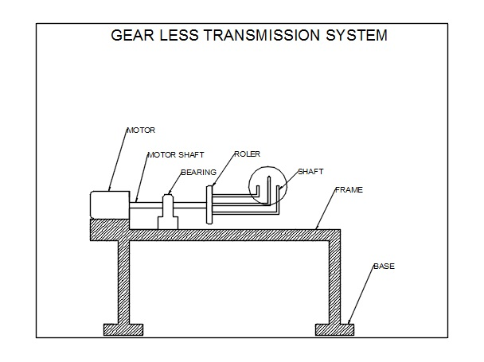
Block Diagram

Slide 5
ADVANTAGES
The Cylinder-piston Mechanism transmits the input power towards the output side such a way that the angular Forces produced in the slacks are simply transmitted with the help of cylinder-piston mechanism which takes up the I/P power and the angle drive is transferred towards the O/P slack and Cylinder-piston assembly. Hence very little friction plays while the power is being transmitted.
Therefore, it is appreciated that efficiency as high 90-92% is possible in Gear-Less Transmission mechanism.

Slide 6
DISADVANTAGES
Preparation of a statement of the problem indicating the purpose of the machine.

Slide 7
CONCLUSION
Some successful mechanical devices function smoothly however poor fly they are made while other does this only by virtue of an accurate construction & fitting of their moving parts. This projects which looks very simple & easy to construct was actually very difficult to conceive & imagine without seeing an actual one in practice. It is an event a fact in the creative mental process not the forces, which predominate among the schemes of the active tinkers. Motions demands to be studied first & we have done that very thing.We find that while acceptable analysis for existing mechanism can often be made quite easily we cannot without insight & imagination make effective synthesis of new mechanism hence we are mould to present this our project gear-less transmission at 180˚(Cylinder-piston mechanism) which we have managed to successfully device after long & hard input in conceiving its working principle.

