Slide 1
FABRICATION OF PNEUMATIC MOBILE CRANE

Slide 2
Abstract
This project deals with the fabrication of pneumatic mobile crane. The aim of this project work is to acquire practical knowledge in the field of material handling equipment. The project work is concerned with the fabrication of the portable jib crane.
This machine is very useful for lifting and transporting heavy jobs upto two tons for all types of jobs such as automobile repairs and service shops of central workshops, production industries, material handling units etc.

Slide 3
List Of Components
Hook
Lifting Frame
Direction Control Valve
Flow Control Valve
Pneumatic Cylinder
Body Structure
PU Tube

Slide 4
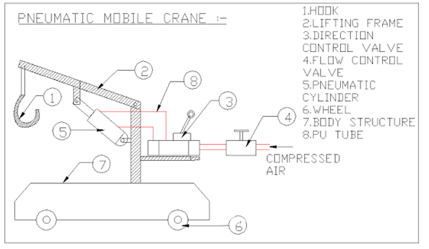
Block Diagram

Slide 5
Working Principle
The total set up of crane and hook assembly is attached at the end of a rod. The rod is fixed on the frame with help of hinged support. The pneumatic cylinder is hinged to the rod. When the pneumatic cylinder actuates the piston, automatically the crane assembly moves upward. Thus the object is lifted. After lifting the object the mobile unit moves to the specified position. Then the solenoid valve actuates the piston towards the ground in order to unload the object. After the object is unloaded the crane assembly goes upward with the help of pneumatic cylinder. This whole set up is mounted on a vehicle which can be moved to the required place with help of motors which gives power to the wheels.

Slide 6
Advantages
Longer life
Flexibility
Efficient and dependable.
Simple installation.
Easy maintenance.

Slide 7
Disadvantages
The life of the parts, like seals, packing and gaskets etc., are very short. But they are essential to prevent leakage.
Cost of this system becomes costlier.

Slide 8
Applications
Foundry
Welding workshops
Automobile workshops
Construction sites, etc.,

Slide 9
Conclusion
For many years cranes have been designed for lifting heavy objects with different capacity in different work sites. Portable cranes are of one type of cranes designed for lifting objects which are beyond the capacity of human being. Of this lifting operation by using portable and moveable
crane which is not being use before, we have identified that there is the need for using portable crane to lift up objects these are beyond the capacity and difficult of human power. Thus this paper provides the design of each part of portable crane. And the design analysis for each part is checked that it is safe accordingly the size of each parts of the crane.

