Slide 1
PNEUMATIC ROTARY GRINDING MACHINE

Slide 2
Abstract
The aim of our project is to design and fabricate a pneumatically operated multipurpose grinder. With this device a number of operations can be performed. A high pressure compressed air is forced on a fan and the fan is made to rotate.
This rotation is transmitted to the machining head by a shaft and the required operation is carried out. Further if a hole is to be drilled in a part in an automobile, the particular part is to be dismantled from the vehicle.
By using this pneumatically operated device holes can be drilled in the required part with one dismantling it from the vehicle. So this pneumatically operated multi purpose grinder is used for various operations with a less amount of investment.

Slide 3
List Of Components
Pneumatic Barrel
Handle
Supporting Column
Multipurpose Grinding Tool
Spring
Frame
Polyuthen Tube

Slide 4
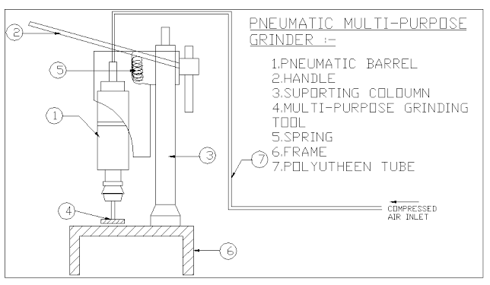
Block Diagram

Slide 5
Existing system
The existing limitations of both the concepts inspired us to innovate our above stated project.
The idea was to have a concept eliminating the existing challenges and incorporate the available benefits.
When the wheel is first started, the operator stands a bit off center, so that if it were to explode, less pathway for injury exists.
For medium carbon or high-carbon workpieces that are already hardened and tempered (such as tool bits and drill bits), the dipping of the piece into the water must be frequent enough to avoid very high heat followed by substantial quenching, which can easily destroy the existing heat treatment.

Slide 6
Disadvantages
Initial cost is high
Spindle rotation is pneumatic power, so this machine having low torque
Need a separate compressor.

Slide 7
Proposed system
A compressor generating a pressure of 4 kgf is sufficient for running our proposed arrangement.
Due to high efficiency, easy to operate and affordable price the proposed model of solenoid operated pneumatic grinding machine is helpful and completes all the expectations needed in the mini industries.
Future scope of proposed research work is to increase the production rate, grind the metal jobs easily.
It can withstand the vibrations, there areno hazards from jerk, no special training required to operate it.

Slide 8
Advantages
Low cost, so it can be used in small scale industries.
Higher rate and quicker operations
A number of operations like (drilling), screw driving, reaming etc., can be done.
The nuts and bolts can be tightened to a particular pressure by operating the gate valve placed in the control unit and the pressure gauge.
Both loosening and tightening is possible. Since there is air flow in both directions.

Slide 9
Applications
In automobile workshops.
In small scale industries.
In such places where frequent changes in operations are required .
In welding shops for grinding.

Slide 10
Conclusion
As per the above discussion we concluded that to overcome problems in conventional grinding Machines, due to high efficiency, easy to operate and affordable price the proposed model of Pneumatic Rotary Grinding machine is helpful and completes all the expectations needed in the mini industries. Future scope of proposed research work is to increase the Production rate, grind the metal jobs easily. It can withstand the vibrations, there arena hazards from jerk, no special training required to operate it. After studying this report we have known that how the pneumatic grinding machine will work, and knowing the construction and how the mechanism works in the machine. We learnt how the theoretical design is possible in practical. This grinding machine has lighter weight compared to other machines. The cost of machine is less and easy to operate so it is affordable for all industries.

