Slide 1
FABRICATION OF PNEUMATIC BREAKING SYSTEM

Slide 2
Abstract
The aim is to design and develop a control system based on breaking system of an AIR controlled safely automotive wheel braking system.
The control valve which directs the air to the double acting cylinder for breaking control. This braking actions is implemented In our project, we have to apply this braking system in one wheel as a model.

Slide 3
List Of Components
1.Double Acting cylinder
2. 5/2 Solenoid Valve
3.Electric Motor
4. Disc Brake
5.Brake Actuator

Slide 4
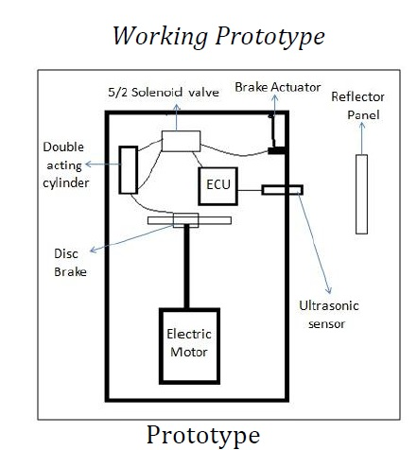
Block Diagram

Slide 5
Advantages
Brake cost will be less
Free from wear adjustments
Less power consumption
Less skill technicians is sufficient to operate
Installation is simplified very much

Slide 6
Disadvantages
Need separate air tank
This brake system is costlier one.
Addition cost is required to install this system to four wheeler

Slide 7
Applications
This system may be applicable in all types of light vehicles like cars, Rickshaws, Tempos.
This system also successfully installed in the heavy vehicles like buses, trucks, trailers, etc.

Slide 8
Conclusion
By doing this mini project we were able to understand the importance of Coordination between the various departments in an manufacturing unit This brake system offers ample scope for improvement By providing intermittent force at the brake plate. One of the major aims to achieve is that when the operator sees a brake force , that he needs to know immediately strike him, implying that the designs simple and easily understandable. Such was the case with AIR brake system. AIR Brake system are hailed as the greatest mechanical contrivance.

