Slide 1
Mega Satellite Constellation System Optimization From Network Control Structure Perspective

Slide 2
Abstract
The network control plays a vital role in the mega satellite constellation (MSC) to coordinate massive network nodes to ensure the effectiveness and reliability of operations and services for future space wireless communications networks. One of the critical issues in satellite network control is how to design an optimal network control structure (ONCS) by configuring the least number of controllers to achieve efficient control interaction within a limited number of hops. Considering the wide coverage, rising capacity, and no geographical constraints of space platforms, this paper contributes to designing the ONCS by constructing an optimal space control network (SCN) to improve the temporal effectiveness of network control.

Slide 3
Specifically, we formulate the optimal SCN construction problem from the perspective of satellite coverage factors, and apply geometric topology analysis to derive both the conditions for constructing the optimal SCN and the formulaic conclusions for SCN and MSC configurations (i.e., scale and structure). From numerical results, we investigate the tradeoff between network scale, the number of controllers, and control delays in several satellite network control scenarios, to provide guidelines for the MSC control. We also design the optimal SCN for an existing MSC system to demonstrate the effectiveness of the proposed ONCS.

Slide 4
Existing System
There are several limitations exist in the introduced framework. The Constellation Coverage Computation Module only considers perturbation and ignores others such as radiation, third body, and atmospheric drag perturbations.
Two comparisons are performed for the optimization results: a comparison with a global coverage constellation and a comparison with an all-in-single-stage constellation.
The computational scalability of this model depends on two major factors the number of areas of interest and the number of stages. The number of scenarios grows as the factorial of the number of regions.
The current assumption of three uncertain areas of interest, there exist total six scenarios possible as depicted.

Slide 5
Disadvantage of Existing System
This problem is addressed in, where the need for an increased accuracy in orbit determination is pushed forward as a means to reduce false alarms and implement automatic orbital corrections.
Alternative solutions to the debris problem include active removal and space-based surveillance networks.
It highlights also the tools most often proposed in the analyzed works to overcome constellation management issues, such as applications of machine learning/artificial intelligence and resource/infrastructure sharing.
Among the issues to be faced in the “constellation race” the space traffic management is probably the most critical, yet not directly faced.

Slide 6
PROPOSED SYSTEM :
The proposed multi-stage satellite constellation enables the constellation designer to react flexibly and efficiently to the uncertain future expansion of the areas of interest.
Another relevant concept was proposed by Paek regarding the reconfigurable satellite constellation between the global and local modes to consider different areas of interest for Earth observation.
The framework proposed in this paper is applied to the particular case of a two-stage problem with uncertainties lying in the second stage area of interest.
The purpose of the constellation is telecommunications; therefore, a maximum latency is set according to the International Telecommunication Union (ITU) recommendation for the mouth-to-ear delay for high-quality speech.

Slide 7
ADVANTAGE
At the same time, constellation management shall be enhanced to make an efficient use the new infrastructure.
Other efficient deployment strategies are compared in such as J2 driven deployment and carrier-vehicle deployment.
A survey of mobile satellite systems endorsing IP-based communication, discouraging however communication satellites other than GEO, mainly for cost efficiency.
Using this approach, the temporarily unused spectrum could be reallocated for a more efficient use.
The level of maturity reached by these three areas is, however, not homogeneous: communication is probably the most matured, where relevant work is being done concerning infrastructure integration and protocol efficiency.

Slide 8
TITTLE | AUTHOR | DESCRIPTION
Small satellites for global coverage: Potential and limits | Sandaua, R.; Brieß, K.; D’Errico, M. | There is an increasing need for Earth Observation (EO) missions to meet the information requirements in connection with Global Change Studies.
Boom of the CubeSat: A Statistic Survey of CubeSats Launch in 2003–2015 | Panga, W.J.; Bo, B.; Meng, X.; Yu, X.Z.; Guo, J.; Zhou, J. | The CubeSats can, in general, be distinguished from other nanosatellites by their standardized modular design.

Slide 9
TITTLE | AUTHOR | DESCRIPTION
Space traffic management in the new space era | Muelhaupt, T.J.; Sorge, M.E.; Morin, J.; Wilson, R.S. | Major changes are expected in the space environment due to the imminent launch of NewSpace (sometimes Space 2.0) systems, particularly large low Earth orbit (LEO) constellations that will change the space operations environment.
LEO and MEO Broadband Constellations Mega Source of Consternation | Henry, C. | Demand for ever-faster broadband internet connections is maxing out today’s satellites, setting off an industry-wide stampede toward increasingly powerful high-throughput satellites (HTS).

Slide 10
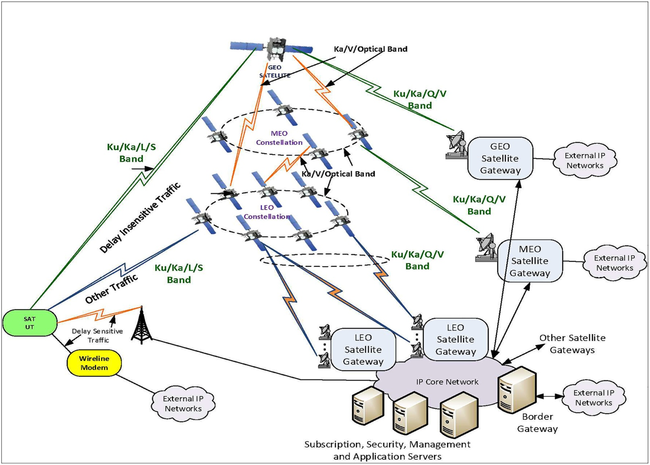
Block Diagram

Slide 11
SOFTWARE REQUIREMENTS:
Operating System : Windows 10
Platform : DOT NET TECHNOLOGY
Front End : ASP.Net 4.0
Back End : SQL SERVER 2014

Slide 12
HARDWARE REQUIREMENTS:
Keyboard
Mouse
Hard disk 500GB
Ram 4 Gb

Slide 13
CONCLUTION
The increasing trend of launching very small satellites into space has been clear and well established for the last two decades. Smaller satellites are in turn paving the way to constellations, which are gaining widespread interest. Spacecraft constellations are appealing, especially in three fields, namely, (i) communications, for global coverage, (ii) Earth observation, for near real time measurements and (iii) space observation for continuous monitoring/surveillance. During this survey, about one hundred companies have been found proposing constellations with varying numbers of satellites. Satellite sizes range mainly from nano to micro-sizes, i.e., from 1 kg up to 100 kg. Most of them are expected to be active in orbit before 2025. The most common number of elements for the constellations is below 150 units.

Slide 14
REFERENCE
1. McIntyre, D.A. The 10 Biggest Tech Failures of the Last Decade—Failure to Launch Iridium. 14 May 2009. Available online: http://content.time.com/time/specials/packages/article/0,28804,1898610_1898625_1898640, 00.html (accessed on 28 June 2019).
2. Glasner, J. Globalstar: Broke But Not Out. 14 November 2001. Available online: https://www.wired.com/ 2001/11/globalstar-broke-but-not-out/ (accessed on 20 July 2019).
3. Williams, C.; Doncaster, B.; Shulman, J. 2018 Nano/Microsatellite Market Forecast, 8th ed.; SpaceWorks Enterprises Inc.: Atlanta, GA, USA, 2018.
4. Lal, B.; de la Rosa, E.B.; Behrens, J.; Corbin, B.; Green, E.K.; Picard, A.A.J.; Balakrishnan, A. Global Trends in Small Satellites; IDA Science and Technology Policy Institute: Alexandria, VA, USA, 2017.
5. Sandaua, R.; Brieß, K.; D’Errico, M. Small satellites for global coverage: Potential and limits. ISPRS J. Photogramm. Remote Sens. 2010, 65, 492–504.

Slide 15
6. Panga, W.J.; Bo, B.; Meng, X.; Yu, X.Z.; Guo, J.; Zhou, J. Boom of the CubeSat: A Statistic Survey of CubeSats Launch in 2003–2015. In Proceedings of the 67th International Astronautical Congress (IAC), Guadalajara, Mexico, 26–30 September 2016.
7. Muelhaupt, T.J.; Sorge, M.E.; Morin, J.; Wilson, R.S. Space traffic management in the new space era. J. Space Saf. Eng. 2019, 85, 51–60.
8. Selva, D.; Golkar, A.; Korobova, O.; Cruz, I.L.; Collopy, P.; de Weck, O.L. Distributed Earth Satellite Systems: What Is Needed to Move Forward? J. Aerosp. Inf. Syst. 2017, 14, 412–438. [CrossRef]
9. Henry, C. LEO and MEO Broadband Constellations Mega Source of Consternation. 13 March 2018. Available online: https://spacenews.com/divining-what-the-stars-hold-in-store-for-broadband-megaconstellations/ (accessed on 20 July 2019).
10. Globalstar Completes 48-Satellite Constellation. 23 November 1999. Available online: https://www. wirelessnetworksonline.com/doc/globalstar-completes-48-satellite-constellati-0001 (accessed on 28 June 2019).

