Slide 1
Dynamic Age Minimization with Real-Time Information Preprocessing for Edge-Assisted IoT Devices with Energy Harvesting

Slide 2
Abstract
Age of information (AoI) is a newly proposed metric to quantify the freshness of system status. However, in many cases, the original raw data collected by IoT devices needs to be preprocessed in real-time to extract the hidden effective information, which is usually time consuming. To this end, we promote an edge computing assisted approach and aim to reduce the AoI by flexibly offloading the raw IoT data to the edge server for information preprocessing. We consider that the IoT devices can opportunistically collect extra energy through energy harvesting for sustainable operations, and propose a novel timely system status update model that consists of multiple IoT devices with energy harvesting and edge-assisted information preprocessing. The objective is to minimize the system-wide average AoI under a fixed energy cost budget. To tackle the key challenges due to the unpredictability of the stochastic energy harvesting process and the long-term energy constraints, we propose a Lyapunov-based average AoI Minimization (LAoIM) algorithm to derive an approximate optimal solution, and further quantify the performance gap from the optimal solution. Extensive numerical evaluations demonstrate that LAoIM can take full advantages of local and edge computation resources and achieve superior performance gain over existing schemes.

Slide 3
Existing System
The most natural mode of DL computation offloading is similar to the existed “end-cloud” computing, i.e., the end device sends its computation requests to the cloud for DL inference.
All these challenges put forward the need for a novel training scheme against existing cloud training.
In this case, DL is used to learn input-solution relations, and DNN-based methods are only available when optimization algorithms for the original caching problem exist.
Most existed works focus only on vision applications. However, the heterogeneous data structures and characteristics of a wide variety of DL-based services are not addressed well yet.
Existing FL methods focus on synchronous training, and can only process hundreds of devices in parallel.

Slide 4
Disadvantage of Existing System
We propose a novel alternate group iteration optimization (AGIO) algorithm, which decomposes the original problem into three subproblems, and alternately optimizes each subproblem using the group interior point iterative algorithm.
An achievable rate maximization problem was discussed in for multiuser satellite IoT system with SWIPT and MEC to overcome the limitation in battery capacity and computing capability of IoT terminals.
With the development of artificial intelligence technology, reinforcement learning (RL) methods are used to solve various communication problems in 5G and IoT systems.
We formulate a more practical WSN energy minimization problem by jointly optimizing the key decision variables in the system.

Slide 5
PROPOSED SYSTEM :
Adaptive Locality Sensitive Hashing (A-LSH), a variant of LSH commonly used for indexing high-dimensional data, is proposed to index these vectors for fast and accurate lookup.
In, the proposed distributed infrastructure Deep Decision ties together powerful edge nodes with less powerful end devices.
Based on these prediction models, wireless conditions and server load levels, the proposed Neurosurgeon evaluates each candidate point in terms of end-to-end latency or mobile energy consumption and partition the DNN at the best one.
In, a Fused Tile Partitioning (FTP) method, able to divide each CNN layer into independently distributable tasks, is proposed.

Slide 6
ADVANTAGE
It can attribute the success to more reasonable expressions of several parameters, which affects the system performance.
Although the current terminal devices are equipped with high-performance hardware, it is still difficult to meet the needs of computing intensive tasks, especially in the case of ensuring low power consumption and low latency.
In such new framework, the communication and computation resource allocation as well as wireless energy harvesting scheme are crucial for maximizing the system performance.
We analyze the transmission process of the system, we can formulate an problem which can optimize the system performance.
It also indicates the distinguished feature of our algorithm both in energy consumption performance and latency performance.

Slide 7
TITTLE | AUTHOR | DESCRIPTION
A comprehensive survey on internet of things (IoT) toward 5G sireless systems | Chettri, L.; Bera, R. | This paper provides a comprehensive review on emerging and enabling technologies related to 5G system that enables internet of things.
From IoT to 5G HoT: The next generation IoT-based intelligent algorithms and 5G technologies | Wang, D.; Chen, D.; Song, B.; Guizani, N.; Yu, X.; Du, X. | The Internet of Things is a novel paradigm with access to wireless communication systems and artificial intelligence technologies, which is considered to be applicable to a variety of promising fields and applications.

Slide 8
TITTLE | AUTHOR | DESCRIPTION
Three tier fog networks: Enabling IoT/5G for latency sensitive applications | Shahzadi, R.; Niaz, A.; Ali, M.; Naeem, M.; Rodrigues, J.J.; Qamar, F.; Anwar, S.M. | Fog computing provides mobile computing, network control and storage to the network edges to assist latency critical and computation-intensive applications.
Security in 5G-Enabled internet of things communication: Issues, challenges, and future research roadmap | Wazid, M.; Das, A.K.; Shetty, S.; Gope, P.; Rodrigues, J.J. | Some of the future research challenges and directions in the security of 5G-enabled IoT environment are displayed.

Slide 9
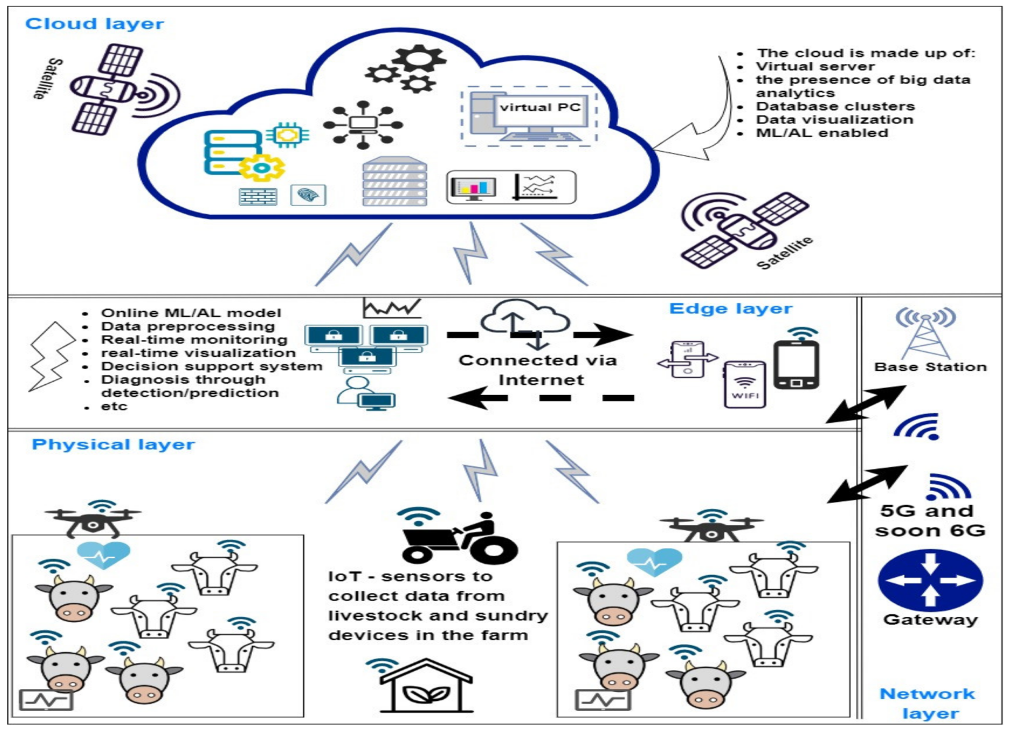
Block Diagram

Slide 10
SOFTWARE REQUIREMENTS:
Operating System : Windows 10
Platform : DOT NET TECHNOLOGY
Front End : ASP.Net 4.0
Back End : SQL SERVER 2014

Slide 11
HARDWARE REQUIREMENTS:
Keyboard
Mouse
Hard disk 500GB
Ram 4 Gb

Slide 12
CONCLUTION
In this paper, we investigate the wireless information transmission and energy transfer of a novel SWIPT-MEC enabled WSN-assisted IoT System. We fomulate an optimization problem by jointly optimizing the CPU frequency, transmitted power, offloading weight factor and harvest weight factor to achieve the minimum system energy consumption. In order to render the problem solvable, we propose a novel alternate group iteration optimization (AGIO) algorithm, which decomposes the original problem into three subproblems and alternately optimizes each subproblem using the group interior point iterative optimization algorithm. Finally, numerical simulation of the proposed strategy is carried on to compare with the two other benchmark schemes. The results demonstrate that the proposed design presents the performance advantages both in energy consumption and latency.

Slide 13
REFERENCE
1. Chettri, L.; Bera, R. A comprehensive survey on internet of things (IoT) toward 5G sireless systems. IEEE Internet Things J. 2020, 7, 16–32. [CrossRef]
2. Shafique, K.; Khawaja, B.A.; Sabir, F.; Qazi, S.; Mustaqim, M. Internet of things (IoT) for next-generation smart systems: A review of current challenges, future trends and prospects for emerging 5G-IoT scenarios. IEEE Access 2020, 7, 23022–23040. [CrossRef]
3. Wang, D.; Chen, D.; Song, B.; Guizani, N.; Yu, X.; Du, X. From IoT to 5G HoT: The next generation IoT-based intelligent algorithms and 5G technologies. IEEE Commun. Mag. 2018, 56, 114–120. [CrossRef]
4. Shahzadi, R.; Niaz, A.; Ali, M.; Naeem, M.; Rodrigues, J.J.; Qamar, F.; Anwar, S.M. Three tier fog networks: Enabling IoT/5G for latency sensitive applications. China Commun. 2019, 16, 1–11.
5. Wazid, M.; Das, A.K.; Shetty, S.; Gope, P.; Rodrigues, J.J. Security in 5G-Enabled internet of things communication: Issues, challenges, and future research roadmap. IEEE Access 2020, 9, 4466–4489. [CrossRef]

Slide 14
6. Ma, X.E.Z.; Yu, K. Energy-efficient computation offloading and resource allocation in SWIPT-based MEC Networks. IEEE Access 2020. [CrossRef]
7. Dua, A.; Dutta, A.; Zaman, N.; Kumar, N. Blockchain-based E-waste Management in 5G Smart Communities. In Proceedings of the IEEE INFOCOM 2020—IEEE Conference on Computer Communications Workshops (INFOCOM WKSHPS), Toronto, ON, Canada, 6–9 July 2020; pp. 195–200.
8. Lu, W.; Xu, X.; Huang, G.; Li, B.; Wu, Y.; Zhao, N.; Yu, F.R. Energy efficiency optimization in SWIPT enabled WSNs for smart agriculture. IEEE Trans. Ind. Inform. 2020, 17, 4335–4344. [CrossRef]
9. Cui, J.; Zhang, Y.; Cao, M.; Wang, S.; Xu, Y. Thyroid tumor care risk based on medical IoT system. Micropress. Microsyst. 2021, 82, 103845. [CrossRef]
10. Zhang, Q.; Sun, H.; Wei, Z.; Feng, Z. Sensing and Communication Integrated System for Autonomous Driving Vehicles. In Proceedings of the IEEE INFOCOM 2020—IEEE Conference on Computer Communications Workshops (INFOCOM WKSHPS), Toronto, ON, Canada, 6–9 July 2020; pp. 1278–1279.

