Slide 1
A Consortium Blockchain-based Access Control Framework with Dynamic Orderer Node Selection for 5G-enabled Industrial IoT

Slide 2
Abstract
5G-enabled Industrial Internet of Things (IIoT) deployment will bring more severe security and privacy challenges, which puts forward higher requirements for access control. Blockchain-based access control method has become a promising security technology, but it still faces high latency in consensus process and weak adaptability to dynamic changes in network environment. This paper proposes a novel access control framework for 5G-enabled IIoT based on consortium blockchain. We design three types of chaincodes for the framework named Policy Management Chaincode (PMC), Access Control Chaincode (ACC) and Credit Evaluation Chaincode (CEC). The PMC and ACC are deployed on the same data channel to implement the management of access control policies and the authorization of access.

Slide 3
The CEC deployed on another channel is used to add behavior records collected from IIoT devices and calculate the credit value of IIoT domain. Specifically, we design a two-step credit-based Raft consensus mechanism, which can select the orderer nodes dynamically to achieve fast and reliable consensus based on historical behavior records stored in the ledger. Furthermore, we implement the proposed framework on a real-world testbed and compare it with the framework based on Practical Byzantine Fault Tolerance (PBFT) consensus. The experiment results show that our proposed framework can maintain lower consensus cost time with 100ms level and achieves 4 to 5 times throughput with lower hardware resource consumption and communication consumption. Besides, our design also improves the security and robustness of the access control process.

Slide 4
Existing System
Most existing industrial IoT (IIoT) implementations, however, are still relying on a centralized architecture, which is vulnerable to the single point of failure attack and requires a massive amount of computation at the central entity.
It has a significant impact on the existing industry models in many fields, including manufacturing, power system, transportation, agriculture, supply chain, and the food industry.
It is believed that the blockchain technology will have a profound impact on existing IIoT infrastructures.
We also provide a practical integration architecture to integrate blockchain into existing IIoT platforms, as a blockchainenabled IIoT platform.

Slide 5
Disadvantage of Existing System
It is necessary to solve the transaction problem of the blockchain in the case of high throughput on the basis of the existing blockchain technologies, and provide the possibility for the implementation of the blockchain in the smart grid.
The current smart grid equipment management has basic coding standardization problems.
It inherits the advantages of centralization and alleviate the problem of monopoly.
When the traditional single node architecture evolves into distributed system, the frst problem is to ensure the consistency.
Consistency is the most basic and important problem of blockchain system.

Slide 6
PROPOSED SYSTEM :
Some research works have been proposed to deal with storage issues, such as BigChainDB and Inter-Planetary File System (IPFS).
In their proposed platform, smart contracts are used to run the pricing mechanism as well as control energy trading transactions and crowdsources.
It also proposed an intelligent energyaware resource management system within cloud data centers using blockchain technologies.
The appearance of blockchain technologies brings great opportunities for ensuring secured P2P energy trading; moreover, some recent studies proposed to use of blockchain to handle the challenges in the EMS.

Slide 7
ADVANTAGE
The IoT device identifer can uniquely identify a single entity or a type of entity and is used to identify the device in the system.
The current popular consensus mechanisms are generally only suitable for a single blockchain application, and the performance of the consensus mechanisms are related to the specifc requirements of different applications.
If the distributed system can achieve "consistency", it can present a perfect and scalable "virtual node", which has better performance and stability than physical nodes.
Due to blockchain’s distributed storage and credibility, it is used to identify and register IoT devices in smart grid, ensuring the reliability and accuracy of smart grid IoT devices management.

Slide 8
TITTLE | AUTHOR | DESCRIPTION
Consortium blockchain based data aggregation and regulation mechanism for smart grid | M. Fan, X. Zhang, | In the process of regulation, the control centre, grid operator, and equipment supplier receive fixed-height blocks from the blockchain, and obtain plaintext from the decryption.
A group signature and authentication scheme for blockchain-based mobile-edge computing | S. Zhang, J. Lee, | In this paper, we propose a group signature scheme designed for validating blocks of blockchain to address such issues.

Slide 9
TITTLE | AUTHOR | DESCRIPTION
An iterative two-layer optimization charging and discharging trading scheme for electric vehicle using consortium blockchain | Y. Li, B. Hu, | In order to solve the mixed-integer programming (MIP) problem that exists in this model, an improved heuristic algorithm, the adaptive inertia weight krill herd (KH) algorithm is proposed.
Joint resource allocation and incentive design for blockchain-based mobile edge computing | W. Sun, J. Liu, Y. Yue and P. Wang, | Mobile edge computing (MEC), as a promising technology, provides proximate and prompt computing service for mobile users on various applications.

Slide 10
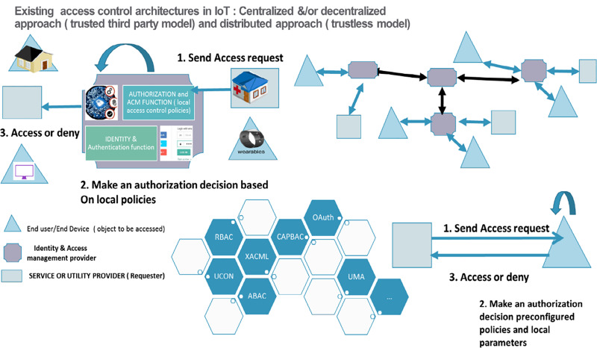
Block Diagram

Slide 11
SOFTWARE REQUIREMENTS:
Operating System : Windows 10
Platform : DOT NET TECHNOLOGY
Front End : ASP.Net 4.0
Back End : SQL SERVER 2014

Slide 12
HARDWARE REQUIREMENTS:
Keyboard
Mouse
Hard disk 500GB
Ram 4 Gb

Slide 13
CONCLUTION
Smart grid is the most promising vertical industry application of 5G. Tis paper integrated blockchain technology into 5G MEC-based smart grid to solve the coding and identifcation problems of massive smart grid IoT devices. In the life cycle management of smart grid equipment, unifed smart grid equipment coding or identifcation can serve as the index of blockchain explorer for data searching and extracting. Because blockchain has the characteristics of decentralization, distribution, credibility, and traceability, this paper proposed a hybrid blockchain mechanism for the identifcation and registration of IoT devices in smart grid. Tis hybrid mechanism is deployed on the MEC server, which acts as both a gateway for the public chain and a gateway for the private chain. Furthermore, as the basic technology in blockchain, we studied a number of consensus algorithms, and discussed their suitability for the hybrid blockchain. Finally, the performances of these consensus algorithms are analyzed and compared.

Slide 14
REFERENCE
1. M. Fan, X. Zhang, Consortium blockchain based data aggregation and regulation mechanism for smart grid. IEEE Access 7, 35929–35940 (2019)
2. S. Zhang, J. Lee, A group signature and authentication scheme for blockchain-based mobile-edge computing. IEEE Internet Things J. 7(5), 4557–4565 (May 2020)
3. Y. Li, B. Hu, An iterative two-layer optimization charging and discharging trading scheme for electric vehicle using consortium blockchain. IEEE Trans Smart Grid 11(3), 2627–2637 (May 2020)
4. W. Sun, J. Liu, Y. Yue and P. Wang, Joint resource allocation and incentive design for blockchain-based mobile edge computing, in IEEE Transactions on Wireless Communications, https://doi.org/10.1109/TWC.2020.2999721.
5. J. Feng, F. Richard Yu, Q. Pei, X. Chu, J. Du and L. Zhu, Cooperative Computation Ofoading and Resource Allocation for Blockchain-Enabled Mobile-Edge Computing: A Deep Reinforcement Learning Approach, in IEEE Internet of Things Journal, vol. 7, no. 7, pp. 6214–6228, July 2020.

Slide 15
6. Y. Liu, F.R. Yu, X. Li, H. Ji, V.C.M. Leung, Decentralized resource allocation for video transcoding and delivery in blockchain-based system with mobile edge computing. IEEE Trans. Veh. Technol. 68(11), 11169–11185 (Nov. 2019)
7. F. Guo, F.R. Yu, H. Zhang, H. Ji, M. Liu, V.C.M. Leung, Adaptive Resource Allocation in Future Wireless Networks With Blockchain and Mobile Edge Computing. IEEE Trans. Wireless Commun. 19(3), 1689–1703 (2020)
8. J. Wu, N. Tran, Application of blockchain technology in sustain- able energy systems: An overview. Sustainability 10(9), 3067 (2018)
9. Y. Cao, Energy internet blockchain technology, in The Energy Internet. Elsevier, 2019, pp. 45–64.
10. A. S. Musleh, G. Yao, and S. Muyeen, Blockchain applications in smart grid–review and frameworks, IEEE Access, vol. 7, pp. 86 746– 86 757, 2019.

