Slide 1
A 2.4 GHz Power Receiver Embedded With a Low-Power Transmitter and PCE of 53.8%, for Wireless Charging of IoTWearable Devices

Slide 2
Abstract
This article presents a 2.4 GHz and high-efficiency wireless power receiver (Rx) integrated with a low-power transmitter (Tx) for wireless charging of the Internet-of-Things (IoT) or wearable devices. A single pole double throw (SPDT) circuit isolates the operation of the Rx from Tx, thereby offering the capability of sharing antenna between them. The Rx employs a high-efficiency radio frequency (RF)-dc converter, which is facilitated with threshold voltage cancellation technique for enhancing the efficiency, and adjustable internal impedance matching network to compensate the nonlinear behavior of the input impedance with respect to input power level. In addition, it includes a boost dc-dc converter to charge the storage element with a fixed voltage and current. The Tx utilizes a low-power phase-locked loop (PLL) and a class-D power amplifier (PA). Several techniques are adopted to achieve low power consumption. The chip is implemented in a 180 nm CMOS process with a die size of 2.3 mm x 5 mm. The Rx shows the measured RF to dc maximum power conversion efficiency (PCE) of 53.8% at the input power level of 0 dBm. The Tx achieves a variable output power range of -10 to 10 dBm, while consumes 4 and 23 mA at 0 and 10 dBm output power, respectively.

Slide 3
Existing System
A variety of devices that utilize the same frequency as specified low power systems exist.
However, due to reflection and other phenomena, areas with predominately weaker signals may not be always be constant, since in actual space both weak and strong signals exist.
To distinguish between data intended for the target device or other equipment, a special system-level data string is placed at the beginning of the data packet.
Conventional specified low-power products typically only include a wireless block and function for outputting demodulated data, so an external MCU is needed to perform data discrimination.

Slide 4
Disadvantage of Existing System
In order to address the limits of the OFDM decode-and-forward relay system performance, the authors detailed a Power Allocation (PA) optimization problem to expand its feasible data rate.
The problem is non-curved and does not have direct solutions, the authors designed an RA approach by treating it as two separate sub-problems.
The authors have shown that the problem is NP-hard, and presented two approximation algorithms based on the greedy and relax rounding schemes to achieve better and guaranteed performance in the context of charger placements.
In particular, they examined the impact of information transmissions and energy transfer in the same frequency band.

Slide 5
PROPOSED SYSTEM :
Various LPWAN protocols have been proposed, but each has its advantages and disadvantages, and even the suitability of the LPWAN method itself may be called into question. In response, we are offering a proposal.
This ensures compatibility with a range of applications and markets, from IoT, industrial equipment, and automotive to electronic toys and consumer devices.
ROHM also support customer development through proposals and development tools based on decades of experience.
ROHM Sub-GHz specified low power wireless communication modules are capable of transmitting and receiving over longer distances with very low power, making them ideal for smart meters and smart communities along with the M2M and IoT markets.

Slide 6
ADVANTAGE
To be specific, the authors have assembled a proof-of-idea model of the framework and probed the model to assess its plausibility and performance on a small-scale system.
Their major goal was to get the sensor networks powered efficiently with/without batteries to keep the network lifetime at the greatest level and avoid any degradation in the network’s performance.
The UGV position is chosen to be in the centroid of the cluster in order to ensure that wireless charging takes place in the context of the cluster nodes efficiently.
The harvested and accessible energy of the sensor network’s was managed with an improved energy efficient ant-based routing protocol, which basically helped much in optimizing the available power.

Slide 7
TITTLE | AUTHOR | DESCRIPTION
An Energy Efficient WSN Implementation for Monitoring and Critical Event Detection | Sakkijha, Z.; Qaderi, H.; Ghatasheh, O.; Issa, A.; Shatat, A.; Jaber, H.; Alwardat, R.; Alhaj-Ali, S. | In this paper, an energy-efficient implementation for WSN is presented that utilizes deep-sleep power-saving mode in order to optimize the energy consumption while maintaining a reliable sensing and monitoring operation.
Hybrid wireless sensor networks: A prototype | Khalifeh, A.; Bartolini, N.; Silvestri, S.; Bongiovanni, G.; Al-Assaf, A.; Alwardat, R.; Alhaj-Ali, S. | All these devices are equipped with sensors, a microcontroller and a wireless communication module such that they are capable of covering an AoI in the terrestrial and aerial dimension.

Slide 8
TITTLE | AUTHOR | DESCRIPTION
LiM-AHP-GC: Life Time Maximizing based on Analytical Hierarchal Process and Genetic Clustering protocol for the Internet of Things environment | Darabkh, K.A.; Wafa’a, K.K.; Ala’F, K. | Wireless Sensor Network (WSN) plays a considerable role in IoT as of covering a spacious application range indispensable for the IoT.
Wireless Sensor Network Energy Model and Its Use in the Optimization of Routing Protocols | Del-Valle-Soto, C.; Mex-Perera, C.; Nolazco-Flores, J.A.; Velázquez, R.; Rossa-Sierra, A. | In this study, a Wireless Sensor Network (WSN) energy model is proposed by defining the energy consumption at each node.

Slide 9
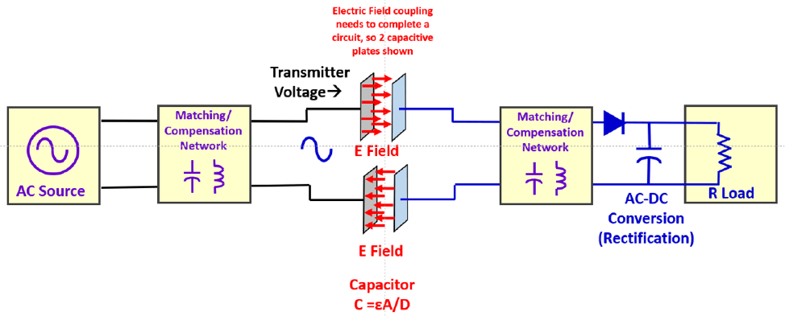
Block Diagram

Slide 10
SOFTWARE REQUIREMENTS:
Operating System : Windows 10
Platform : DOT NET TECHNOLOGY
Front End : ASP.Net 4.0
Back End : SQL SERVER 2014

Slide 11
HARDWARE REQUIREMENTS:
Keyboard
Mouse
Hard disk 500GB
Ram 4 Gb

Slide 12
CONCLUTION
In this paper, a study on radio frequency-based wireless charging utilizing off-the-shelf product was provided. In particular, with the aid of the Powercast power charging and harvesting circuit, a set of experiments was conducted to fully understand the technology in terms of the amount of energy received at the charged node, charging time, and charging distance. In addition, the paper provided a theoretical analysis on how to estimate the amount of the energy received for a given distance between the transmitter and receiver. Also, we presented the details on the path loss model to be used based on the crossover distance i.e., to invoke a two-ray path loss model or a Friis model. Accordingly, the amount of energy received was estimated theoretically and compared with the obtained experimental values, which showed a close match between the two results. Moreover, we compared the charging time and distance for the dipole and patch antennas, and the experimental results showed that the later one yielded better performance. Additionally, a use case in the area of WSN was demonstrated, where the sensor nodes were clustered using the Unsupervised Machine Learning K-means algorithm, and the centroid of each of the K-clusters was chosen. An Unmanned Ground Vehicle was used to act as a Cluster Head and wireless charging node to power the nodes within each of the clusters. For future work, we plan to conduct more experiments to take into consideration the potential existence of obstacles between the wireless charging station and wireless nodes. In addition, we are working toward building our own charging system and comparing it with the one used in this study.

Slide 13
REFERENCE
1. Del-Valle-Soto, C.; Velázquez, R.; Valdivia, L.J.; Giannoccaro, N.I.; Visconti, P. An Energy Model Using Sleeping Algorithms for Wireless Sensor Networks under Proactive and Reactive Protocols: A Performance Evaluation. Energies 2020, 13, 3024. [CrossRef]
2. Sakkijha, Z.; Qaderi, H.; Ghatasheh, O.; Issa, A.; Shatat, A.; Jaber, H.; Alwardat, R.; Alhaj-Ali, S. An Energy Efficient WSN Implementation for Monitoring and Critical Event Detection. In Proceedings of the 2019 2nd IEEE Middle East and North Africa COMMunications Conference (MENACOMM), Manama, Bahrain, 19–21 November 2019; pp. 1–6.
3. Khalifeh, A.; Bartolini, N.; Silvestri, S.; Bongiovanni, G.; Al-Assaf, A.; Alwardat, R.; Alhaj-Ali, S. Hybrid wireless sensor networks: A prototype. In Proceedings of the IFIP Conference on Human-Computer Interaction, Bombay, India, 14–18 September 2019; pp. 549–553.
4. Darabkh, K.A.; Wafa’a, K.K.; Ala’F, K. LiM-AHP-GC: Life Time Maximizing based on Analytical Hierarchal Process and Genetic Clustering protocol for the Internet of Things environment. Comput. Netw. 2020, 176, 107257. [CrossRef]
5. Del-Valle-Soto, C.; Mex-Perera, C.; Nolazco-Flores, J.A.; Velázquez, R.; Rossa-Sierra, A. Wireless Sensor Network Energy Model and Its Use in the Optimization of Routing Protocols. Energies 2020, 13, 728.

Slide 14
6. Mohammad, T.; Chih-Min, Y.; Meng-Lin, K.; Kai-Ten, F. On Hybrid Energy Utilization in Wireless Sensor Networks. Energies 2017, 10, 1940.
7. Jain, A.K. Data clustering: 50 years beyond K-means. Pattern Recognit. Lett. 2010, 31, 651–666. [CrossRef]
8. Liu, G.; Mrad, N.; Xiao, G.; Li, Z.; Ban, D. RF-based power transmission for wireless sensors nodes. In Proceedings of the Smart Materials & Structures/NDT in Aerospace/NDT in Canada 2011, Montreal, QC, Canada, 2–4 November 2011.
9. Darabkh, K.A.; Al-Maaitah, N.J.; Jafar, I.F.; Ala’F, K. EA-CRP: A Novel Energy-aware Clustering and Routing Protocol in Wireless Sensor Networks. Comput. Electr. Eng. 2017, 72, 702–718. [CrossRef]
10. Al-Agtash, S.; Tanash, R.; AlQudah, M. Deploying agents for monitoring and notification of wireless sensor networks. In Proceedings of the 2016 IEEE 28th International Conference on Tools with Artificial Intelligence (ICTAI), San Jose, CA, USA, 6–8 November 2016; pp. 754–757

