Slide 1
Nonnegative Matrix Factorization based Heterogeneous Graph Embedding Method for Trigger-Action Programming in IoT

Slide 2
Abstract
Nowadays, users can personalize IoT devices/Web services via Trigger-Action Programming (TAP). As the number of connected entities grows, the relations of triggers and actions become progressively complex (i.e., the heterogeneity of TAP), which becomes a challenge for existing models to completely preserve the heterogeneous data and semantic information in trigger and action. To address this issue, we propose IoT-NMF, a Nonnegative-Matrix-Factorization-based heterogeneous graph embedding method for TAP. Prior to using IoT-NMF, we map triggers and actions to an IoT Heterogeneous Information Network (IoT-HIN), from which we can extract three structures that preserve heterogeneous relations in triggers and actions. IoT-NMF can factorize the structures simultaneously for getting low-dimensional representation vectors of the triggers and actions, which can be further utilized in Artificial Intelligence of Things (AIoT) applications (e.g., TAP rule recommendation). Lastly, we demonstrate the proposed approach using an IFTTT dataset. The result shows that IoT-NMF outperforms the state-of-the-art approaches.

Slide 3
Existing System
Network analysis has attracted considerable attention as networks exist in various complex systems, such as biological and social systems.
Network analysis heavily relies on the network representation, which is traditionally represented as discrete adjacency matrix.
However, this straightforward representation usually cannot well reflect the underlying distinct structural characteristics of networks and suffers from the data sparsity issue.
The representations of nodes within a community should be more similar than those belonging to different communities.
Therefore, whether the learned embedding space can well reflect the community structures in the original network is a critical requirement for network embedding methods.

Slide 4
Disadvantage of Existing System
These algorithms usually result in an eigenvalue decomposition problem and the communities can be identified from the resultant eigenvectors.
However, it is generally hard to tell the exact physical meanings of those eigenvectors, which is important for explaining the final results when associated with real world applications.
In this paper, we propose how to apply nonnegative matrix factorization based methods to solve the community discovery problem.
In this paper, we will investigate another important issue, community discovery, in network analysis.

Slide 5
PROPOSED SYSTEM :
In this paper, we propose a novel Modularized Nonnegative Matrix Factorization (M-NMF) model to incorporate the community structure into network embedding.
We proposed a novel Modularized Nonnegative Matrix Factorization (M-NMF) model for network embedding, which preserves both the microscopic structure (firstand second-order proximities) and mesoscopic community structure.
A number of community detection methods have been proposed from different perspectives.
M-NMF0 is our proposed M-NMF model which only preserves the first- and second-order proximities.

Slide 6
ADVANTAGE
We further compare the performance of the proposed Symmetric Nonnegative Matrix Factorization (SNMF) method with other competitive algorithms.
The data set we used here is the WebKB data set4, which consists of about 6000 web pages from computer science departments of four schools.
Efficiently identifying those communities can help us to know the nature of those networks better and facilitate the analysis on those large networks.
The users that are familiar with many users (via user network) while they do not watch similar movies or give similar ratings as their friends can be thought as boundary spanners.

Slide 7
TITTLE | AUTHOR | DESCRIPTION
The diameter of the world wide web | Albert R, Jeong H, Barabasi A-L (1999) | we use local connectivity measurements to construct a topological model of the world wide web, allowing us to explore and characterize its large scale properties.
Classes of small-world networks | Amaral LAN, Scala A, Bartheélémy M, Stanley HE (2000) | we note for the classes of broad-scale and single-scale networks that there are constraints limiting the addition of new links.

Slide 8
TITTLE | AUTHOR | DESCRIPTION
Small-world networks: evidence for a crossover picture | Barthelemy M, Amaral LAN (1999) | We propose that the average distance $\ell$ between any two vertices of the network is a scaling function of $n / n^*$.
Metagenes and molecular pattern discovery using matrix factorization | Brunet JP, Tamayo P, Golub TR, Mesirov JP (2004) | We describe here the use of nonnegative matrix factorization (NMF), an algorithm based on decomposition by parts that can reduce the dimension of expression data from thousands of genes to a handful of metagenes.

Slide 9
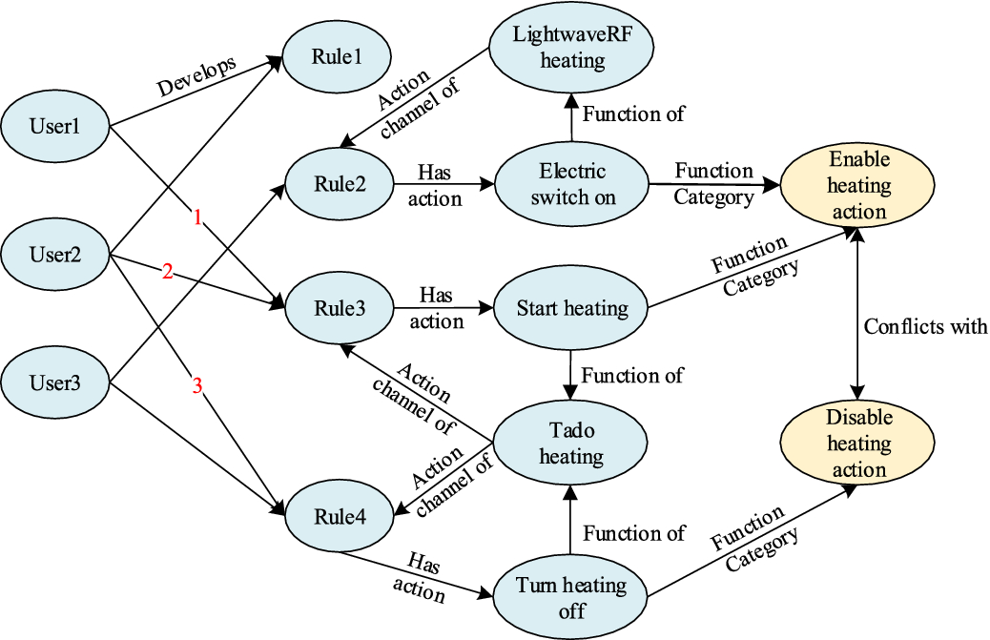
Block Diagram

Slide 10
SOFTWARE REQUIREMENTS:
Operating System : Windows 10
Platform : DOT NET TECHNOLOGY
Front End : ASP.Net 4.0
Back End : SQL SERVER 2014

Slide 11
HARDWARE REQUIREMENTS:
Keyboard
Mouse
Hard disk 500GB
Ram 4 Gb

Slide 12
CONCLUTION
In this paper, we propose how to apply nonnegative matrix factorization based methods to solve the community discovery problem. We have proposed three concrete algorithms, Symmetric NMF, Asymmetric NMF and Joint NMF to work on undirected networks, directed networks and compound networks, and we also proved the correctness and convergence of those algorithms. Finally the experiments on real world network data sets are presented to show the effectiveness of those methods.

Slide 13
REFERENCE
Albert R, Jeong H, Barabasi A-L (1999) The diameter of the world wide web. Nature 401:130
Amaral LAN, Scala A, Bartheélémy M, Stanley HE (2000) Classes of small-world networks. Proc Natl Acad Sci USA 97:11149–11152
Barthelemy M, Amaral LAN (1999) Small-world networks: evidence for a crossover picture. Phys Rev Lett 82:3180
Brunet JP, Tamayo P, Golub TR, Mesirov JP (2004) Metagenes and molecular pattern discovery using matrix factorization. Proc Natl Acad Sci USA 102(12):4164–4169
Chen G, Wang F, Zhang C (2007) Collaborative filtering using orthogonal nonnegative matrix tri-factorization. In: ICDM workshops on high performance computing, pp 303–308

Slide 14
Ding C, He X, Simon HD (2005) On the equivalence of nonnegative matrix factorization and spectral clustering. In: Proceedings of SIAM international conference on data mining, pp 606–610
Ding C, Li T, Jordan MI (2006a) Convex and semi-nonnegative matrix factorizations. LBNL Tech Report 60428
Ding C, Li T, Peng W, Park H (2006b) Orthogonal nonnegative matrix tri-factorizations for clustering. In: SIGKDD, pp 126–135
Ding C, Li T, Peng W (2008) On the equivalence between nonnegative matrix factorization and probabilistic latent semantic indexing. Comput Stat Data Anal 52(1):155–173
Faloutsos M, Faloutsos P, Faloutsos C (1999) On power-law relationships of the internet topology. In: SIGCOMM, pp 251–262

