Slide 1
SILedger A Blockchain and ABE-based Access Control for Applications in SDN-IoT Networks

Slide 2
Abstract
The Software Defined Network in Internet of Things (SDN-IoT) is enjoying growing popularity due to its flexibility, automaticity and programmability. However, there still lack proper permission management on SDN-IoT applications (SIApps), especially when the SIApp’s required northbound interfaces are located in multiple heterogeneous controllers without mutual trust. Existing access control methods are usually based on centralized models, proprietary controllers, trusting conditions or manual operation. It can incur unnecessary performance degradation and poor scalability. To solve this problem, this paper proposes the SIApps’ ledger (SILedger), an open, trusted, and decentralized access control mechanism based on blockchain and attribute-based encryption (ABE).

Slide 3
It can not only support effective authorization of SIApps in heterogeneous and untrusted SDN-IoT control domains, but also record all interactions between SIApps and resources, and thus facilitate SIApps’ further charging, analysis and audit. The main idea is that the SIApps are authorized using access tokens encrypted by ABE, and these tokens are seen as the currency of blockchain to be distributed. Specifically, we re-design blockchain transaction, token encryption, token initialization and token update schemes to achieve cross-domain, fine-grained and flexible SIApps’ permission management. In order to mitigate the delay and complexity problem of blockchain and ABE, we devise the access control framework that separates authorization from call process of SIApps. Finally, we perform security analysis and implement a FISCO-BCOS-based prototype for SILedger. The experimental results show that it can provide effective access control for SIApps with negligible overheads.

Slide 4
Existing System
Existing works that provide application flow authentication or flow secure constraint are to extend an individual secure module on a controller rather than a monolithic secure module in a multi-controllers environment.
In a network with the physically decentralized control plane, simply combing those existing schemes fails to effectively solve all the common security issues simultaneously, because all secure modules must work seamlessly among multiple controllers.
We utilize the existing stable Blockchain platform to implement our requirements rather than building a new Blockchain.
Key Generation is the second phase that is executed at the AA, which should exist on the cloud or the fog/edge node.

Slide 5
Disadvantage of Existing System
Many solutions (including blockchain based) have been proposed to overcome these problems.
In a system consisting of multiple SDN networks, problems like security, performance, reliability, and scalability arise due to the centralized control architecture.
Several existing studies focus on the problem of state consistency among numerous controllers.
Although there are multiple studies in the literature offering a reliable and scalable solution to the distributed network for management, however, none of these studies have solved this problem completely.

Slide 6
PROPOSED SYSTEM :
The proposed system is evaluated to have less cryptographic load by offloading the IoT nodes with Edge nodes.
To prevent data leakage and to protect user privacy, the authors have proposed a solution to isolate and serve different information retrieval requests for each type of personal information.
Therefore, in this paper, we have proposed a permissioned blockchain based data provenance mechanism which offloads the computational load of (1) hash calculation for blockchain and (2) cryptographic load of digital signature by outsourcing the mechanism to the Edge nodes.
Data integrity, sender authentication and data accuracy can be ensured by using this algorithm in the proposed system.

Slide 7
ADVANTAGE
We built a normal distributed SDN to compare the flow rule table update performance of our proposed Blockchain IoT architecture in large-scale network.
It can be seen from the experimental results that the performance of our proposed architecture (permissioned Blockchain based SDN) continuously improves as compare to the public blockchain based SDN in terms of percentage time reduction as the rate of packet-in arrival increases.
The system improves the networks performance and capacity in the face of network attacks such as spoofing and DDoS/DoS attacks.
We performed extensive experiments to evaluate our approach in terms of accuracy, scalability, security, and efficiency.

Slide 8
TITTLE | AUTHOR | DESCRIPTION
Vulnerabilities in sdn due to separation of data and control planes | S. Faizullah and S. AlMutairi, | Software defined networking (SDN) is a new approach to networking which enable comprehensive network programmability.
Software-defined networking: A comprehensive survey | D. Kreutz, F. Ramos, P. Verissimo, C. E. Rothenberg, S. Azodolmolky, and S. Uhlig, | It is both difficult to configure the network according to predefined policies, and to reconfigure it to respond to faults, load and changes.

Slide 9
TITTLE | AUTHOR | DESCRIPTION
Distblocknet: A distributed blockchains-based secure sdn architecture for iot networks | P. K. Sharma, S. Singh, Y.-S. Jeong, and J. H. Park, | These issues are caused by key mechanisms being distributed to the IoT network on a large scale, which is why a distributed secure SDN architecture for IoT using the blockchain technique (DistBlockNet) is proposed in this research.
Enhancing sdn security for iot-related deployments through blockchain | C. Tselios, I. Politis, and S. Kotsopoulos, | The majority of business activity of our integrated and connected world takes place in networks based on cloud computing infrastructure that cross national, geographic and jurisdictional boundaries.

Slide 10
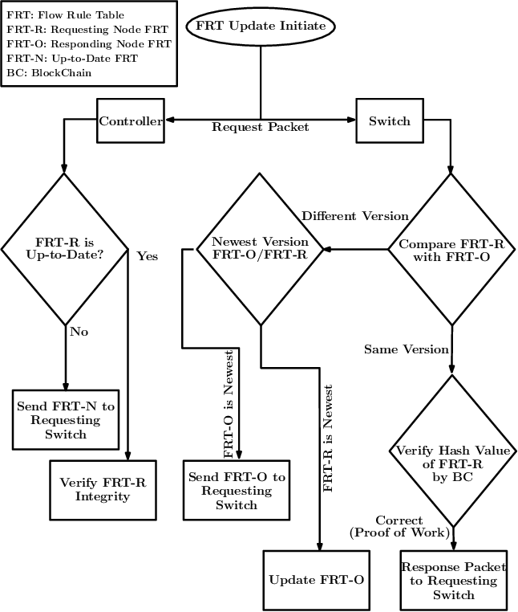
Block Diagram

Slide 11
SOFTWARE REQUIREMENTS:
Operating System : Windows 10
Platform : DOT NET TECHNOLOGY
Front End : ASP.Net 4.0
Back End : SQL SERVER 2014

Slide 12
HARDWARE REQUIREMENTS:
Keyboard
Mouse
Hard disk 500GB
Ram 4 Gb

Slide 13
CONCLUTION
In this paper, we propose an innovative, secure SDN in IoT network architecture using permissioned blockchains. We analyze the challenges faced by large scale IoT networks after the introduction of new communication paradigms. Our approach addresses those challenges effectively and performs well under the scenarios where the previous methods failed to show efficient results. The system improves the networks performance and capacity in the face of network attacks such as spoofing and DDoS/DoS attacks. Our approach reduces the response time of the attack by allowing IoT forwarding devices to check for any change in the latest flow rules table. We evaluate our approach (permissioned blockchain based SDN) in terms of performance overhead, scalability, and bandwidth utilization efficiency and compare it with Public blockchain based SDN and OpenFlow SDN models. The experimental results show that our proposed method outperforms the existing baseline models. In the future, we will extend our proposed model to work with distributed cloud computing architectures in order to evaluate and compare it with other proposed solutions.

Slide 14
REFERENCE
[1] Gartner, “Iot opportunities and challenges in 2019 and beyond,” in https://www.gartner.com/en/webinars/26641/iot-opportunitiesand-challenges-in-2019-and-beyond.
[2] S. Faizullah and S. AlMutairi, “Vulnerabilities in sdn due to separation of data and control planes,” International Journal of Computer Applications, vol. 975, p. 8887.
[3] D. Kreutz, F. Ramos, P. Verissimo, C. E. Rothenberg, S. Azodolmolky, and S. Uhlig, “Software-defined networking: A comprehensive survey,” arXiv preprint arXiv:1406.0440, 2014.
[4] P. K. Sharma, S. Singh, Y.-S. Jeong, and J. H. Park, “Distblocknet: A distributed blockchains-based secure sdn architecture for iot networks,” IEEE Communications Magazine, vol. 55, no. 9, pp. 78–85, 2017.
[5] C. Tselios, I. Politis, and S. Kotsopoulos, “Enhancing sdn security for iot-related deployments through blockchain,” in 2017 IEEE Conference on Network Function Virtualization and Software Defined Networks (NFV-SDN), 2017, pp. 303–308.

Slide 15
[6] B. A. A. Nunes, M. Mendonca, X.-N. Nguyen, K. Obraczka, and T. Turletti, “A survey of software-defined networking: Past, present, and future of programmable networks,” IEEE Communications Surveys & Tutorials, vol. 16, no. 3, pp. 1617–1634, 2014.
[7] M. Yu, L. Jose, and R. Miao, “Software defined traffic measurement with opensketch,” in Presented as part of the 10th {USENIX} Symposium on Networked Systems Design and Implementation ({NSDI} 13), 2013, pp. 29–42.
[8] A. Reyna, C. Mart´ın, J. Chen, E. Soler, and M. D´ıaz, “On blockchain and its integration with iot. challenges and opportunities,” Future Generation Computer Systems, vol. 88, pp. 173–190, 2018.
[9] F. Casino, T. K. Dasaklis, and C. Patsakis, “A systematic literature review of blockchain-based applications: current status, classification and open issues,” Telematics and Informatics, vol. 36, pp. 55–81, 2019.
[10] M. Banerjee, J. Lee, and K.-K. R. Choo, “A blockchain future for internet of things security: A position paper,” Digital Communications and Networks, vol. 4, no. 3, pp. 149–160, 2018.

