Slide 1
Policy-based Broadcast Access Authorization for Flexible Data Sharing in Clouds

Slide 2
Abstract
Cloud storage services allow data owners to outsource their potentially sensitive data (e.g., private genome data) to remote cloud servers in a ciphertext form. To enable data owners to further share the data encrypted in ciphertexts, many proxy re-encryption (PRE) schemes are proposed. However, most schemes only support single-recipient or coarse-grained re-encryption, which may limit the flexibility for data sharing. To address this issue, we propose a Policy-based Broadcast Access Authorization (PBAA) scheme by introducing the well-established identity-based broadcast encryption (IBBE) and key-policy attribute-based encryption into PRE. In our PBAA scheme, a data owner can apply IBBE to encrypt his data to a group of recipients. More importantly, the data owner can generate a delegation key with an access policy, and send this key to the cloud such that it can convert any initial ciphertext satisfying the access policy into a new ciphertext for a new group of recipients. With these features, cloud users can share their remote data in a secure and flexible way. Security analysis and performance evaluation show that the PBAA scheme is secure and efficient, respectively.

Slide 3
Existing System
These algorithms become sublinear in the number of existing Usrs as they are executed with a logarithmic number of secrets to cover all existing Usrs.
Such schemes assure forward and backward security by only changing the public information and without affecting secret shares given to existing users.
The ability to derive the secret encryption/decryption keys using public values is a key point to achieve transparency in subscription handling. Most of the existing GKM schemes fail to achieve this objective.
The rekey process is not transparent, thus shifting the burden of acquiring new keys on existing users when others leave or join.

Slide 4
Disadvantage of Existing System
This raises a serious problem when the encrypted data needs to be shared to more people beyond those initially designated by the data owner.
To address this problem, we introduce and formalize an identity-based encryption transformation (IBET) model by seamlessly integrating two well-established encryption mechanisms, namely identity-based encryption (IBE) and identity-based broadcast encryption (IBBE).
This paper attempts to solve such problem technically so that the authorities can transform the ciphertexts from one 2 encryption system to another, without handing over their decryption keys.
This scheme requires the interaction between data owners and a key generator authority for each transformation, which may result an efficiency problem.

Slide 5
PROPOSED SYSTEM :
The proposed key management scheme works efficiently even when there are thousands of Usrs.
The OCBE protocols, proposed by Li and Li, provide the capability of delivering information to qualified users in an oblivious way.
Based on our preliminary work , we propose a provably secure BGKM scheme, called ACVBGKM, and formalize the notion of BGKM.
Having identified these problems, our preliminary work , proposes an approach to make rekey transparent to users by not distributing actual keys during the registration phase.
We propose an efficient approach for finegrained encryption-based access control for documents stored in an untrusted cloud file storage.

Slide 6
ADVANTAGE
The performance of the asymmetric encryption is thus independent of the data size.
We conducted a series of experiments to evaluate the performance of the IBET scheme.
In particular, we implemented the efficient BB04 IBE scheme to compare its performance with ours in terms of file creation and file access.
Many efforts have been made to improve efficiency and security of PRE and most of them focus on unidirectional PRE.
Moreover, it enables users to first choose efficient identitybased encryption mechanisms to protect data, and then transform the encrypted data (if they like) so that users from a different (IBBE) encryption system can access.

Slide 7
TITTLE | AUTHOR | DESCRIPTION
Cloud data protection for the masses | D. Song, E. Shi, I. Fischer, and U. Shankar, | Offering strong data protection to cloud users while enabling rich applications is a challenging task.
Enabling cloud storage auditing with verifiable outsourcing of key updates | J. Yu, K. Ren, and C. Wang, | In particular, we leverage the third party auditor (TPA) in many existing public auditing designs, let it play the role of authorized party in our case, and make it in charge of both the storage auditing and the secure key updates for key-exposure resistance.

Slide 8
TITTLE | AUTHOR | DESCRIPTION
Achieving secure, universal, and fine-grained query results verification for secure search scheme over encrypted cloud data | H. Yin, Z. Qin, J. Zhang, L. Ou, and K. Li, | Secure search techniques over encrypted cloud data allow an authorized user to query data files of interest by submitting encrypted query keywords to the cloud server in a privacy-preserving manner.
Security analysis on one-tomany order preserving encryption-based cloud data search | K. Li, W. Zhang, C. Yang, and N. Yu, | When using deterministic OPE, the ciphertexts will reveal the distribution of relevance scores.

Slide 9
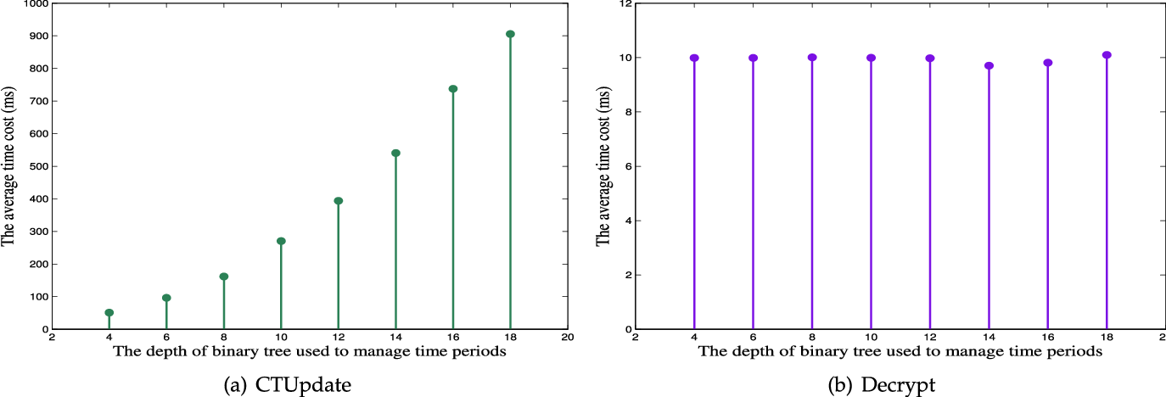
Block Diagram

Slide 10
SOFTWARE REQUIREMENTS:
Operating System : Windows 10
Platform : DOT NET TECHNOLOGY
Front End : ASP.Net 4.0
Back End : SQL SERVER 2014

Slide 11
HARDWARE REQUIREMENTS:
Keyboard
Mouse
Hard disk 500GB
Ram 4 Gb

Slide 12
CONCLUTION
In this paper we studied how to securely and efficiently transform encrypted data in clouds. To address this issue, we proposed an identity-based encryption transformation (IBET) model, which connects the well-studied IBE and IBBE systems. IBET allows data owners to secure outsourced data with identity-based access control, which eliminates complicated cryptographic certificates for all users. Moreover, IBET provides a transformation mechanism for data owners to authorize cloud service provider (CSP) to transform a file in IBE-ciphertext formant into a file in IBBE-ciphertext format, so that a set of authorized users can access the underlying data. We proposed a concrete IBET scheme that is secure against powerful attacks. Thorough experimental analyses demonstrate the efficiency and practicability of the scheme.

Slide 13
REFERENCE
[1] D. Song, E. Shi, I. Fischer, and U. Shankar, “Cloud data protection for the masses,” Computer, vol. 45, no. 1, pp. 39–45, 2012.
[2] J. Yu, K. Ren, and C. Wang, “Enabling cloud storage auditing with verifiable outsourcing of key updates,” IEEE Transactions on Information Forensics and Security, vol. 11, no. 6, pp. 1362–1375, 2016.
[3] H. Yin, Z. Qin, J. Zhang, L. Ou, and K. Li, “Achieving secure, universal, and fine-grained query results verification for secure search scheme over encrypted cloud data,” IEEE Transactions on Cloud Computing, 2017.
[4] K. Li, W. Zhang, C. Yang, and N. Yu, “Security analysis on one-tomany order preserving encryption-based cloud data search,” IEEE Transactions on Information Forensics and Security, vol. 10, no. 9, pp. 1918–1926, 2015.
[5] R. Zhang, R. Xue, and L. Liu, “Searchable encryption for healthcare clouds: a survey,” IEEE Transactions on Services Computing, vol. 11, no. 6, pp. 978–996, 2018.

Slide 14
[6] D. Boneh and M. Franklin, “Identity-based encryption from the weil pairing,” SIAM Journal on Computing, vol. 32, no. 3, pp. 586– 615, 2003.
[7] J. Wei, W. Liu, and X. Hu, “Secure data sharing in cloud computing using revocable-storage identity-based encryption,” IEEE Transactions on Cloud Computing, 2016.
[8] D. He, N. Kumar, H. Wang, L. Wang, K.-K. R. Choo, and A. Vinel, “A provably-secure cross-domain handshake scheme with symptoms-matching for mobile healthcare social network,” IEEE Transactions on Dependable and Secure Computing, vol. 15, no. 4, pp. 633–645, 2018.
[9] C. Delerable´e, “Identity-based broadcast encryption with constant size ciphertexts and private keys,” in International Conference on the Theory and Application of Cryptology and Information Security. Springer, 2007, pp. 200–215.
[10] H. Deng, Q. Wu, B. Qin, W. Susilo, J. Liu, and W. Shi, “Asymmetric cross-cryptosystem re-encryption applicable to efficient and secure mobile access to outsourced data,” in Proceedings of the 10th ACM Symposium on Information, Computer and Communications Security. ACM, 2015, pp. 393–404.

