Slide 1
Constrained App Data Caching over Edge Server Graphs in Edge Computing Environment

Slide 2
Abstract
In recent years, edge computing, as an extension of cloud computing, has emerged as a promising paradigm for powering a variety of applications demanding low latency, e.g., virtual or augmented reality, interactive gaming, real-time navigation, etc. In the edge computing environment, edge servers are deployed at base stations to offer highly-accessible computing capacities to nearby end-users, e.g., CPU, RAM, storage, etc. From a service provider's perspective, caching app data on edge servers can ensure low latency in its users' data retrieval. Given constrained cache spaces on edge servers due to their physical sizes, the optimal data caching strategy must minimize overall user latency.

Slide 3
In this paper, we formulate this Constrained Edge Data Caching (CEDC) problem as a constrained optimization problem from the service provider's perspective and prove its NP-hardness. We propose an optimal approach named CEDC-IP to solve this CEDC problem exactly with the Integer Programming technique. We also provide an approximation algorithm named CEDC-A for finding approximate solutions to large-scale CEDC problems efficiently and prove its approximation ratio. CEDC-IP and CEDC-A are evaluated on a real-world data set and a synthesized data set. The results demonstrate that they significantly outperform four representative approaches.

Slide 4
Existing System
Existing PID controllers used in grid resource information system support monitoring, managing, deploying resources and services dynamically.
The existing algorithm that reflects the rate of change in PID output has an advantage in environment with low rate of change.
However, existing cloud computing has inevitable latency caused by its geographical location and the huge traffic concentrated in the central cloud.
Existing caching techniques predominantly predict user patterns or data flows and deploy data in advance to provide data when needed by users.
The possibility of this framework and the proposed algorithm was confirmed by comparing with the PID basic algorithm and the existing algorithm.

Slide 5
Disadvantage of Existing System
In this paper, we investigate the collaborative caching problem in the EC environment with the aim to minimize the system cost including data caching cost, data migration cost and quality-of-service (QoS) penalty.
In the long-term, how to keep an app vendor’s edge caching system stable over time across multiple time slots is the key problem to be solved in this paper.
We refer to this data caching problem in the EC environment collaborative edge data caching (CEDC) problem.
To quantify the optimization objective and constraints in the CEDC problem in a generic manner, we measure the data sizes and cache spaces by the number of data units, and the data retrieval latency with the number of hops.

Slide 6
PROPOSED SYSTEM :
We hope the proposed algorithm not only supports high-quality cloud service by reducing network latency and congestion, but also contributes real-time services, such as AR and VR, autonomous vehicles, and ITS.
The proposed algorithm considers the rate-of-change of the output of the PID controller.
Within that environment, we used four experimental scenarios to evaluate the proposed rate-control algorithm for in- and outflows and caching of streaming data on resource-limited edge nodes.
The proposed algorithm also reflects the rate of change in the PID output and increases sensitivity.
Lightweight, agile caching with a PID controller is proposed as an efficient rate-control algorithm for streaming high-quality data.

Slide 7
ADVANTAGE
To analyze the performance of our CEDC-O comprehensively, we conducted seven sets of simulations to observe its performance in different CEDC scenarios.
This way, we can compare the performance of the four approaches and observe how the changes in the setting parameters impact the performance of CEDC-O.
They addressed this issue with a holistic model for provisioning the storage capability based on the network performance and the provisioning cost.
By innovatively and realistically modeling the CEDC problem as a long-term optimization problem, CEDC-O can help app vendors ensure the longterm performance of their edge data caching performance.

Slide 8
TITTLE | AUTHOR | DESCRIPTION
The foundation of the mobile and wireless communications system for 2020 and beyond: Challenges, enablers and technology solutions | A. Osseiran, V. Braun, T. Hidekazu, P. Marsch, H. Schotten, H. Tullberg, M. A. Uusitalo, and M. Schellman, | The variety of applications and data traffic types will be significantly larger than today, and will result in more diverse requirements on services, devices and networks.
Optimal edge user allocation in edge computing with variable sized vector bin packing | P. Lai, Q. He, M. Abdelrazek, F. Chen, J. Hosking, J. Grundy, and Y. Yang, | In mobile edge computing, edge servers are geographically distributed around base stations placed near end-users to provide highly accessible and efficient computing capacities and services

Slide 9
TITTLE | AUTHOR | DESCRIPTION
Computation peer offloading for energy-constrained mobile edge computing in small-cell networks | L. Chen, S. Zhou, and J. Xu, | OPEN works online without requiring information about future system dynamics, yet provides provably near-optimal performance compared with the oracle solution that has the complete future information.
Computation offloading and resource allocation in wireless cellular networks with mobile edge computing | C. Wang, C. Liang, F. R. Yu, Q. Chen, and L. Tang, | Mobile edge computing has risen as a promising technology for augmenting the computational capabilities of mobile devices.

Slide 10
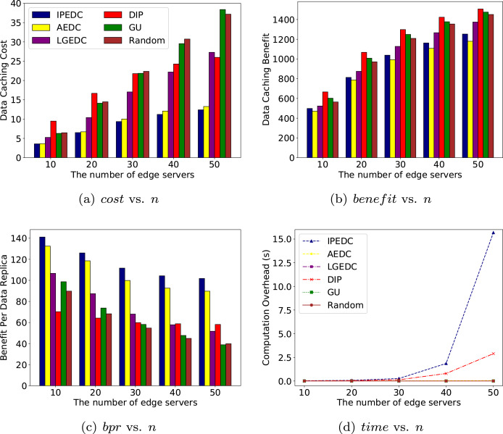
Block Diagram

Slide 11
SOFTWARE REQUIREMENTS:
Operating System : Windows 10
Platform : DOT NET TECHNOLOGY
Front End : ASP.Net 4.0
Back End : SQL SERVER 2014

Slide 12
HARDWARE REQUIREMENTS:
Keyboard
Mouse
Hard disk 500GB
Ram 4 Gb

Slide 13
CONCLUTION
In this paper, we studied the collaborative edge data caching (CEDC) problem. We first identified the major challenges and proposed a comprehensive cost model for this problem, where system cost is composed of data caching cost, data migration cost and QoS penalty. We also proved the N Pcompleteness of the CEDC problem. We proposed CEDC-O, an online algorithm with provable performance guarantee, and evaluated its performance with extensive simulations. This research has established the foundation for the CEDC problem and opened up a number of future research directions. In our future work, we will consider dynamics on available edge server caches, user mobility and security policies.

Slide 14
REFERENCE
[1] A. Osseiran, V. Braun, T. Hidekazu, P. Marsch, H. Schotten, H. Tullberg, M. A. Uusitalo, and M. Schellman, “The foundation of the mobile and wireless communications system for 2020 and beyond: Challenges, enablers and technology solutions,” in IEEE 77th Vehicular Technology Conference (VTC2013-Spring), 2013, pp. 1– 5.
[2] P. Lai, Q. He, M. Abdelrazek, F. Chen, J. Hosking, J. Grundy, and Y. Yang, “Optimal edge user allocation in edge computing with variable sized vector bin packing,” in International Conference on Service-Oriented Computing, 2018, pp. 230–245.
[3] T. X. Tran, M.-P. Hosseini, and D. Pompili, “Mobile edge computing: Recent efforts and five key research directions,” IEEE COMSOC MMTC Commun.-Frontiers, vol. 12, no. 4, pp. 29–33, 2017.
[4] L. Chen, S. Zhou, and J. Xu, “Computation peer offloading for energy-constrained mobile edge computing in small-cell networks,” IEEE/ACM Transactions on Networking, vol. 26, no. 4, pp. 1619–1632, 2018.
[5] C. Wang, C. Liang, F. R. Yu, Q. Chen, and L. Tang, “Computation offloading and resource allocation in wireless cellular networks with mobile edge computing,” IEEE Transactions on Wireless Communications, vol. 16, no. 8, pp. 4924–4938, 2017.

Slide 15
[6] C. You, K. Huang, H. Chae, and B.-H. Kim, “Energy-efficient resource allocation for mobile-edge computation offloading,” IEEE Transactions on Wireless Communications, vol. 16, no. 3, pp. 1397– 1411, 2017.
[7] X. Chen, L. Jiao, W. Li, and X. Fu, “Efficient multi-user computation offloading for mobile-edge cloud computing,” IEEE/ACM Transactions on Networking, vol. 24, no. 5, pp. 2795–2808, 2016.
[8] Q. He, G. Cui, X. Zhang, F. Chen, S. Deng, H. Jin, Y. Li, and Y. Yang, “A game-theoretical approach for user allocation in edge computing environment,” IEEE Transactions on Parallel and Distributed Systems, 2019.
[9] P. Stenstrom, “A survey of cache coherence schemes for multiprocessors,” Computer, vol. 23, no. 6, pp. 12–24, 1990.
[10] J. D. Owens, D. Luebke, N. Govindaraju, M. Harris, J. Kruger, ¨ A. E. Lefohn, and T. J. Purcell, “A survey of general-purpose computation on graphics hardware,” in Computer graphics forum, vol. 26, no. 1. Wiley Online Library, 2007, pp. 80–113.

