Slide 1
Disease Prediction in Health Care System

Slide 2
Abstract
To keep pace with the developments in medical informatics, health medical data is being collected continually.
But, owing to the diversity of its categories and sources, medical data has become so complicated in many hospitals needs a clinical decision support (CDS) system for its management.
To effectively utilize the accumulating health data, we propose a CDS framework that can integrate heterogeneous health data from different sources such as laboratory test results, basic information of patients, and health records into a consolidated representation of features of all patients.

Slide 3
Using the electronic health medical data so created, multilabel classiﬁcation was employed to recommend a list of diseases and thus assist physicians in diagnosing or treating their patients’ health issues more efﬁciently.
Once the physician diagnoses the disease of a patient, the next step is to consider the likely complications of that disease, which can lead to more diseases.
Previous studies reveal that correlations do exist among some diseases. Considering these correlations, a k-nearest neighbors algorithm is improved for multilabel learning by using correlations among labels (CML-kNN).

Slide 4
The CML-kNN algorithm ﬁrst exploits the dependence between every two labels to update the origin label matrix and then performs multilabel learning to estimate the probabilities of labels by using the integrated features.
Finally, it recommends the top N diseases to the physicians. Experimental results on real health medical data establish the effectiveness and practicability of the proposed CDS framework.

Slide 5
Existing System
The existing clinical decision support systems are poor in processing large volumes of multi-structured healthcare data and in providing accurate health recommendation, in practice

Slide 6
Disadvantage of Existing System
Problem transformation method ﬁrst transforms one multilabel dataset into multiple single-label datasets, and then exploits existing single-label learning algorithm to process each single-label dataset.

Slide 7
PROPOSED SYSTEM :
Using Pattern Matching Algorithm the laboratory test data and basic information of patients, a set of experiments of different multi-label learning methods were performed to confirm the effectiveness and practicality of the proposed framework.
The Disease Prediction in health care system is an information system that offers knowledge and personalized information to users in enhancing health and healthcare outcomes .

Slide 8
ADVANTAGE
A novel framework is proposed for retrieving the most rel- evant information of patients from multiple data sources,.
such as laboratory test data, basic information of patients,symptoms of patients and electrocardiogram data, and for combining them to generate integrated features.

Slide 9
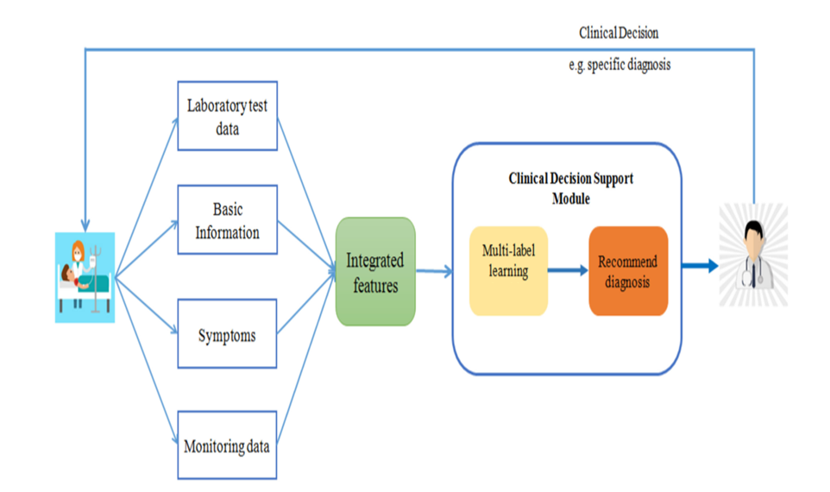
SYSTEM ARCHITECTURE

Slide 10
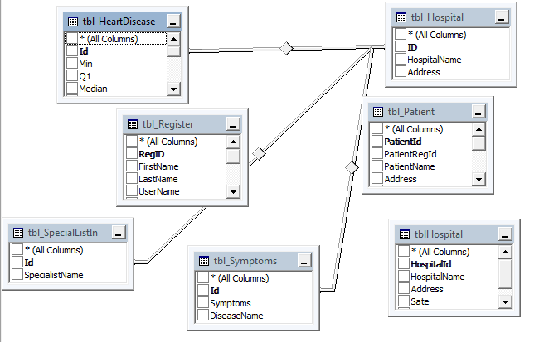
Data Base Diagram

Slide 11
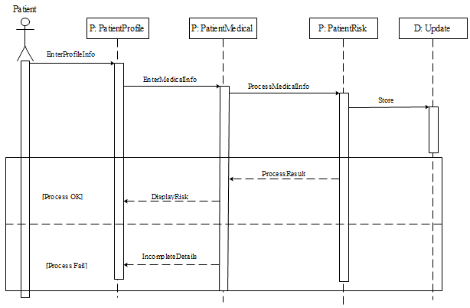
Logic Diagram

Slide 12
MODULES
Register and Login
Health Care Data
Pattern Matching Algorithm
Recommend Diagnosis Analyze

Slide 13
Register and Login
Register as user by providing first name, last name, user name and password, etc..
Login Using User Name and Pasword .

Slide 14
Health Care Data
Patient health care data like height, weight, blood pressure, temperature, heart beat rate , Diseases Symptoms will be given as input.

Slide 15
Pattern Matching Algorithm
Using Pattern Matching Algorithm data of each patient will be compared with symptoms of previous dataset and stored in database.
Using the laboratory test data and basic information of patients, a set of experiments of different multi-label learning methods were performed to confirm the effectiveness and practicality of the proposed framework.

Slide 16
Recommend Diagnosis Analyze
Using Pattern matching we have do string matching with disease dataset then the finalized analyzing disease status will be updated .
Comparing the results of testing items with the reference ranges of those items to identify the abnormal items and quantify the levels of their abnormality.

Slide 17
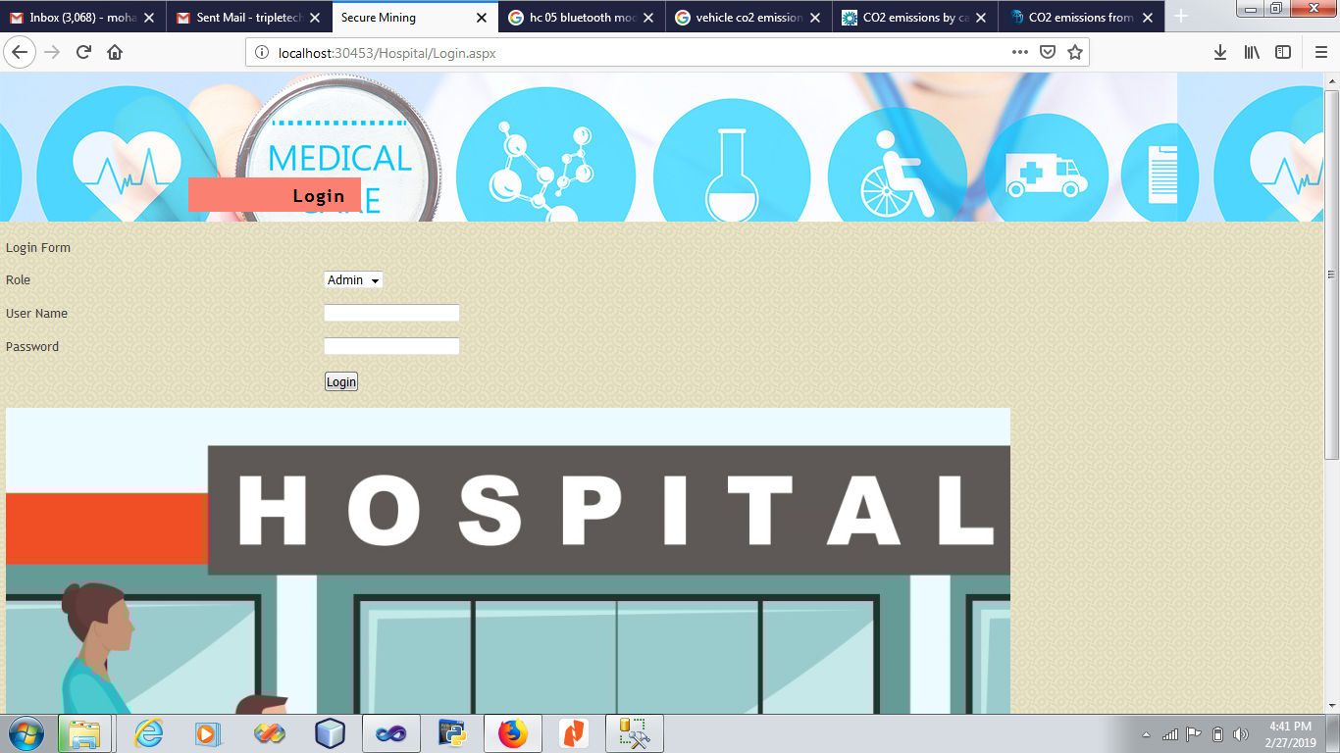
LOGIN SCREEN

Slide 18
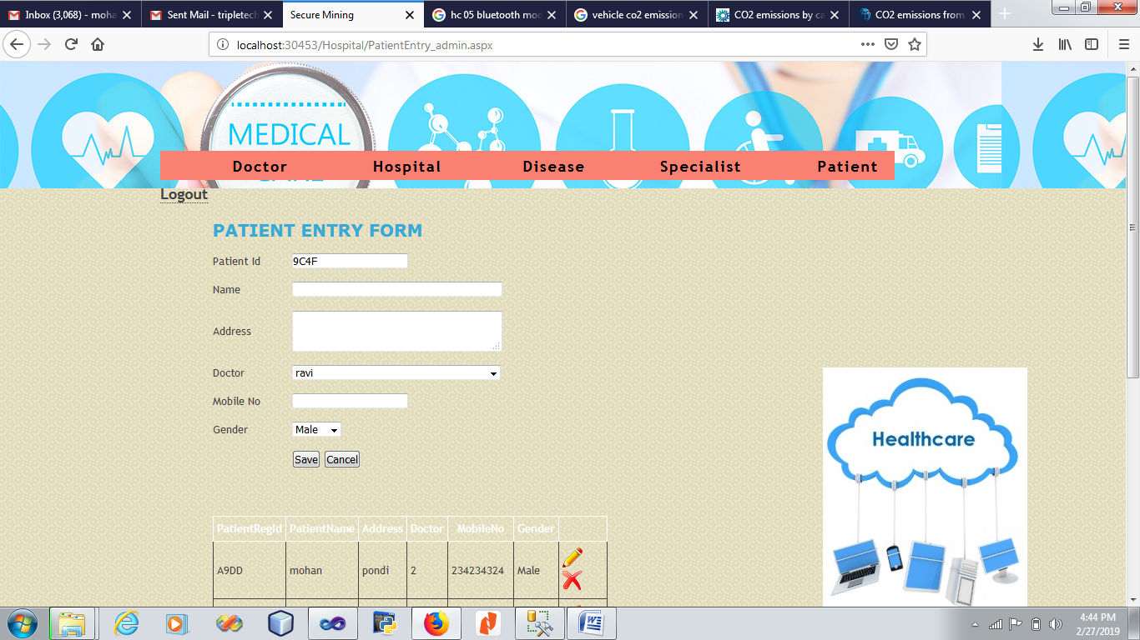
Patient Entry Screen

Slide 19
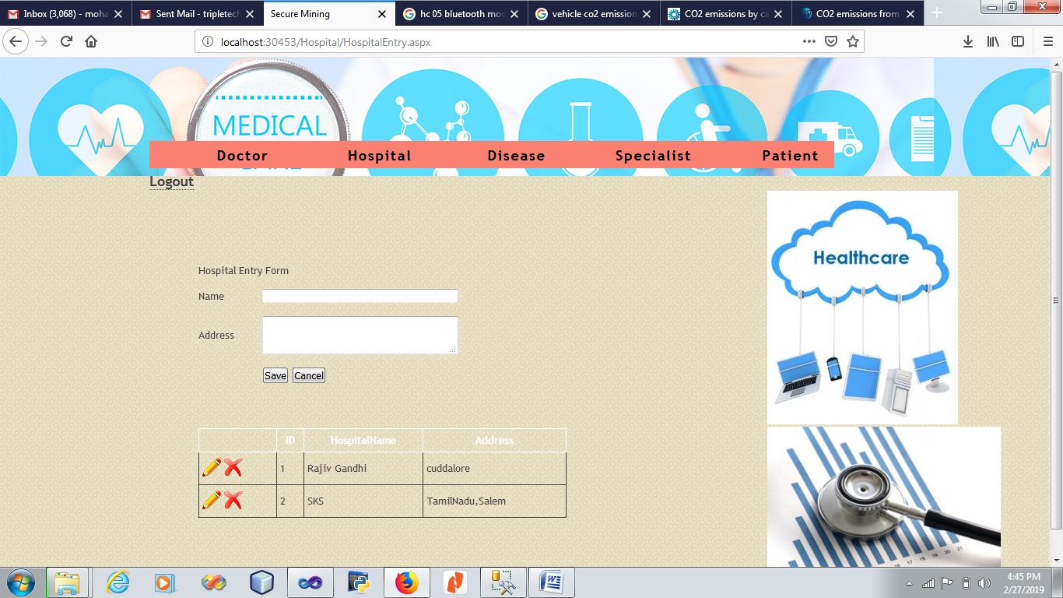
Hospital Entry Screen

Slide 20
SOFTWARE REQUIREMENTS:
Operating system : Windows XP/7.
Coding Language : PHP
Database : MySql

Slide 21
HARDWARE REQUIREMENTS:
System : I3 Processer
Hard Disk : 500 GB.
Monitor : 15 VGA Colour.
Mouse :
Ram : 2 Gb

