Slide 1
Neuroscience and Network Dynamics Toward Brain-Inspired Intelligence

Slide 2
Abstract
This article surveys the interdisciplinary research of neuroscience, network science, and dynamic systems, with emphasis on the emergence of brain-inspired intelligence. To replicate brain intelligence, a practical way is to reconstruct cortical networks with dynamic activities that nourish the brain functions, instead of using only artificial computing networks. The survey provides a complex network and spatiotemporal dynamics (abbr. network dynamics) perspective for understanding the brain and cortical networks and, furthermore, develops integrated approaches of neuroscience and network dynamics toward building brain-inspired intelligence with learning and resilience functions. Presented are fundamental concepts and principles of complex networks, neuroscience, and hybrid dynamic systems, as well as relevant studies about the brain and intelligence. Other promising research directions, such as brain science, data science, quantum information science, and machine behavior are also briefly discussed toward future applications.

Slide 3
Existing System
In contrast, in the mechanism- and structure-oriented approach, brain-inspired intelligent robotics is developed to mimic, apply, and integrate internal mechanisms existing in humans.
Existing as a part of an organic whole, individual components of collective robots must cooperate with each other to achieve harmonious behavior.
When one becomes exposed to a new perception or experience that challenges existing schemas, a process of reorganization and adaptation occurs, leading to new schemas.
Existing fixed-base industrial robots will no longer satisfy the demands of modern markets.

Slide 4
Disadvantage of Existing System
Our brains simultaneously process various streams of temporal information allowing us to solve challenging real-world problems that ensure our survival.
Deep learning provides algorithmic blueprints to organize large neural networks into suitable function approximators that flexibly solve diverse real-world problems.
Surrogate gradient learning avoids such problems by using neuron specific feedback signals as in standard BP and dispensing with stochasticity in the forward pass.
These findings suggest that explicit recurrence is either not necessary for many problems, or that ignoring explicit recurrence in gradient computations does not create a major impediment for successful learning, even when such recurrent connections are present.

Slide 5
PROPOSED SYSTEM :
We expect that this work proposes novel research on developing efficient brain-inspired machine learning methods.
To continue to take advantage of this architecture, we have proposed a hybrid BIC architecture that accommodates and integrates the complexity of the temporal, spatial, and spatiotemporal domains into a single platform.
We also proposed the design of a morphable, intelligent, and collective robot operating system (micROS) for the management, control, and development of collective robots.
We have proposed a framework and components of such a system on the basis of previous research on multiscale spatiotemporal scene perception and understanding.

Slide 6
ADVANTAGE
This temporal restriction improves complexity, but severely restricts learning performance on tasks that require long time horizons.
We then systematically compared the resulting network performance of the two approaches and to networks without any explicit recurrent connections.
The external computation of updates poses a significant performance bottleneck which renders this strategy often too slow for real-time or accelerated learning.
Neuromorphic engineering has taken on the challenge of approaching such efficiency by building scalable, low-power systems that mirror the brain’s essential architectural features.
To achieve this feat, deep learning optimizes loss functions with gradient descent, which can be computed efficiently with the Back-Propagation (BP) algorithm.

Slide 7
TITTLE | AUTHOR | DESCRIPTION
Analog VLSI and Neural Systems | C. Mead, | We have done integration and differentiation with simple, single–timeconstant circuits that had τs + 1 in the denominator of their transfer functions.
Benchmarks for progress in neuromorphic computing | M. Davies, | In order for the neuromorphic research field to advance into the mainstream of computing, it needs to start quantifying gains, standardize on benchmarks and focus on feasible application challenges.

Slide 8
TITTLE | AUTHOR | DESCRIPTION
Loihi: A neuromorphic manycore processor with on-chip learning | M. Davies, N. Srinivasa, T. H. Lin, G. Chinya, P. Joshi, A. Lines, A. Wild, and H. Wang, | It integrates a wide range of novel features for the field, such as hierarchical connectivity, dendritic compartments, synaptic delays, and most importantly programmable synaptic learning rules.
Back propagation and the brain | T. P. Lillicrap, A. Santoro, L. Marris, C. J. Akerman, and G. Hinton, | The backpropagation algorithm learns quickly by computing synaptic updates using feedback connections to deliver error signals.

Slide 9
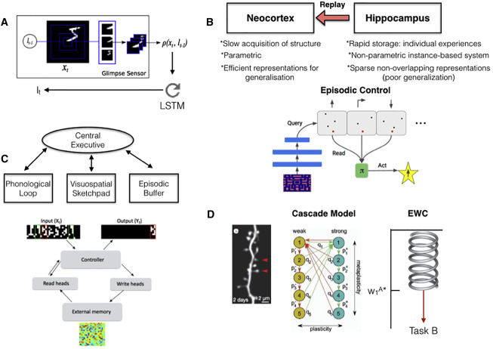
Block Diagram

Slide 10
SOFTWARE REQUIREMENTS:
Operating System : Windows 10
Platform : DOT NET TECHNOLOGY
Front End : ASP.Net 4.0
Back End : SQL SERVER 2014

Slide 11
HARDWARE REQUIREMENTS:
Keyboard
Mouse
Hard disk 500GB
Ram 4 Gb

Slide 12
CONCLUTION
This article has reviewed common bottlenecks encountered when applying gradient-based learning to neuromorphic architectures that require online computation of gradients. Using the example of SNNs, we have shown that many recently proposed learning algorithms for online learning are approximate variants of RTRL. In its exact form, RTRL is an online algorithm to compute gradients in RNNs, but it is computationally expensive. However, when used in combination with temporally local losses and biologically inspired neural architectures such as LIF neurons, it is possible to find effective approximations that reduce RTRL’s computational cost substantially while retaining good learning performance. We have shown that such approximations are inspired by biological neurons whose implicit recurrence structure induces block sparse or approximately block sparse Jacobians, allowing to speed up gradient computation while simultaneously reducing the memory footprint. These conceptual links expose a clear path forward toward building more efficient online learning algorithms for neuromorphic devices.

Slide 13
REFERENCE
[1] C. Mead, Analog VLSI and Neural Systems. Reading, MA: Addison-Wesley, 1989.
[2] C. S. Thakur, J. L. Molin, G. Cauwenberghs, G. Indiveri, K. Kumar, N. Qiao, J. Schemmel, R. Wang, E. Chicca, J. Olson Hasler et al., “Large-scale neuromorphic spiking array processors: A quest to mimic the brain,” Frontiers in neuroscience, vol. 12, p. 891, 2018.
[3] M. Davies, “Benchmarks for progress in neuromorphic computing,” Nature Machine Intelligence, vol. 1, no. 9, pp. 386–388, 2019.
[4] P. A. Merolla, J. V. Arthur, R. Alvarez-Icaza, A. S. Cassidy, J. Sawada, F. Akopyan, B. L. Jackson, N. Imam, C. Guo, Y. Nakamura et al., “A million spiking-neuron integrated circuit with a scalable communication network and interface,” Science, vol. 345, no. 6197, pp. 668–673, 2014.
[5] M. Davies, N. Srinivasa, T. H. Lin, G. Chinya, P. Joshi, A. Lines, A. Wild, and H. Wang, “Loihi: A neuromorphic manycore processor with on-chip learning,” IEEE Micro, vol. PP, no. 99, pp. 1–1, 2018.

Slide 14
[6] G. Indiveri, B. Linares-Barranco, T. Hamilton, A. van Schaik, R. Etienne-Cummings, T. Delbruck, S.-C. Liu, P. Dudek, P. Hafliger, S. Renaud, J. Schemmel, ¨ G. Cauwenberghs, J. Arthur, K. Hynna, F. Folowosele, S. Saighi, T. Serrano-Gotarredona, J. Wijekoon, Y. Wang, and K. Boahen, “Neuromorphic silicon neuron circuits,” Frontiers in Neuroscience, vol. 5, pp. 1–23, 2011.
[7] I. Goodfellow, Y. Bengio, and A. Courville, Deep learning. MIT press, 2016.
[8] T. P. Lillicrap, A. Santoro, L. Marris, C. J. Akerman, and G. Hinton, “Backpropagation and the brain,” Nature Reviews Neuroscience, pp. 1–12, Apr. 2020.
[9] R. Gutig and H. Sompolinsky, “The tempotron: a ¨ neuron that learns spike timing-based decisions,” Nat Neurosci, vol. 9, no. 3, pp. 420–428, Mar. 2006.
[10] S. M. Bohte, J. N. Kok, and J. A. La Poutre, “Spikeprop: ´ backpropagation for networks of spiking neurons.” in ESANN, 2000, pp. 419–424.

