Slide 1
Emotional Semantics-Preserved and Feature-Aligned CycleGAN for Visual Emotion Adaptation

Slide 2
Abstract
Thanks to large-scale labeled training data, deep neural networks (DNNs) have obtained remarkable success in many vision and multimedia tasks. However, because of the presence of domain shift, the learned knowledge of the well-trained DNNs cannot be well generalized to new domains or datasets that have few labels. Unsupervised domain adaptation (UDA) studies the problem of transferring models trained on one labeled source domain to another unlabeled target domain. In this article, we focus on UDA in visual emotion analysis for both emotion distribution learning and dominant emotion classification.

Slide 3
Specifically, we design a novel end-to-end cycle-consistent adversarial model, called CycleEmotionGAN++. First, we generate an adapted domain to align the source and target domains on the pixel level by improving CycleGAN with a multiscale structured cycle-consistency loss. During the image translation, we propose a dynamic emotional semantic consistency loss to preserve the emotion labels of the source images. Second, we train a transferable task classifier on the adapted domain with feature-level alignment between the adapted and target domains. We conduct extensive UDA experiments on the Flickr-LDL and Twitter-LDL datasets for distribution learning and ArtPhoto and Flickr and Instagram datasets for emotion classification. The results demonstrate the significant improvements yielded by the proposed CycleEmotionGAN++ compared to state-of-the-art UDA approaches.

Slide 4
Existing System
Existing methods mainly focus on a single-source setting, which cannot easily handle a more practical scenario of multiple sources with different distributions.
Although different sources are matched towards the target, there may exist significant mis-alignment across different sources.
MADAN also significantly outperforms source-combined DA, in which domain shift also exists among different sources. By bridging this gap, multi-source DA can boost the adaptation performance.
We can deem this performance as a upper bound of UDA. Obviously, a large performance gap still exists between all adaptation algorithms and the oracle method, requiring further efforts on DA.

Slide 5
Disadvantage of Existing System
In this paper, we study the unsupervised domain adaptation (UDA) problem of analyzing visual emotions in one labeled source domain and adapting it to another unlabeled target domain.
In this paper, we study the UDA problem in both image emotion classification and emotion distribution learning tasks.
Due to the complexity and subjectivity of emotions, we find the accuracies of all domain adaptation methods are not very high and effectively adapting image emotions is still a challenging problem.
Similar to GAN and CycleGAN based image generation methods, the proposed CycleEmotionGAN++ also suffers from low quality problem.

Slide 6
PROPOSED SYSTEM :
We conduct extensive experiments on the ArtPhoto and FI datasets, and the results demonstrate the superiority of the proposed CycleEmotionGAN model.
The optimization of the proposed CycleEmotionGAN model is achieved by alternating between two stochastic gradient descent (SGD) steps.
These results demonstrate that the proposed CycleEmotionGAN model can achieve superior performance relative to state-of-the-art approaches.
We propose to adapt image emotions from one source domain to a target domain in an unsupervised manner.

Slide 7
ADVANTAGE
A patch-level discriminator architecture has fewer parameters than a full-image discriminator and can work on arbitrarily-sized images in a fully convolutional fashion with good performance.
The performance comparisons between the proposed Cycle Emotion GAN++ model and state-of-the-art approaches.
The oracle method achieves the best performance on both emotion distribution learning and dominant emotion classification tasks.
Dynamic emotional semantic consistency loss boosts the performance by a large margin; after adding it, the performance improves significantly, proving that preserving the emotion label is of vital importance.
Each of these two components can improve the performance of the model trained in the source domain.

Slide 8
TITTLE | AUTHOR | DESCRIPTION
A bio-informational theory of emotional imagery | P. J. Lang, | A theory of emotional imagery is described which conceives the image in the brain to be a conceptual network, controlling specific somatovisceral patterns, and constituting a prototype for overt behavioral expression.
Real-time multimedia social event detection in microblog | S. Zhao, Y. Gao, G. Ding, and T.-S. Chua, | Detecting events from massive social media data in social networks can facilitate browsing, search, and monitoring of real-time events by corporations, governments, and users.

Slide 9
TITTLE | AUTHOR | DESCRIPTION
Largescale visual sentiment ontology and detectors using adjective noun pairs | D. Borth, R. Ji, T. Chen, T. Breuel, and S.-F. Chang, | The effort also leads to a large publicly available resource consisting of a visual sentiment ontology, a large detector library, and the training/testing benchmark for visual sentiment analysis.
Deep residual learning for image recognition | K. He, X. Zhang, S. Ren, and J. Sun, | We present a residual learning framework to ease the training of networks that are substantially deeper than those used previously.

Slide 10
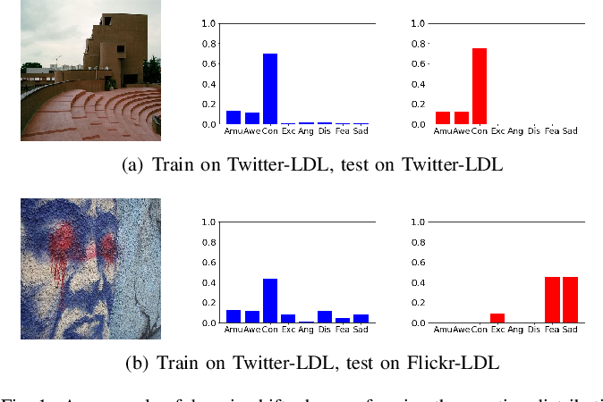
Block Diagram

Slide 11
SOFTWARE REQUIREMENTS:
Operating System : Windows 10
Platform : DOT NET TECHNOLOGY
Front End : ASP.Net 4.0
Back End : SQL SERVER 2014

Slide 12
HARDWARE REQUIREMENTS:
Keyboard
Mouse
Hard disk 500GB
Ram 4 Gb

Slide 13
CONCLUTION
In this paper, we studied the unsupervised domain adaptation (UDA) problem for both emotion distribution learning and dominant emotion classification. We proposed an end-to-end cycle-consistent adversarial model, CycleEmotionGAN++, to bridge the gap between different domains. We generated an adapted domain to align the source and target domains on the pixel-level by improving CycleGAN with a multi-scale structured cycle-consistency loss. During the image translation, we proposed dynamic emotional semantic consistency loss to preserve the emotion labels of the source images. We trained a transferable task classifier on the adapted domain with feature-level alignment between the adapted and target domains. We conducted extensive experiments on the FlickrLDL and Twitter-LDL datasets for emotion distribution learning, and the ArtPhoto and FI datasets for dominant emotion classification. The results on these four datasets demonstrate the significant improvements yielded by the proposed method over state-of-the-art UDA approaches. For future work, we plan to extend the CycleEmotionGAN++ model to multimodal settings, such as audio-visual emotion recognition. We will also investigate domain generalization without accessing target data for VEA and study theoretical deduction to better understand the learning process.

Slide 14
REFERENCE
[1] P. J. Lang, “A bio-informational theory of emotional imagery,” Psychophysiology, vol. 16, no. 6, pp. 495–512, 1979.
[2] S. Zhao, Y. Gao, G. Ding, and T.-S. Chua, “Real-time multimedia social event detection in microblog,” IEEE TCYB, vol. 48, no. 11, pp. 3218–3231, 2017.
[3] D. Borth, R. Ji, T. Chen, T. Breuel, and S.-F. Chang, “Largescale visual sentiment ontology and detectors using adjective noun pairs,” in ACM MM, 2013, pp. 223–232.
[4] K. He, X. Zhang, S. Ren, and J. Sun, “Deep residual learning for image recognition,” in CVPR, 2016, pp. 770–778.
[5] S. Zhao, Z. Jia, H. Chen, L. Li, G. Ding, and K. Keutzer, “Pdanet: Polarity-consistent deep attention network for finegrained visual emotion regression,” in ACM MM, 2019, pp. 192–201.

Slide 15
[6] S. Zhao, Y. Gao, X. Jiang, H. Yao, T.-S. Chua, and X. Sun, “Exploring principles-of-art features for image emotion recognition,” in ACM MM, 2014, pp. 47–56.
[7] K.-C. Peng, A. Sadovnik, A. Gallagher, and T. Chen, “A mixed bag of emotions: Model, predict, and transfer emotion distributions,” in CVPR, 2015, pp. 860–868.
[8] S. Zhao, H. Yao, Y. Gao, R. Ji, W. Xie, X. Jiang, and T.-S. Chua, “Predicting personalized emotion perceptions of social images,” in ACM MM, 2016, pp. 1385–1394.
[9] J. Yang, M. Sun, and X. Sun, “Learning visual sentiment distributions via augmented conditional probability neural network,” in AAAI, 2017, pp. 224–230.
[10] S. Zhao, G. Ding, Q. Huang, T.-S. Chua, B. W. Schuller, and K. Keutzer, “Affective image content analysis: A comprehensive survey.” in IJCAI, 2018, pp. 5534–5541.

