Slide 1
Robust Rank-Constrained Sparse Learning A Graph-Based Framework for Single View and Multiview Clustering

Slide 2
Abstract
Graph-based clustering aims to partition the data according to a similarity graph, which has shown impressive performance on various kinds of tasks. The quality of similarity graph largely determines the clustering results, but it is difficult to produce a high-quality one, especially when data contain noises and outliers. To solve this problem, we propose a robust rank constrained sparse learning (RRCSL) method in this article. The L2,1-norm is adopted into the objective function of sparse representation to learn the optimal graph with robustness. To preserve the data structure, we construct an initial graph and search the graph within its neighborhood. By incorporating a rank constraint, the learned graph can be directly used as the cluster indicator, and the final results are obtained without additional postprocessing. In addition, the proposed method cannot only be applied to single-view clustering but also extended to multiview clustering. Plenty of experiments on synthetic and real-world datasets have demonstrated the superiority and robustness of the proposed framework.

Slide 3
Existing System
When the data are contaminated with noise or outlier, the performance of existing methods will decline greatly because the original true data distribution is destroyed.
The most existing multiview graph learning approaches, they generally focus on the elegant graphs construction model and their corresponding multiview learning mechanism but ignore the data themselves, especially for uncertain noisy data.
However, the data quality restoration are not sufficiently and especially considered in the most existing multiview graph learning approaches.
Extensive experiments on four visual datasets demonstrate the superior and robustness of RMvSL compared with various existing excellent similarity graph learning approaches.

Slide 4
Disadvantage of Existing System
To alleviate this problem, some methods update the graph during the clustering procedure, such as clustering with adaptive neighbors (CANs), constrained Laplacian rank (CLR), and simplex sparse representation (SSR).
In this article, a robust rank constrained sparse learning (RRCSL) method is proposed to solve the above-mentioned problems.
There are various existing algorithms that can solve this problem effectively , such as the Lagrangian method.
This is because the RRCSL method has stronger ability on data representation compared with CAN and CLR, and it avoids the problem of SSR that the similarity graph is not unique.

Slide 5
PROPOSED SYSTEM :
Many multiview graph learning approaches are proposed and applied to clustering problem.
To address the two problems, a Robust Multiview Similarity Learning(RMvSL) method is proposed in this paper.
A multi-graph fusion scheme is proposed in for multiview clustering, which enforces the fusion graph to be approximated to original graph from each view but with an explicit cluster structure.
Multiview graph learning aims to learn a fusion graph from the different views, which can cover all the useful cues from all views and obtain further performance improvement.
With the proposed unified framework, each variable is not optimized in isolation during iteration.

Slide 6
ADVANTAGE
All these ensure that the RRCSL method achieves the best performance on all datasets.
Among numerous clustering techniques, graph-based clustering methods focus on the internal data structure, and have shown better performance.
Therefore, the clustering performance relies highly on the graph construction procedure.
Two widely used clustering performance measures are adopted to evaluate the clustering results, namely, accuracy (ACC) and normalized mutual information (NMI).
In this way, data can be classified directly and, therefore, the quality and efficiency of clustering have been improved.

Slide 7
TITTLE | AUTHOR | DESCRIPTION
Fast large-scale spectral clustering via explicit feature mapping | L. He, N. Ray, Y. Guan, and H. Zhang, | The main idea in our method consists of employing random Fourier features to explicitly represent data in kernel space.
A distributed fuzzy associative classifier for big data | A. Segatori, A. Bechini, P. Ducange, and F. Marcelloni, | Fuzzy associative classification has not been widely analyzed in the literature, although associative classifiers (ACs) have proved to be very effective in different real domain applications.

Slide 8
TITTLE | AUTHOR | DESCRIPTION
Locality adaptive discriminant analysis | X. Li, M. Chen, F. Nie, and W. Qi, | Linear Discriminant Analysis (LDA) is a popular technique for supervised dimensionality reduction, and its performance is satisfying when dealing with Gaussian distributed data
Triangle lasso for simultaneous clustering and optimization in graph datasets | Y. Zhao, K. Xu, E. Zhu, X. Liu, X. Zhu, and J. Yin, | We demonstrate through extensive numerical experiments that triangle lasso is robust to the imperfect data.

Slide 9
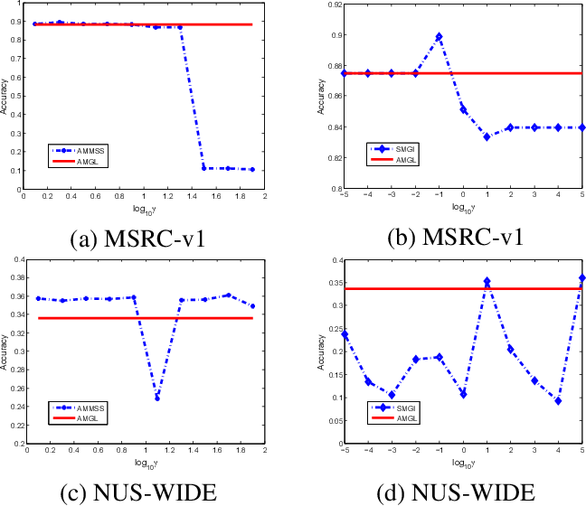
Block Diagram

Slide 10
SOFTWARE REQUIREMENTS:
Operating System : Windows 10
Platform : DOT NET TECHNOLOGY
Front End : ASP.Net 4.0
Back End : SQL SERVER 2014

Slide 11
HARDWARE REQUIREMENTS:
Keyboard
Mouse
Hard disk 500GB
Ram 4 Gb

Slide 12
CONCLUTION
In this article, we proposed a new graph-based RRCSL framework for both single-view and multiview clustering. In our method, the sparse representation with a rank constraint is adopted to learn the desired similarity graph, and a predefined graph is used to guide the graph learning procedure. Therefore, the obtained graph has more capability on data representation and relationship preservation. Besides, L2,1-norm is combined to reduce the impact of data noises and outliers. For multiview clustering, our adaptive distribution strategy of weights solves the problem that clustering is affected by the low-performing views. Extensive experiments on real-world datasets have demonstrated the superiority and robustness of the proposed framework.

Slide 13
REFERENCE
[1] L. He, N. Ray, Y. Guan, and H. Zhang, “Fast large-scale spectral clustering via explicit feature mapping,” IEEE Trans. Cybern., vol. 49, no. 3, pp. 1058–1071, Mar. 2019.
[2] A. Segatori, A. Bechini, P. Ducange, and F. Marcelloni, “A distributed fuzzy associative classifier for big data,” IEEE Trans. Cybern., vol. 48, no. 9, pp. 2656–2669, Sep. 2018.
[3] X. Li, M. Chen, F. Nie, and W. Qi, “Locality adaptive discriminant analysis,” in Proc. Int. Joint Conf. Artif. Intell., 2017, pp. 2201–2207.
[4] Y. Zhao, K. Xu, E. Zhu, X. Liu, X. Zhu, and J. Yin, “Triangle lasso for simultaneous clustering and optimization in graph datasets,” IEEE Trans. Knowl. Data Eng., vol. 31, no. 8, pp. 1610–1623, Aug. 2019.
[5] J. Xu, M. Yu, L. Shao, W. Zuo, and D. Zhang, “Scaled simplex representation for subspace clustering,” IEEE Trans. Cybern., vol. 51, no. 3, pp. 1493–1505, Mar. 2021.

Slide 14
[6] Y. Pang, J. Xie, F. Nie, and X. Li, “Spectral clustering by joint spectral embedding and spectral rotation,” IEEE Trans. Cybern., vol. 50, no. 1, pp. 247–258, Jan. 2020.
[7] M. Brbic and I. Kopriva, “ ´ L0-motivated low-rank sparse subspace clustering,” IEEE Trans. Cybern., vol. 50, no. 4, pp. 1711–1725, Apr. 2020.
[8] Y. Zhao, A. K. Shrivastava, and K. L. Tsui, “Regularized Gaussian mixture model for high-dimensional clustering,” IEEE Trans. Cybern., vol. 49, no. 10, pp. 3677–3688, Oct. 2019.
[9] J. Wen et al., “DIMC-Net: Deep incomplete multi-view clustering network,” in Proc. ACM Int. Conf. Multimedia, 2020, pp. 3753–3761.
[10] H. Fan, L. Zheng, C. Yan, and Y. Yang, “Unsupervised person reidentification: Clustering and fine-tuning,” ACM Trans. Multimedia Comput. Commun. Appl., vol. 14, no. 4, pp. 1–18, 2018.

