Slide 1
NPRACH-Aware Link Adaptation and Uplink Resource Allocation in NB-IoT Cellular Networks

Slide 2
Abstract
In narrowband Internet of Things (NB-IoT), a link adaptation technique can be performed, considering multiple resource unit types, repetition numbers, and modulation-coding schemes, to enhance transmission reliability. Then, a base station should allocate downlink and uplink resources for each device using the link adaptation decision to transmit data in NB-IoT frame structures. However, because narrowband physical random access channels (NPRACHs) will occupy the partial uplink radio resource, the uplink transmission of a device using the assigned uplink radio resource without considering NPRACHs will cause severe interference.

Slide 3
To solve the above issue, this article investigates the joint link adaptation and uplink resource allocation problem with the consideration of NPRACHs. The objective is to minimize the consumption of radio resources while the uplink data requirement of each device can be satisfied. We prove our target problem is NP -hard and cannot be approximated with a ratio better than 3/2 . Then, we propose a dynamic-programming algorithm without considering NPRACHs for the link adaptation problem and finally propose an uplink resource allocation algorithm considering NPRACHs based on the dynamic-programming algorithm. We prove that the proposed dynamic-programming algorithm with pseudo-polynomial time can find an optimal solution for the link adaptation problem. Compared with two previous algorithms, the simulation results show the efficacy of the proposed algorithm.

Slide 4
Existing System
These design changes earn IoT requirements while ensuring best co-existence performance with the existing LTE system.
It is expected that the time required for developing NB-IOT products will be positively reduced for existing LTE equipment and software vendors.
NB-IOT design is based on existing LTE functionalities, it is possible to use existing infrastructure for sites with newer equipment, only with software upgrade.
However, it is still challenging to incorporate the NB-IOT features such as repetition, low complexity (which affects channel estimation quality), and mobility in deploying the already existing LTE interference management techniques.

Slide 5
Disadvantage of Existing System
The problem is combinatorial due to the binary variables which can be converted to a convex problem using the well-known time-sharing property.
The rate maximization problems are well-known and they are non-convex due to the presence of a binary assignment variable and an interference term in the denominator.
The scope of this article is further extended to provide a novel approach for some of the issues of RRM design (i.e., inter-cell interference and asymmetric traffic between downlink and uplink) using recently introduced solutions as cooperative interference prediction (CIP) and flexible duplexing techniques.
In order to address this issue, in, the authors proposed a resource muting approach within the flexible duplexing framework.

Slide 6
PROPOSED SYSTEM :
They proposed an enhanced OLLA (eOLLA) scheme to adaptively modify the step size and to update the offset according to the reception conditions.
Therefore, optimal resource use techniques must be proposed that incorporate repetition, mobility, tones allocation, etc. for efficient spectrum usage.
Most of the proposed algorithms are power hungry because most of the power is consumed during transmission and reception.
The purpose of inner loop link adaptation is to guarantee the transmission BLER to the target.
The Repetition is the key solution adopted by NB-IOT to achieve enhanced coverage with low complexity.

Slide 7
ADVANTAGE
It is of utmost importance to evaluate the performance of NB-IoT in HetNets and to devise novel solutions for ICI mitigation, as traditional solutions might not be well suited to NB-IoT due to its limited bandwidth availability.
However, this raises serious concerns about the performance of the technology due to severe interference from multi-tier 5G heterogeneous networks (HetNets).
However, the performance evaluation is conducted in a single-cell scenario and the effect of ICI, retransmission, and control channel overhead have not been considered.
Retransmissions improve undoubtedly the packet reception reliability but at the cost of increased latency, reduced spectrum efficiency and battery life, due to overhead and redundancy.

Slide 8
TITTLE | AUTHOR | DESCRIPTION
Uplink Scheduling and Link Adaptation for Narrowband Internet of Things Systems | C. Yu, L. Yu, Y. Wu, Y. He, and Q. Lu, | In NB-IoT systems, repeating transmission data or control signals has been considered as a promising approach for enhancing coverage.
Enhancing coverage in narrow bandIoT using machine learning | M. Chafii, F. Bader, and J. Palicot, | In this work, we propose a new method for enhancing the NB-IoT coverage based on machine learning algorithms.

Slide 9
TITTLE | AUTHOR | DESCRIPTION
A Primer on 3GPP Narrowband Internet of Things | Y. P. E. Wang, X. Lin, A. Adhikary, A. Grovlen, Y. Sui, Y. Blankenship, J. Bergman, and H. S. Razaghi, | We also share the various design rationales during the standardization of NB-IoT in Release 13 and point out several open areas for future evolution of NB-IoT.
A survey on NBIoT downlink scheduling: Issues and potential solutions | R. Boisguene, S. Tseng, C. Huang, and P. Lin, | The NarrowBand Internet of Things (NB-IoT) is one of the most promising technologies that fits the requirements of the low-power wide area networks (LPWAN).

Slide 10
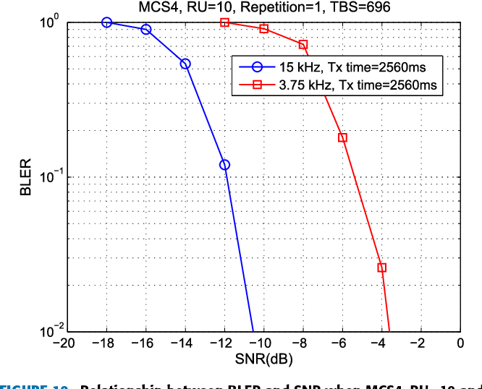
Block Diagram

Slide 11
SOFTWARE REQUIREMENTS:
Operating System : Windows 10
Platform : DOT NET TECHNOLOGY
Front End : ASP.Net 4.0
Back End : SQL SERVER 2014

Slide 12
HARDWARE REQUIREMENTS:
Keyboard
Mouse
Hard disk 500GB
Ram 4 Gb

Slide 13
CONCLUTION
NB-IoT is a promising technology for enabling future IoT applications. However, scarce system bandwidth and frequency sharing with LTE raise several challenging issues that need to be addressed in order to exploit fully the potential of this technology. This paper highlighted some of the major RRM issues that need to be tackled for achieving the maximum spectral efficiency. Moreover, the paper also presented a novel RRM framework specifically designed for NB-IoT and exploiting the CIP and flexible duplexing techniques for addressing those issues. Simulation results show that the proposed framework mitigates significantly the impact of ICI, reduces the retransmissions, accommodate asymmetric traffic and improve the overall spectrum resource utilization. It is observed that with the proposed RRM framework up to 14% improvement in terms of information rate and 58% reduction in resource wastage can be achieved.

Slide 14
REFERENCE
[1] “3GPP TR45.820: Cellular System Support for Ultra Low Complexity and Low Throughput Internet of Things,” Tech. Rep., 2015.
[2] “3GPP R1157199: NB-IoT Initial analysis of PRACH capacity ,” Tech. Rep., 2015.
[3] C. Yu, L. Yu, Y. Wu, Y. He, and Q. Lu, “Uplink Scheduling and Link Adaptation for Narrowband Internet of Things Systems,” in IEEE Access, vol. 5, pp. 1724–1734, 2017.
[4] M. Chafii, F. Bader, and J. Palicot, “Enhancing coverage in narrow bandIoT using machine learning,” in IEEE Wireless Communications and Networking Conference (WCNC), 2018, pp. 1–6.
[5] Y. P. E. Wang, X. Lin, A. Adhikary, A. Grovlen, Y. Sui, Y. Blankenship, J. Bergman, and H. S. Razaghi, “A Primer on 3GPP Narrowband Internet of Things,” IEEE Communications Magazine, vol. 55, no. 3, pp. 117– 123, 2017.

Slide 15
[6] R. Boisguene, S. Tseng, C. Huang, and P. Lin, “A survey on NBIoT downlink scheduling: Issues and potential solutions,” in 13th International Wireless Communications and Mobile Computing Conference (IWCMC), 2017, pp. 547–551.
[7] R. C. J. Neto, E. B. Rodrigues, and C. T. Oliveira, “Performance Analysis of Resource Unit Configurations for M2M Traffic in the Narrowband-IoT System,” in 35th Brazilian Communications and Signal Processing Symposium, 2017.
[8] H. Malik, H. Pervaiz, M. M. Alam, Y. Le Moullec, A. Kuusik, and M. A. Imran, “Radio Resource Management Scheme in NB-IoT Systems,” in IEEE Access, vol. 6, pp. 15 051–15 064, 2018.
[9] H. Malik, M. Ghoraishi, and R. Tafazolli, “Cross-layer approach for asymmetric traffic accommodation in full-duplex wireless network,” in European Conference on Networks and Communications (EuCNC), 2015, pp. 265–269.
[10] K. Balachandran, J. H. Kang, K. Karakayali, and K. M. Rege, “Flexible duplex in FDD spectrum,” in IEEE International Conference on Communications Workshops (ICC Workshops), 2017, pp. 296–301.

