Slide 1
ITCN An Intelligent Trust Collaboration Network System in IoT

Slide 2
Abstract
Artificial Intelligence (AI) technology has been widely applied to Internet of Thing (IoT) and one of key applications is intelligence data collection from billions of IoT devices. However, many AI based data collection approaches lack security considerations leading to availability restricted. In this paper, an Intelligent Trust Collaboration Network System (ITCN) is established to collect data through collaboration with mobile vehicles and Unmanned Aerial Vehicle (UAV) for IIoT. The first, a deadline-aware data collection collaboration network framework is proposed by collaboration with mobile vehicles and UAV. The second, an active and verifiable trust evaluation approach is proposed to obtain the trust of the data participants, which ensures the security and privacy of the system. The last, a trust joint AI based UAV trajectory optimization algorithm is proposed to collect as much baseline data as possible, so more trust of data participants can be accurately evaluated and the data can be collected before deadline at low cost. The simulation results show that ITCN reduces the cost by 35.08% compared with using the UAV only, saves the collection time by 58.32% and increases the accuracy by 33.34% on average compared with the previous strategies only using vehicles.

Slide 3
Existing System
A workflow process specifying a blueprint flow description was taken into consideration to fulfill the existing facility in the intelligent house condition.
It consisted of employing the chart concept to explain a shorter response period and combine the service with existing methods.
Industrial IoT targets existing automated industrial systems looking for dramatic improvements in productivity and efficiency.
It has stated that various IoT applications still need to be exploited, such as blockchain technology, in order to maintain transaction information, enhance the existing structure performance, or develop next-generation systems.

Slide 4
Disadvantage of Existing System
The process includes perceiving, recognizing, and reasoning for intuitive problem solving and decision-making.
Therefore, it is crucial to understand the evolution and equally essential to identify potential security vulnerabilities and issues to offer mitigation towards success.
Transportation systems constitute an indispensable part of modern life that plays a critical role in coordinating all forms of transport and related traffic to offer safety by tackling a range of challenging issues.
Novel ICT-enabled technologies are irresistibly integrating into automobiles to improve driving experiences and tackle some burning issues, such as traffic congestion, road accident, and other road fatalities that causes death and property lost.

Slide 5
PROPOSED SYSTEM :
The proposed structure has been evaluated by designing a wearable device as a prototype, as well as receiver units.
It can be seen that the data the proposed approach is able to deliver enhanced the data rate and lowered the energy consumption and packet loss.
The presented facility structure utilized the data mining categorization process to evaluate the possibility of the proposed approach.
In order to assess the proposed approach, three IoT application situations involving wearable devices, the smart home, and the smart city were studied.
However, the proposed model does not consider security protocols, but appears to be advantageous for making the process more useful and secure.

Slide 6
ADVANTAGE
The control services are responsible for determining system performances by utilizing a variety of different facilities such as network optimization, resource allocation, network-wide Security, etc.
However, when a remote node is compromised, it may simply return random results without running any computation, which may hamper the performance and the responsiveness of the object detection application.
Interaction and cooperation among multiple cloud service providers (CSPs) as a single cloud would not provide all devices with satisfactory quality of services due to performance and the high cost of cloud deployment or country policy.
Although a significant improvement in automation and connectivity is observed, IoV based model is still inefficient due to the lack of technical sophistication to reduce the road causalities to zero.

Slide 7
TITTLE | AUTHOR | DESCRIPTION
GNSS Time Synchronisation in Co-operative Vehicular Networks | K. F. Hasan, | Time synchronization is critical for the operation of distributed systems in networked environments.
Internet of Things (IoT): Opportunities, issues and challenges towards a smart and sustainable future | S. Nižetić, P. Šolić, D. L.-d.-I. González-de, and L. Patrono, | The focus of the conference was directed towards key conference tracks such as Smart City, Energy/Environment, e-Health and Engineering Modelling.

Slide 8
TITTLE | AUTHOR | DESCRIPTION
Cognitive internet of vehicles | M. Chen, Y. Tian, G. Fortino, J. Zhang, and I. J. C. C. Humar, | In this paper, an innovative paradigm called Cognitive Internet of Vehicles (CIoV) is proposed to help address the aforementioned challenge.
Critical reasons for crashes investigated in the national motor vehicle crash causation survey | S. Singh, | Databases such as the National Automotive Sampling System (NASS) Crashworthiness Data System (CDS) do not provide information on pre-crash scenarios and the reasons underlying the critical pre-crash events.

Slide 9
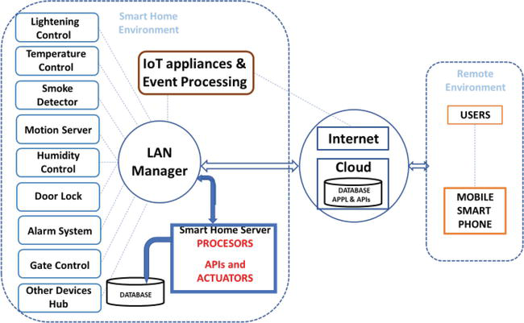
Block Diagram

Slide 10
SOFTWARE REQUIREMENTS:
Operating System : Windows 10
Platform : DOT NET TECHNOLOGY
Front End : ASP.Net 4.0
Back End : SQL SERVER 2014

Slide 11
HARDWARE REQUIREMENTS:
Keyboard
Mouse
Hard disk 500GB
Ram 4 Gb

Slide 12
CONCLUTION
The advent of artificial intelligence and cloud computing has brought some new prospects for the transportation system's future realization. Simultaneously, new technology faces unique challenges due to the heterogenic structure and critical nature of the transportation system and its application. This chapter presents an overview of the future transportation expectation. Systematically it illustrates the evolution of Intelligent Transportation System, including the recent development of the smart city-centric framework Cognitive Internet of Vehicles. Later it covers the Security, Privacy, and Trust issues related to the emerging intelligent transportation system. More specifically, it discussed the enabling security supports by the evolved framework and the potential attack surface that extends due to the multifarious communication. Overall, the chapter deduced that CIoV has the potential to meet great expectations by understanding that the technologies involved with the new integrated Cognitive engine will provide significant benefits that can reduce human errors and fatal crashes. This chapter indicates that it has potential for much wide use of cognitive engine technology and therefore further need to explore.

Slide 13
REFERENCE
[1] K. F. Hasan, "GNSS Time Synchronisation in Co-operative Vehicular Networks," Queensland University of Technology, 2018.
[2] A. B. o. Statistics. Motor Vehicle Census, Australia [Online]. Available: https://www.abs.gov.au/ausstats/abs@.nsf/mf/9309.0
[3] W. E. Forum, "The number of cars worldwide is set to double by 2040," World Economic Forum, USA2016 2016. Available: https://www.weforum.org/agenda/2016/04/the-number-of-cars-worldwide-is-set-to-double-by-2040
[4] S. Nižetić, P. Šolić, D. L.-d.-I. González-de, and L. Patrono, "Internet of Things (IoT): Opportunities, issues and challenges towards a smart and sustainable future," Journal of Cleaner Production, vol. 274, p. 122877, 2020.
[5] M. Chen, Y. Tian, G. Fortino, J. Zhang, and I. J. C. C. Humar, "Cognitive internet of vehicles," vol. 120, pp. 58-70, 2018.

Slide 14
[6] S. Singh, "Critical reasons for crashes investigated in the national motor vehicle crash causation survey," 2015.
[7] K. F. Hasan, T. Kaur, M. M. Hasan, and Y. Feng, "Cognitive internet of vehicles: Motivation, layered architecture and security issues," in 2019 International Conference on Sustainable Technologies for Industry 4.0 (STI), 2019, pp. 1-6.
[8] T. Lozano-Perez, Autonomous robot vehicles: Springer Science & Business Media, 2012.
[9] W. Xu, H. Zhou, N. Cheng, F. Lyu, W. Shi, J. Chen, et al., "Internet of vehicles in big data era," IEEE/CAA Journal of Automatica Sinica, vol. 5, pp. 19-35, 2017.
[10] J. Contreras-Castillo, S. Zeadally, and J. A. Guerrero-Ibañez, "Internet of vehicles: architecture, protocols, and security," IEEE internet of things Journal, vol. 5, pp. 3701-3709, 2017.

