Slide 1
Energy-efficient Offloading for Mission-critical IoT Services Using EVT-embedded Intelligent Learning

Slide 2
Abstract
Mobile edge computing (MEC) is a promising technique to alleviate the energy limitation of Internet of things (IoT) devices, as it can offload local computing tasks to the edge server through a cellular network. By leveraging extreme value theory (EVT), this work proposes a priority-differentiated offloading strategy that takes into account the stringent quality of service (QoS) requirements of mission-critical services and green resource allocation. Particularly, Lyapunov optimization is first introduced to derive an upper-bound queue minimization problem with the consideration of energy consumption and task priority. The peaks-over-thresholds (POT) model is then applied to evaluate the stationery status and cooperate with Wolf-PHC learning to optimize resource allocation. Finally, simulation results verify that the proposed offloading policy performs well in terms of its energy-saving capability while satisfying different demands of mission-critical IoT services.

Slide 3
Existing System
Increasing interconnections and usage of power networks makes the system to work at almost full loading capacities. Any type of disturbance in such scenario results in congestion of the existing network.
In this paper we define Educational Data Learning Analytics and discussed about existing tools, how the stack holders can make use of it for student success.
The existing systems apply cryptographic methods at a fine-grained access control and data sharing levels for the services of dynamic user groups in cloud, but it poses to be a challenging issue.
The world of automation has already being into existence for prolong period which results in various researches and industries to develop commercial products.

Slide 4
Disadvantage of Existing System
It is proved that the resource allocation problem for IoT devices under the fixed offloading strategy is convex.
The formulated multiple timescales problem has been solved by a sample average approximation (SAA) oriented technique.
We formulated the energy cost minimization problem for the short packets transmission for mission-critical IoT in MEC system, and revealed the effect of short packet transmission on radio resource management.
The minimization problem is a mixed integer non-linear programming (MINLP) problem, and it is challenging to solve this problem in the best way.

Slide 5
PROPOSED SYSTEM :
The proposed technique, comprehensive and energy efficient deep learning-based offloading technique (CEDOT), intelligently selects the partial offloading policy and also the size of each component of a task to reduce the service delay and energy consumption of UEs.
Due to the complexity and computation of the mathematical model in the algorithm being high, due to trained DNN the complexity and computation are minimized in the proposed work.
The proposed work considers all the important parameters in the cost function and generates a comprehensive training dataset with high computation and complexity.
The trained DNN is tested on unseen data to calculate the accuracy of the proposed technique.

Slide 6
ADVANTAGE
On this basis, an iterative algorithm is designed, whose performance is comparable to the best solution for exhaustive search, and aims to jointly optimize the offloading strategy and resource allocation.
In addition, to provide a comprehensive evaluation, a pair of system performance metrics are considered the convergence performance and the total energy consumption, respectively.
Therein, several sub-optimal solutions that achieve different leverages between the system performance and the time complexity are explored.
Thereof, the optimal joint optimization solution based on branch and bound method and two time-efficient suboptimal solutions are designed, respectively.

Slide 7
TITTLE | AUTHOR | DESCRIPTION
Energy efficient mimo relay transmissions via joint power allocations | C. Li, F. Sun, J.M. Cioffi, L. Yang, | By employing the high signal-to-noise ratio (SNR) approximation, the problem becomes suddenly a pseudo-convex optimization problem.
Overhearing-based co-operation for two-cell network with asymmetric uplink–downlink traffics | C. Li, J. Wang, F.-C. Zheng, J.M. Cioffi, L. Yang, | In this paper, a new transmission protocol is proposed for a two-cell network, where each cell, respectively, has one-uplink and one-downlink data traffic requirement.

Slide 8
TITTLE | AUTHOR | DESCRIPTION
Mobile edge computing: a key technology towards 5G | Y.C. Hu, M. Patel, D. Sabella, N. Sprecher, V. Young, | Mobile Edge Computing (MEC) is an emerging technology in 5G era which enables the provision of the cloud and IT services within the close proximity of mobile subscribers.
A survey on mobile edge computing: the communication perspective | Y. Mao, C. You, J. Zhang, K. Huang, K.B. Letaief, | This paper provides a comprehensive survey of the state-of-the-art MEC research with a focus on joint radio-and-computational resource management.

Slide 9
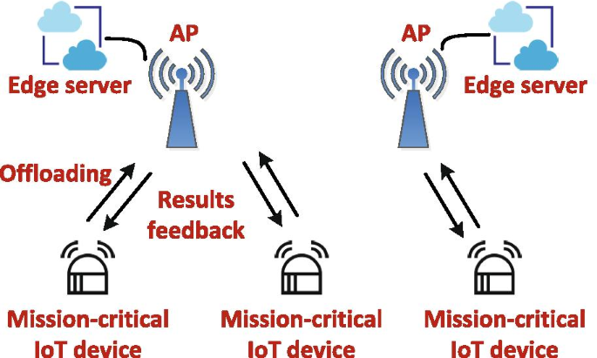
Block Diagram

Slide 10
SOFTWARE REQUIREMENTS:
Operating System : Windows 10
Platform : DOT NET TECHNOLOGY
Front End : ASP.Net 4.0
Back End : SQL SERVER 2014

Slide 11
HARDWARE REQUIREMENTS:
Keyboard
Mouse
Hard disk 500GB
Ram 4 Gb

Slide 12
CONCLUTION
In this paper, the energy cost minimization for mission-critical IoT in MEC system was studied. The formulated minimization problem is a MINLP problem, which has been decomposed into two sub-problems for analytical tractability, i.e., the task offloading decision-making sub-problem and the resource optimization sub-problem. We demonstrated that the resource management sub-problem of IoT devices under the fixed offloading strategy are convex and can be best solved by the existing convex optimization tools. On this basis, we showed that the optimal solution to the original optimization problem was attainable by an exhaustive search enabled approach, which suffered an exponentially increased time complexity. Thereafter, a time-efficient sub-optimal algorithm was designed, which was conducted in an iterative manner and had a provable convergence guarantee compared with a wide range of benchmark schemes, the simulation results show the effectiveness of our algorithm in terms of convergence and energy consumption. In the future, we will investigate the joint offloading decision and radio resource management for MEC-enabled IoT networks with ultra-low latency consideration. Besides, the optimization for AP deployment will be another important direction.

Slide 13
REFERENCE
1. C. Li, F. Sun, J.M. Cioffi, L. Yang, Energy efficient mimo relay transmissions via joint power allocations. IEEE Trans. Circuits Syst. 61(7), 531–535 (2014)
2. C. Li, J. Wang, F.-C. Zheng, J.M. Cioffi, L. Yang, Overhearing-based co-operation for two-cell network with asymmetric uplink–downlink traffics. IEEE Trans. Signal Inf. Process. Netw. 2(3), 350–361 (2016)
3. Y.C. Hu, M. Patel, D. Sabella, N. Sprecher, V. Young, Mobile edge computing: a key technology towards 5G. European Telecommunications Standards Institute (ETSI) White Paper (2015)
4. Y. Mao, C. You, J. Zhang, K. Huang, K.B. Letaief, A survey on mobile edge computing: the communication perspective. IEEE Commun. Surv. Tutor. 19(4), 2322–2358 (2017).
5.N. Abbas, Y. Zhang, A. Taherkordi, T. Skeie, Mobile edge computing: a survey. IEEE Internet Things J. 5(1), 450–465 (2018)

Slide 14
6.T.X. Tran, A. Hajisami, P. Pandey, D. Pompili, Collaborative mobile edge computing in 5g networks: new paradigms, scenarios, and challenges. IEEE Commun. Mag. 55(4), 54–61 (2017)
7.Y. Du, K. Wang, K. Yang, G. Zhang, Energy-efficient resource allocation in UAV based MEC system for IoT devices. In: IEEE Global Telecommunications Conference (Globecom) (2018), pp. 1–6
8.T.Q. Dinh, Q.D. La, T.Q. Quek, H. Shin, Learning for computation offloading in mobile edge computing. IEEE Trans. Commun. 66(12), 6353–6367 (2018)
9.W. Wen, Y. Fu, T.Q.S. Quek, F.-C. Zheng, S. Jin, Joint uplink/downlink sub-channel, bit and time allocation for multi-access edge computing. IEEE Commun. Lett. 23(10), 1811–1815 (2019)
10.Z. Yang, Y. Liu, Y. Chen, N. Al-Dhahir, Cache-aided NOMA mobile edge computing: a reinforcement learning approach. IEEE Trans. Wirel. Commun. (2020). https://doi.org/10.1109/TWC.2020.3006922

