Slide 1
Endogenous Trusted DRL-Based Service Function Chain Orchestration for IoT

Slide 2
Abstract
With the development of the Internet of Things, trust has become a limited factor in the integration of heterogeneous IoT networks. In this regard, we use the combination of blockchain technology and SDN/NFV to build a heterogeneous IoT network resource management model based on the consortium chain. In order to solve the efficiency problem caused by the full amount of data on the chain, we deploy light nodes and full nodes for the consortium chain. At the same time, we use the idea of identification to realize the separation of identification and resource information, build the application mode of on-chain identification and off-chain information, and realize resources endogenous trust management. We also propose a practical Byzantine fault-tolerant consensus mechanism based on reputation value to save consensus costs and improve efficiency. Combined with artificial intelligence technology, we introduce deep reinforcement learning for service function chain orchestration, and design a service function chain orchestration algorithm based on Asynchronous Advantage Actor-Critic to optimize orchestration costs. The final simulation results show that the consensus algorithm and service function chain orchestration algorithm we designed have good performance in terms of cost saving and efficiency improvement.

Slide 3
Existing System
THz based communications require rethinking of existing solutions and investigate novel approaches that offer a seamless operation over the entire THz band.
Various shortcomings in existing wireless communications has led to the foundation for the next generations. This paper provides a detailed survey on 6g wireless network.
Upcoming technologies such as artificial intelligence (AI), virtual reality, and the Internet of Everything (IOE) require low latency, ultrahigh data rates and reliability, for the uplink and downlink which cannot be satisfied by existing 5G‟s ubiquitous mobile ultra-broadband, ultrahigh-speedwith-low latency communications, and ultrahigh data density.

Slide 4
Disadvantage of Existing System
In order to overcome the interference problem, inter-cell cooperation has been studied in LTE under the name of coordinated multi-point (CoMP) transmissions or network MIMO.
The main problem is that while globally optimal policies are known and can be computed in principle (see, e.g.,for the max-min fairness policy), these policies do not scale neither in performance nor computationally.
In symbiotic radio networks, the user association problem can be solved with limited environmental information using DRL.
UAV communications involve some security and privacy problems such as eavesdropping and jamming. These problems may pose threats to personal information, so it needs to be comprehensively investigated.

Slide 5
PROPOSED SYSTEM :
In the framework of PoX, enormous alternative mechanisms have been proposed in terms of cost, eco-friendliness, fairness and performance.
Fast smart contract deployment (FSCD) is an advanced mechanism proposed for accelerating and securing the service in B-RAN .
By implementing the concept of template in smart contracts, the root contract in FSCD defines the service terms in detail, which is later automatically applied to all services.
In order to implement the proposed design and better test its performance, we assess the basic capability needs in B-RAN and construct a corresponding prototype.

Slide 6
ADVANTAGE
The key contribution of their study is to demonstrate how the presence of foveated rendering can improve the rendering performance by reducing the field of view.
It is necessary to optimize the performance of the cloud rendering pipeline.
The future C-V2X architecture should support the deterministic transmission, in additional to the enhanced performance of latency, reliability, and throughput. Synchronization is the premise.
These new technologies not only provide enhanced transmission performance, but also provide positioning, sensing, and 3D imaging capabilities.
Iterative processing is used in the SCC decoder, and a performance similar to that of a classic PCC may be achieved.

Slide 7
TITTLE | AUTHOR | DESCRIPTION
Cellular architecture and key technologies for 5G wireless communication networks | Wang C X, Haider F, Gao X Q, et al. | The fourth generation wireless communication systems have been deployed or are soon to be deployed in many countries.
The tactile Internet: applications and challenges | Fettweis G P. | Wireless communications today enables us to connect devices and people for an unprecedented exchange of multimedia and data content.

Slide 8
TITTLE | AUTHOR | DESCRIPTION
A vision of 6G wireless systems: applications, trends, technologies, and open research problems | Saad W, Bennis M, Chen M. | We then identify the enabling technologies for the introduced 6G services and outline a comprehensive research agenda that leverages those technologies.
6G technologies: key drivers, core requirements, system architectures, and enabling technologies | Zong B Q, Fan C, Wang X Y, et al. | The key drivers of 6G result not only from the challenges and performance limits that 5G presents but also from the technology-driven paradigm shift and the continuous evolution of wireless networks.

Slide 9
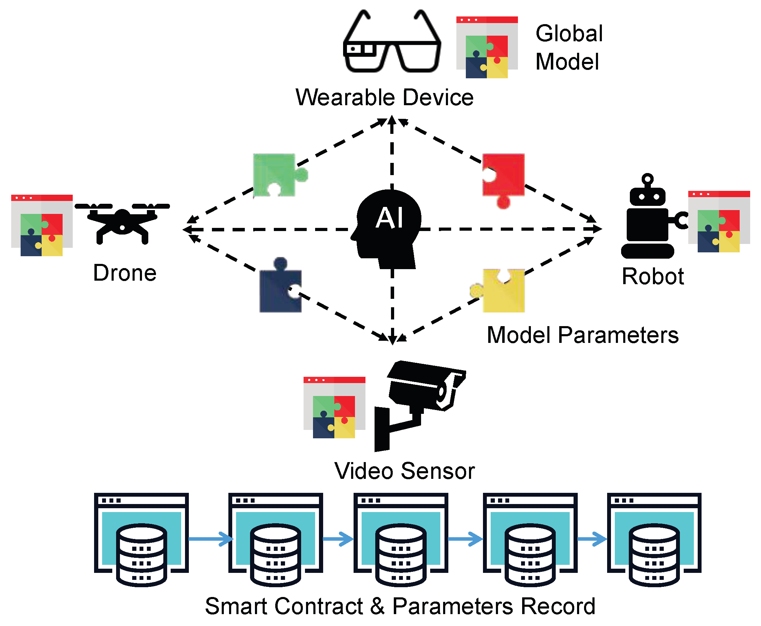
Block Diagram

Slide 10
SOFTWARE REQUIREMENTS:
Operating System : Windows 10
Platform : DOT NET TECHNOLOGY
Front End : ASP.Net 4.0
Back End : SQL SERVER 2014

Slide 11
HARDWARE REQUIREMENTS:
Keyboard
Mouse
Hard disk 500GB
Ram 4 Gb

Slide 12
CONCLUTION
In this comprehensive survey review, a vision, enabling technologies, four new paradigm shifts, and future research directions of 6G wireless communication networks have been proposed, after having pointed out the limitations of current 5G wireless communication networks. New performance metrics and application scenarios of 6G have been introduced, e.g., to provide global coverage, enhanced spectral/energy/cost efficiency, better intelligence level, security and resilience, etc. In addition, example industry verticals of 6G wireless communication networks have been given, with cloud VR, IoT industry automation, CV2X, digital twin body area network, and energy efficient wireless network control and federated learning systems as illustrations. The enabling technologies to meet the 6G requirements have been provided. Novel air interface and transmission technologies have been investigated, such as new waveforms, multiple access, channel coding, CF massive MIMO, dynamic and intelligent spectrum sharing and accessing, blockchain-based wireless accessing and networking, photonics defined radio, and MCo for uRLLC. Also, novel network architectures have been studied, including SDN/NFV, network slicing, SBA, CSA, DEN2 , CF, and cloud/fog/edge computing. The four new paradigm shifts, i.e., global coverage (satellite, UAV, terrestrial, maritime communications), all spectra (sub-6 GHz, mmWave, THz, optical frequency bands), full applications (AI-enabled wireless communications), and strong network security, have been proposed to achieve a fully integrated 6G network. Future research directions have also been pointed out in each part. We believe that this survey review can provide academic researchers and industry experts with sufficient insightful thoughts on the developments of future 6G wireless communication networks.

Slide 13
REFERENCE
1 Wang C X, Haider F, Gao X Q, et al. Cellular architecture and key technologies for 5G wireless communication networks. IEEE Commun Mag, 2014, 52: 122–130
2 Fettweis G P. The tactile Internet: applications and challenges. IEEE Veh Technol Mag, 2014, 9: 64–70
3 Saad W, Bennis M, Chen M. A vision of 6G wireless systems: applications, trends, technologies, and open research problems. IEEE Netw, 2020, 34: 134–142
4 Zong B Q, Fan C, Wang X Y, et al. 6G technologies: key drivers, core requirements, system architectures, and enabling technologies. IEEE Veh Technol Mag, 2019, 14: 18–27
5 Dang S, Amin O, Shihada B, et al. From a human-centric perspective: what might 6G be. https://arxiv.org/pdf/1906. 00741.pdf

Slide 14
6 ITU-R M.2083 report. IMT vision–framework and overall objectives of the future development of IMT for 2020 and beyond. https://www.itu.int/rec/R-REC-M.2083-0-201509-I/en
7 Chen S Z, Liang Y C, Sun S H, et al. Vision, requirements, and technology trend of 6G: how to tackle the challenges of system coverage, capacity, user data-rate and movement speed. IEEE Wirel Commun, 2020, 27: 218–228
8 Zhang Z Q, Xiao Y, Ma Z, et al. 6G wireless networks: vision, requirements, architecture, and key technologies. IEEE Veh Technol Mag, 2019, 14: 28–41
9 Yang P, Xiao Y, Xiao M, et al. 6G wireless communications: vision and potential techniques. IEEE Netw, 2019, 33: 70–75
10 Zhang L, Liang Y C, Niyato D. 6G visions: mobile ultra-broadband, super internet-of-things, and artificial intelligence. China Commun, 2019, 16: 1–14

