Slide 1
Harvesting Devices’ Heterogeneous Energy Profiles and QoS Requirements in IoT WPT-NOMA vs BAC-NOMA

Slide 2
Abstract
The next generation Internet of Things (IoT) exhibits a unique feature that IoT devices have different energy profiles and quality of service (QoS) requirements. In this paper, two energy and spectrally efficient transmission strategies, namely wireless power transfer assisted non-orthogonal multiple access (WPT-NOMA) and backscatter communication (Back-Com) assisted NOMA (BAC-NOMA), are proposed by utilizing this feature of IoT and employing spectrum and energy cooperation among the devices. In particular, the use of NOMA ensures that the devices with different QoS requirements can share the same spectrum, and WPT and Back-Com are employed to utilize the cooperation among the devices with different energy profiles, which avoids the use of a dedicated power beacon.

Slide 3
Furthermore, for the proposed WPT-NOMA scheme, the application of hybrid successive interference cancelation (SIC) decoding order is also considered, and analytical results are developed to demonstrate that WPT-NOMA can avoid outage probability error floors and realize the full diversity gain. Unlike WPT-NOMA, BAC-NOMA suffers from an outage probability error floor, and the asymptotic behavior of this error floor is analyzed in the paper by applying the extreme value theory. In addition, the effect of a unique feature of BAC-NOMA, i.e., employing one device’s signal as the carrier signal for another device, is studied, and its impact on the diversity gain is revealed. Simulation results are also provided to compare the performance of the proposed strategies and verify the developed analytical results.

Slide 4
Existing System
Existing research studies try to find a good trade-off between the information rate, the transmission delay, the constellation size, the distance between the nodes and the signal-to-noise ratio.
With this focus on mind, the work in surveys various existing solutions for secure data aggregation, classifying them based on the node topology and mechanisms employed for ensuring privacy.
Moreover, replacing batteries can be too difficult when severe environmental conditions exist.
LEACH is still the most important and most used basic routing algorithm for WSNs. After 18 years of existence, much attention is still devoted to LEACH by the research community working in the area of routing in WSN.

Slide 5
Disadvantage of Existing System
The analytical results developed in the paper show that this virtual fading is damaging to the reception reliability, and the diversity gain achieved by BAC-NOMA is capped by one.
We will show that this fast fading has a harmful impact on the outage probability.
In addition, the effect of using one device’s signal as the carrier signal was studied, and its harmful impact on the diversity gain was revealed.
We note that the provided simulation results show that the choice of α has a significant impact on the performance of WPT-NOMA, and therefore an important direction for future research is to develop low-complexity algorithms for optimizing α.

Slide 6
PROPOSED SYSTEM :
In, a novel protocol is proposed in which mobile terminals form a virtual MIMO uplink by means of device relaying on Device to Device (D2D) tier in 5G Cellular Networks.
In, applications of CMIMO are proposed in networks of intelligent transportation systems (ITS) for reducing the total energy consumption.
The scheme proposed is based on CMIMO-SM and its detailed energy consumption is compared with the traditional single-input-single-output (SISO) scheme.
Transmission Power Control (TPC) has been proposed in the literature to improve energy efficiency by adjusting the transmission power of the radio.

Slide 7
ADVANTAGE
In this paper, the outage performance of WPT-NOMA with hybrid SIC decoding order is analyzed, and the obtained analytical results demonstrate that outage probability error floors can be avoided and the full diversity gain is still achievable.
This feature of WPT-NOMA can lead to a potential performance loss compared BAC-NOMA which can support continuous data transmission.
In addition, the figures also demonstrate that the performance of BAC-NOMA can be improved by increasing M, i.e., inviting more delay-tolerant devices to participate in NOMA transmission is beneficial to improve reception reliability.
In, the outage probability is used as the metric for the performance evaluation, whereas the ergodic data rate is used as the metric .

Slide 8
TITTLE | AUTHOR | DESCRIPTION
Sparse code multiple access | H. Nikopour and H. Baligh, | Sparse Code Multiple Access (SCMA) enables non-orthogonal transmissions of multiple users’ signals among code and power domain, which could greatly improve the spectral efficiency.
System-level performance evaluation of downlink non-orthogonal multiple access (NOMA) | Y. Saito, A. Benjebbour, Y. Kishiyama, and T. Nakamura, | Based on computer simulations, we show under multiple configurations that the system-level performance achieved by NOMA is superior to that for OMA.

Slide 9
TITTLE | AUTHOR | DESCRIPTION
Simple semi-grantfree transmission strategies assisted by non-orthogonal multiple access | Z. Ding, R. Schober, P. Fan, and H. V. Poor, | Grant-free transmission is an important feature to be supported by future wireless networks since it reduces the signalling overhead caused by conventional grant-based schemes.
Deep reinforcement learning for throughput improvement of the uplink grant-free NOMA system | J. Zhang, X. Tao, H. Wu, N. Zhang, and X. Zhang, | In this work, we apply deep reinforcement learning (DRL) in the decision making for grant-free NOMA systems, to mitigate collisions and improve the system throughput in an unknown network environment.

Slide 10
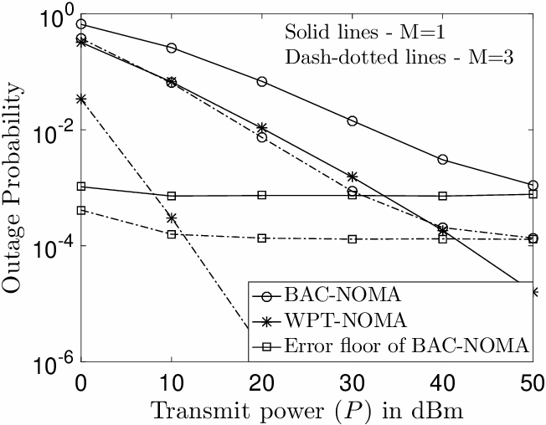
Block Diagram

Slide 11
SOFTWARE REQUIREMENTS:
Operating System : Windows 10
Platform : DOT NET TECHNOLOGY
Front End : ASP.Net 4.0
Back End : SQL SERVER 2014

Slide 12
HARDWARE REQUIREMENTS:
Keyboard
Mouse
Hard disk 500GB
Ram 4 Gb

Slide 13
CONCLUTION
In this paper, two energy and spectrally efficient transmission strategies, namely WPT-NOMA and BAC-NOMA, were proposed by employing the energy and spectrum cooperation among the IoT devices. For the proposed WPT-NOMA scheme, hybrid SIC decoding order was used to improve reception reliability, and the developed analytical results demonstrate that WPT-NOMA can avoid outage probability error floors and realize the full diversity gain. Unlike WPT-NOMA, BAC-NOMA suffers from an outage probability error floor, and the asymptotic behaviour of this error floor was analyzed in the paper by applying EVT. In addition, the effect of using one device’s signal as the carrier signal was studied, and its harmful impact on the diversity gain was revealed. In this paper, we have studied the two techniques from the communication perspective, and it is worth to point out that different hardware circuits are required by the two techniques. Therefore, comparing the two schemes using more sophisticated metrics from both the communication and circuit theories will be an important direction for future research.

Slide 14
REFERENCE
[1] Roadmap for IoT Research, Innovation and Development in Europe, EU NGIoT, Jan. 2020.
[2] Z. Ding, X. Lei, G. K. Karagiannidis, R. Schober, J. Yuan, and V. K. Bhargava, “A survey on non-orthogonal multiple access for 5G networks: Research challenges and future trends,” IEEE J. Sel. Areas Commun., vol. 35, no. 10, pp. 2181–2195, Oct. 2017.
[3] H. Nikopour and H. Baligh, “Sparse code multiple access,” in Proc. IEEE Int. Symp. Pers. Indoor Mobile Radio Commun., London, U.K., Sep. 2013, pp. 332–336.
[4] Y. Saito, A. Benjebbour, Y. Kishiyama, and T. Nakamura, “System-level performance evaluation of downlink non-orthogonal multiple access (NOMA) ,” in Proc. IEEE 24th Annu. Int. Symp. Pers., Indoor, Mobile Radio Commun. (PIMRC), London, U.K., Sep. 2013, pp. 611–615.
[5] Z. Ding, R. Schober, P. Fan, and H. V. Poor, “Simple semi-grantfree transmission strategies assisted by non-orthogonal multiple access,” IEEE Trans. Commun., vol. 67, no. 6, pp. 4464–4478, Jun. 2019.

Slide 15
[6] J. Zhang, X. Tao, H. Wu, N. Zhang, and X. Zhang, “Deep reinforcement learning for throughput improvement of the uplink grant-free NOMA system,” IEEE Internet Things J., vol. 7, no. 7, pp. 6369–6379, Jul. 2020.
[7] J. Choi, “NOMA-based compressive random access using Gaussian spreading,” IEEE Trans. Commun., vol. 67, no. 7, pp. 5167–5177, Jul. 2019.
[8] Z. Ding, R. Schober, and H. V. Poor, “A new QoS-guarantee strategy for NOMA assisted semi-grant-free transmission,” submitted to, IEEE Trans. Wireless Commun. [Online]. Available: http://arxiv.org/abs/2004.12997
[9] Z. Ding, R. Schober, and H. V. Poor, “Unveiling the importance of SIC in NOMA systems—Part 1: State of the art and recent findings,” IEEE Commun. Lett., vol. 24, no. 11, pp. 2373–2377, Nov. 2020.
[10] Z. Ding, R. Schober, and H. V. Poor, “Unveiling the importance of SIC in NOMA systems—Part II: New results and future directions,” IEEE Commun. Lett., vol. 24, no. 11, pp. 2378–2382, Nov. 2020.

