Slide 1
Reg Price Region-Based Pricing Scheme for Provisioning Safety-as-a-Service in IoT Applications

Slide 2
Abstract
In this paper, we propose a region-based pricing scheme, named as RegPrice, for provisioning safety-related decisions dynamically to the end-users. Typically, heterogeneous type of sensor nodes are present in the device layer of Safe-aaS. Considering the case of safety in road transportation, we compute the fixed and variable costs incurred in procurement, deployment, and maintenance for each of these different types of sensor nodes. We introduce the concept of tariff cost, which varies with the type of road in different regions and presence of similar homogeneous sensor nodes deployed in that region. Finally, we estimate the utility of a sensor node, which is a function of the sensing area, ratio of the fixed cost to total cost incurred, responsiveness factor, and rating given by an end-user for that sensor node. The SSPs provide rent to the sensor/vehicle owners for taking their sensor nodes on lease. In order to formulate the interactions among the SSPs and sensor owners, we apply first-price, sealed-bid auction-based game theoretic approach, where SSPs act as bidders. Exhaustive simulation results depict that the proposed pricing scheme, RegPrice, is capable of reducing the expenses of a SSP by 7.51% and 9.71% compared to the existing pricing schemes.

Slide 3
Existing System
The computer resources in Cloud exist as commodities distributed across geographical regions. In this paper, we use the term Cloud Compute Commodities (C3)) to address the Cloud resources, which may include CPU, bandwidth, storage etc.
All these studies have focused on investigating the existing prices or on how to derive cost savings for the users based on current prices mostly for reserved and on-demand customers.
The reserved services the negotiation on price may still exist, it does not provide much option than paying whatever is asked by the providers.
On other two instances the possibility of negotiation is very good and hence several optionality of service contracts exists.

Slide 4
Disadvantage of Existing System
We first show the impact of the sensing data buying price and service subscription fee to a profit of one service provider.
The concept of smart data pricing (SDP) has been introduced as an alterative to address network resource management issues.
Together with a large number of devices, data communication and networking become important issues that need further analysis and optimization to meet specific requirements of IoT.
However, an important issue is how to set the price that is profitable for the provider and attractive for mobile users.
We then consider the impact of the bundle. Here, we consider a symmetric setting of both providers for simplicity.

Slide 5
PROPOSED SYSTEM :
They showed that the statistical model they have proposed fits well with these data series and claim that they would be able to model the dynamics of spot price.
By developing a simple workflow engine, a scheduling algorithm based on GA and PSO is proposed into optimize the workflow execution.
In the authors have proposed a centralized decision based algorithm that adopts a game-theory approach to provide service to clients through cooperation as well as competition among the providers.
A market driven dynamic pricing mechanism is proposed in and revenue maximization for the providers is studied using dynamic programming.

Slide 6
ADVANTAGE
SDP is a new concept to enhance network performance and to support data management through using pricing incentives. For example, during a congestion period, dynamic pricing is used to defer some non-urgent users from accessing networks, improving QoS performance.
With SDP, data can be managed flexibly and efficiently through intelligent and adaptive incentive mechanisms.
The major benefits are to improve system efficiency and user satisfaction, enhance flexibility, safety, and security, and finally open new business opportunity and revenue stream.
Due to the flexibility and efficiency, cloud computing becomes a typical infrastructure to store and process a large amount of IoT data collected from devices and sensors.

Slide 7
TITTLE | AUTHOR | DESCRIPTION
Internet of Things (IoT): A vision, architectural elements, and future directions | J. Gubbi, R. Buyya, S. Marusic, and M. Palaniswami, | Ubiquitous sensing enabled by Wireless Sensor Network (WSN) technologies cuts across many areas of modern day living.
Business models for the Internet of things | E. Bucherer and D. Uckelmann, | This article provides theoretically and practically grounded assistance to companies that are today engaged primarily in non-digital industries in the development and implementation of business models that use the Internet of Things.

Slide 8
TITTLE | AUTHOR | DESCRIPTION
Smart data pricing: Economic solutions to network congestion | S. Sen, C. J. Wong, S. Ha, M. Chiang, | The telecommunications industry has long practiced dynamic TDP plans for voice calls to respond to demand variability in call volume by adjusting users’ prices/incentives.
Research Directions for the Internet of Things | J. A. Stankovic, | Many technical communities are vigorously pursuing research topics that contribute to the Internet of Things (IoT).

Slide 9
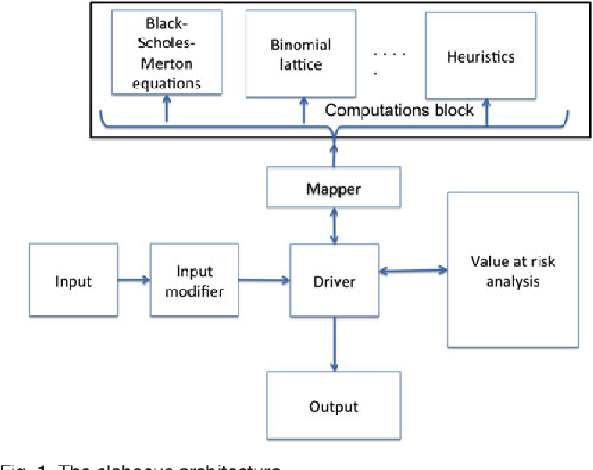
Block Diagram

Slide 10
SOFTWARE REQUIREMENTS:
Operating System : Windows 10
Platform : DOT NET TECHNOLOGY
Front End : ASP.Net 4.0
Back End : SQL SERVER 2014

Slide 11
HARDWARE REQUIREMENTS:
Keyboard
Mouse
Hard disk 500GB
Ram 4 Gb

Slide 12
CONCLUTION
In this article, we have considered smart data pricing (SDP) for IoT systems and services. We have first introduced an overview of IoT including its architecture, benefits, and business models. Then, we have reviewed some related work of applying SDP to IoT. We have proposed a new pricing scheme for IoT service providers taking into account sensing data buying and subscription with bundling. The numerical results have clearly shown that with bundling, multiple providers can form a coalition to achieve higher profit.

Slide 13
REFERENCE
[1] J. Gubbi, R. Buyya, S. Marusic, and M. Palaniswami, “Internet of Things (IoT): A vision, architectural elements, and future directions,” Future Generation Computer Systems, vol. 29, no. 7, pp. 1645-1660, September 2013.
[2] E. Bucherer and D. Uckelmann, “Business models for the Internet of things,” in Architecting the internet of things, pp. 253-277, Springer Berlin Heidelberg, 2011.
[3] S. Sen, C. J. Wong, S. Ha, M. Chiang, “Smart data pricing: Economic solutions to network congestion,” Communications of the ACM, 2014.
[4] R. Minerva, A. Biru, and D. Rotondi, “Towards a definition of the Internet of Things (IoT) ,” IEEE Technical Report, Revision 1, Published 27 May 2015.
[5] J. A. Stankovic, “Research Directions for the Internet of Things,” IEEE Internet of Things Journal, vol. 1, no. 1, pp. 3-9, February 2014.

Slide 14
[6] A. Osterwalder, and Y. Pigneur, “Business model generation: a handbook for visionaries, game changers, and challengers,” John Wiley & Sons, 2010.
[7] J. S. Lee and B. Hoh, “Sell your experiences: a market mechanism based incentive for participatory sensing,” in IEEE International Conference on Pervasive Computing and Communications, pp. 60-68, 2010.
[8] P. Samimi and A. Patel, “Review of pricing models for grid & cloud computing,” in IEEE Symposium on Computers & Informatics, pp. 634-639, Kuala Lumpur, Malaysia, March 2011.
[9] M. Mihailescu and Y. M. Teo, “Dynamic resource pricing on federated clouds,” in IEEE/ACM International Conference on Cluster, Cloud and Grid Computing, pp. 513-517, Melbourne, Australia, May 2010.
[10] U. Adeel, S. Yang, and J. A. McCann, “Self-optimizing citizen-centric mobile urban sensing systems,” in Proceedings of the 11th International Conference on Autonomic Computing, pp. 161-167, 2014.

