Slide 1
Economic performance of a grid-interactive system with storage under a dynamic electricity pricing environment

Slide 2
Abstract
This paper aims to evaluate the economic performance of a grid-connected system with storage under a dynamic electricity pricing environment with time-of-use (TOU) and feed-in electricity tariffs.
The storage can assist in the demand side management as well as to reduce the electricity bill of the consumers. In this case, consumers would purchase electricity during off-peak pricing periods to charge the batteries, and during peak pricing periods, the energy stored would be used to supply the demand or sold back to the grid.

Slide 3
Therefore, the two objectives are to minimize the cost of energy drawn from the utility, while maximizing the energy injected under the Time-of-Use and Feed-in-Tariff schemes.
Thereafter, the performance of the developed model to maximize the proposed grid-interactive system’s economic profitability is analysed through a case study which is simulated using Matlab.
Simulation results show that a potential of 52% energy cost saving can be achieved using the proposed system rather than supplying the load demand by the grid exclusively.

Slide 4
Existing System
In most of the developed countries, the market-oriented electricity arbitrage process is used to promote the development of energy storage systems. From the grid point of view, the presence of arbitrage allows the grid to shift peaking demand by regulating the electricity prices using different strategies such as the TOU .
However, an optimal energy control system is required to achieve minimal electricity cost by responding at the same time to the design and operational constraints of the system.

Slide 5
Disadvantages
Power shutdown problems
Voltage Fluxvation
Increase electricity bill

Slide 6
Proposed System
To help reduce their peak power demands and save money, many utilities are introducing programs that encourage their customers to use electricity during off-peak hours. The programs pass on the savings to you, the customer, through rebates or reduced electricity rates.
Smart meters and home energy management systems allow customers to program how and when their home uses energy. Such programs might charge you the actual cost of power at any one time, ranging from high prices during times of peak demand to low prices during off-peak hours. If you are able to shift your power use to off-peak times -- such as running your dishwasher late in the evening -- these programs can save you money while helping your utility.

Slide 7
Advantages
No power Shutdown problem
Decrease Electricity Bill

Slide 8
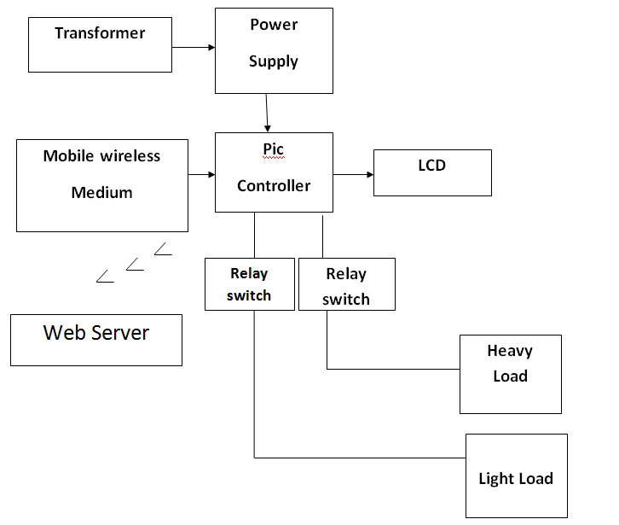
Block Diagram

Slide 9
Literature Survey
TITLE | AUTHOR | CONCEPT
A multi-objective market-driven framework for power matching in the smart grid." | Azar, Armin Ghasem, Mohsen Afsharchi, Mansoor Davoodi, and Bahram Sadeghi Bigham. | Smart grids, to facilitate the electricity production, distribution and consumption, employ information and communication technologies simultaneously.
"Low complexity energy management strategy for grid profile smoothing of a residential gridconnected microgrid using generation and demand forecasting | Arcos-Aviles, Diego, Julio Pascual, Francesc Guinjoan, Luis Marroyo, Pablo Sanchis, and Martin P. Marietta. | This paper presents the design of an energy management strategy based on a low complexity Fuzzy Logic Control (FLC) for grid power profile smoothing of a residential grid-connected microgrid including Renewable Energy Sources (RES) and battery Energy Storage System (ESS

Slide 10
Demand Side Management of a grid connected PV-WT-Battery hybrid system. | Phiri, S. F., and K. Kusakana. | Due to technological developments, some isolated areas, where consumers were supplied with electricity using standalone hybrid systems, are currently being connected to the grid
Energy management of a grid-connected hydrokinetic system under Time of Use tariff. | Katakana, Kanzumba. | In this work, the optimal power scheduling for a grid-connected hydrokinetic-battery hybrid system is proposed to sufficiently explore hydrokinetic energy and to benefit customers at demand side.

Slide 11
Software Requirements
Windows 7
PLC Ladder diagram or Ladder Login

Slide 12
Hardware Requirements
Transformer (230v to 12 v)
Power Supply Board
PLC Board
Grid
LCD Display

Slide 13
Reference
[1 ] Azar, Armin Ghasem, Mohsen Afsharchi, Mansoor Davoodi, and Bahram Sadeghi Bigham. "A multi-objective market-driven framework for power matching in the smart grid.
[2] Arcos-Aviles, Diego, Julio Pascual, Francesc Guinjoan, Luis Marroyo,Pablo Sanchis, and Martin P. Marietta. "Low complexity energy management strategy for grid profile smoothing of a residential grid connected micro grid using generation and demand forecasting."
[3] Phiri, S. F., and K. Kusakana. "Demand Side Management of a grid connected PV-WT-Battery hybrid system.

Slide 14
[4] Kusakana, Kanzumba. "Energy management of a grid-connected hydrokinetic system under Time of Use tariff.
[5 ] Kusakana, K. "Minimum cost solution of isolated battery-integrated diesel generator hybrid systems.
6] Kusakana, K., and H. J. Vermaak. "Hybrid Photovoltaic-Wind system as power solution for network operators in the DR Congo."
[7] Lin, Boqiang, and Wei Wu. "Economic viability of battery energy storage and grid strategy: A special case of China electricity market."
[8] Numbi, B. P., and S. J. Malinga. "Optimal energy cost and economic analysis of a residential grid-interactive solar PV system-case of eThekwini municipality in South Africa."

