Slide 1
Medical Data Security using Block Chain Technology

Slide 2
Abstract
The health care services industry is always showing signs of change and supporting new advancements and advances.
One of the predominant requirements in today's health care systems is to protect the patient's medical report against potential attackers.
Hence, it is basic to have secure information that can just approve people can get to the patient's medical report. So, We have proposed Block chain technology as a disbursed approach to grant security in accessing the medical report of a patient.

Slide 3
It's composed of three 1. Authentication, 2. Encryption and 3. Data Retrieval using Block Chain technology.
For authentication - Quantum Cryptography, for Encryption - AES and for Data Retrieval - SHA algorithms are used to resist the frequent attacks.
This proposed framework may likewise ensure the protection of the patients and moreover keeps up the security and trustworthiness of the health care system.

Slide 4
OBJECTIVE
To Protect Medical data’s from unauthorized user or hackers using Block Chain Crypto System

Slide 5
Existing System
The existing systems are poor in processing large volumes of multi-structured healthcare data with less security using AES Algorithum and not providing accurate health recommendation data.

Slide 6
Disadvantage of Existing System
Problem transformation method ﬁrst transforms one multilabel dataset into multiple single-label datasets, and then exploits existing single-label learning algorithm to process each single-label dataset.

Slide 7
PROPOSED SYSTEM :
The main aim of this research is to provide secure management in accessing the medical records using block chain technology by unique identification of the data security.
Using Block Chain Crypto System Algorithm the laboratory test data and basic information of patients are Encrypted.
The clinical dataset is an information system that offers knowledge and personalized information to users in enhancing health and healthcare outcomes .

Slide 8
ADVANTAGE
Using Crypto System the data of each patient are secured with crypto currency encryption process.
A novel framework is proposed for retrieving the most relevant information of patients from multiple data sources,.
such as laboratory test data, basic information of patients, symptoms of patients and electrocardiogram data, and for combining them to generate integrated features.

Slide 9
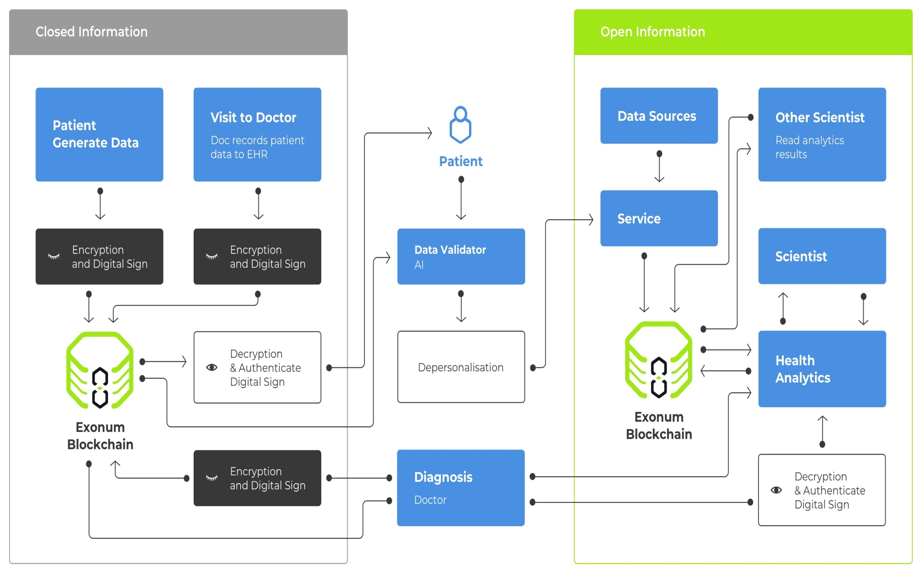
Architecture Diagram

Slide 10
Literature Review
Paper -I
1.Blockchain: A panacea for healthcare cloud-based data security and privacy
Technology Used:
Public key encryption and DUKPT is used.
Methodology:
Health Information is considered the most sensitive information associated to an individual.
Limitations:
Various authentication procedures that uniquely recognize users and restrict access to the resources

Slide 11
Paper-II
2. Authentication and Access Control in e-Health Systems in the Cloud
Technology Used:
Public key encryption and DUKPT is used.
Methodology:
Health Information is considered the most sensitive information associated to an individual.
Limitations:
Various authentication procedures that uniquely recognize users and restrict access to the resources

Slide 12
Paper-III
3. Big data security and privacy in healthcare : A review
Technology Used :
Big data
Methodology:
state-of-the-art security and privacy issues in big data as applied to healthcare industry and discuss some available data privacy, data security, users’ accessing mechanisms and strategies.
Limitations:
Need Large memory hardisk

Slide 13
Paper-IV
4. Metrics for assessing block chain-based healthcare de-centralized apps
Technology Used :
pseudo-anonymous transactions
Methodology:
Smart contracts are built atop a blockchain to support on-chain storage and enable Decentralized Apps (DApps) to interact with the blockchain programatically.
Limitations:
Programmable blockchains have generated interest in the healthcare domain as a potential solution to resolve key challenges, such as gapped communications, inefficient clinical report delivery, and fragmented health records

Slide 14
Paper-V
  5. Block chain technology in healthcare: The revolution starts here
Technology Used :
Block chain
Methodology:
Block chain technology has shown its considerable adaptability in recent years as a variety of market sectors sought ways of incorporating its abilities into their operations
Limitations:
While so far most of the focus has been on the financial services industry, several projects in other service related areas such as healthcare show this is beginning to change.

Slide 15
SOFTWARE REQUIREMENTS:
Operating system : Windows XP/7.
Coding Language : Asp.Net
IDE : .Net Framwork3.5
Database : Mssql2008

Slide 16
HARDWARE REQUIREMENTS:
System : I3 Processer
Hard Disk : 500 GB.
Monitor : 15 VGA Colour.
Mouse :
Ram : 2 Gb

