Slide 1
Predictive Estimation of Optimal Signal Strength from Drones over IoT Frameworks in Smart Cities

Slide 2
Abstract
The integration of drones, IoT, and AI domains can produce exceptional solutions to today's complex problems in smart cities. A drone, which essentially is a data-gathering robot, can access geographical areas that are difficult, unsafe, or even impossible for humans to reach. In this paper, an intelligent technique is proposed to predict the signal strength from a drone to IoT devices in smart cities in order to maintain the network connectivity, provision the desired QoS, and identify the drone coverage area. An ANN based efficient and accurate solution is presented to predict the signal strength from a drone based on several pertinent factors like drone altitude, path loss, etc. Furthermore, the signal strength estimates are then used to predict the drone flying path. The findings show that the proposed ANN technique has achieved good agreement with the validation data generated via simulations, yielding determination coefficient R2 to be 0.96 and 0.98, for variation in drone height and distance from a drone, respectively. Therefore, the proposed ANN technique is reliable, useful, and fast to estimate the signal strength, determine the optimal drone flying path and predict the next location based on received signal strength.

Slide 3
Existing System
Drones are attractive for emergency communication because of the possibility of rapid deployment and users operating them from their existing mobile handsets in disaster zones.
In particular, when flying drones are used, they can support the connectivity of existing terrestrial wireless networks such as cellular and broadband networks.
A variety of research work addresses the wide range of IoT technologies existing or even under standardization that would need to be integrated into the future communication network.
Instead of inventing new energy resources for UAVs, new research has been shifting towards better utilization of existing energy resources.

Slide 4
Disadvantage of Existing System
The UAV can enable the communication services, while the wireless communication networks are damaged during disaster.
The impacts of environment will destroy the signal by reflection, diffraction, and scattering, while as make signal weak.
During transmission signal, the signal strength suffers from dynamics of the atmosphere and the environment impacts such as scattering, diffraction, reflection, and shadowing of electromagnetic waves, which can powerfully distort the signals.
Therefore, we investigate the impact of a limited number of signal strength measurements on the accuracy of coverage prediction and estimation of propagation parameters.

Slide 5
PROPOSED SYSTEM :
The proposed network architecture, that is, the integration of drones, IoT and smart wearable devices, offers numerous services like supporting disaster relief team to save human lives, long-distance communication, greening communication, etc.
A mobile ad hoc network (MANET) is proposed to connect the drones and responders to perform tasks efficiently.
Recommendations for WSN and UAV have been made based on the proposed classification of three stages of disaster management, i.e., pre-disaster preparedness, disaster assessment, disaster response and recovery.
Effective iterative lowcomplexity algorithms have been proposed to solve the optimization problems associated with these types of relay networks .

Slide 6
ADVANTAGE
Therefore, the performance of communication link among the drones and other robots on the ground get more degradation and attenuation.
Regarding indoor environments neuro-fuzzy is proposed to simulate the propagation model for predicting RSS and comparing the performance with empirical models of channels.
The path loss information may be used as a controlling factor for system performance or coverage.
The primary application of analytically of the channel is the ability to optimize the performance of the smart UAV rapidly.
They are already beginning to efficiently replace that connected sensors at stationary with one device which has most essential features such as easy to deploy, flexible payloads, reprogrammable, measure anything at any time in anywhere.

Slide 7
TITTLE | AUTHOR | DESCRIPTION
Software Defined Integrated Satellite-Terrestrial Network: A Survey | Y. Miao, Z. Cheng, W. Li, H. Ma, X. Liu, and Z. Cui, | In this paper, we started introducing the SDN-based integrated satellite-terrestrial network architecture and discuss the unified and simple system functional architecture.
Broadband Hybrid Satellite-Terrestrial Communication Systems Based on Cognitive Radio toward 5G | M. Jia, X. Gu, Q. Guo, W. Xiang, and N. Zhang, | The development of 5G terrestrial mobile communications technology has been a driving force for revolutionizing satellite mobile communications.

Slide 8
TITTLE | AUTHOR | DESCRIPTION
Implementation of call admission control technique in HAP for enhanced QoS in wireless network deployment | S. Alsamhi and N. Rajput, | Exponential growth in the number of subscribers of mobile communication services has prompted service providers to maintain high level of quality of service (QoS).
Wide-area wireless communication challenges for the Internet of Things | H. S. Dhillon, H. Huang, and H. Viswanathan, | In this paper, we motivate the need for wide-area M2M wireless networks, especially for short data packet communication to support a very large number of IoT devices.

Slide 9
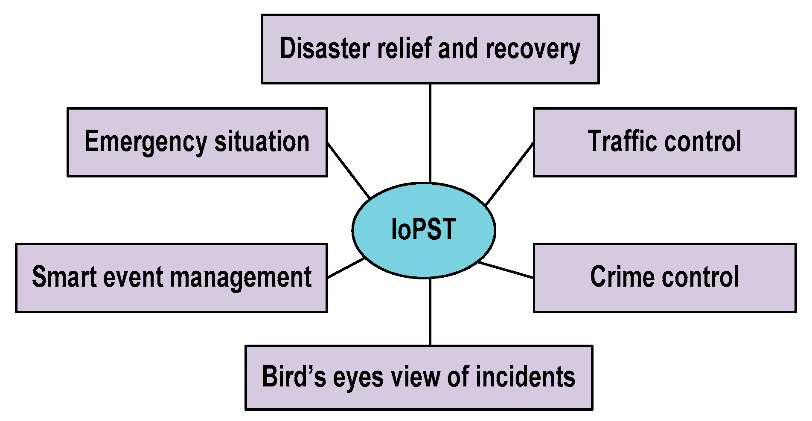
Block Diagram

Slide 10
SOFTWARE REQUIREMENTS:
Operating System : Windows 10
Platform : DOT NET TECHNOLOGY
Front End : ASP.Net 4.0
Back End : SQL SERVER 2014

Slide 11
HARDWARE REQUIREMENTS:
Keyboard
Mouse
Hard disk 500GB
Ram 4 Gb

Slide 12
CONCLUTION
Combination of artificial intelligent (AI) and the integration of UAV and IoT can produce amazing sophisticated solutions to today’s problems. Therefore, it is considered a microcosm of IoT and already beginning to replace that connected sensors at stationary efficiently. IoT devices are unable to send the capture data to long distance. Furthermore, integration of UAV and IoT devices will bring a solution to our today problems. Smart UAVis proposed here for gathering data for different IoT device and makes a decision and then sends data to the final destination. Therefore, smart UAVconsider as UAV as services. The signal strength from smart UAV is affected by environmental impacts. Therefore, it is difficult to achieve high accuracy for estimating the signal strength, if unpredictability of channel makes between UAV or IoT devices. As long as, it is required for design the appreciate transmitter and receiver according to the ecological effects. Then, the signal will be easy to recover at the receiver. Design the receiver depends on the accurate prediction of the signal. The efficient and accurate signal strength is predicted based on altitude, path loss, channel distribution, elevation angle and the distances, using ANN is analyzed. ANN plays an essential role in training big data in very fast. Furthermore, it gives a correct prediction and appreciates decision. Notably, it is relatively difficult to find a method of signal strength estimation which can achieve a general estimation. Because of the signal strength depends on the wireless channel dynamic variation terrain characteristics. However, the ANN can give an accurate prediction where a very close agreement to generic estimation.

Slide 13
REFERENCE
[1] Y. Miao, Z. Cheng, W. Li, H. Ma, X. Liu, and Z. Cui, "Software Defined Integrated Satellite-Terrestrial Network: A Survey," in International Conference on Space Information Network, 2016, pp. 16-25.
[2] M. Jia, X. Gu, Q. Guo, W. Xiang, and N. Zhang, "Broadband Hybrid Satellite-Terrestrial Communication Systems Based on Cognitive Radio toward 5G," IEEE Wireless Communications, vol. 23, pp. 96-106, 2016.
[3] S. Alsamhi and N. Rajput, "Implementation of call admission control technique in HAP for enhanced QoS in wireless network deployment," Telecommunication Systems, vol. 63, pp. 141-151, 2016.
[4] S. Alsamhi and N. Rajput, "An Efficient Channel Reservation Technique for Improved QoS for Mobile Communication Deployment Using High Altitude Platform," Wireless Personal Communications, vol. 91, pp. 1095-1108, 2016.
[5] H. S. Dhillon, H. Huang, and H. Viswanathan, "Wide-area wireless communication challenges for the Internet of Things," IEEE Communications Magazine, vol. 55, pp. 168-174, 2017.

Slide 14
[6] M. Mozaffari, W. Saad, M. Bennis, and M. Debbah, "Mobile unmanned aerial vehicles (UAVs) for energy-efficient internet of things communications," IEEE Transactions on Wireless Communications, vol. 16, pp. 7574-7589, 2017.
[7] L. A. Grieco, A. Rizzo, S. Colucci, S. Sicari, G. Piro, D. Di Paola, et al., "IoT-aided robotics applications: Technological implications, target domains and open issues," Computer Communications, vol. 54, pp. 32-47, 2014.
[8] V. Dutta and T. Zielinska, "Networking technologies for robotic applications," arXiv preprint arXiv:1505.07593, 2015.
[9] L. Dauphin, C. Adjih, H. Petersen, and E. Baccelli, "Low-Cost Robots in the Internet of Things: Hardware, Software & Communication Aspects," in Proceedings of the 2017 International Conference on Embedded Wireless Systems and Networks, 2017, pp. 284-289.
[10] A. Roy Chowdhury, "IoT and Robotics: a synergy," PeerJ Preprints, vol. 5, p. e2760v1, 2017.

