Slide 1
Multi-Perspective Trust Management Framework for Crowdsourced IoT Services

Slide 2
Abstract
We propose a novel generic trust management framework for crowdsourced IoT services. The framework exploits a multi-perspective trust model that captures the inherent characteristics of crowdsourced IoT services. Each perspective is defined by a set of attributes that contribute to the perspective’s influence on trust. The attributes are fed into a machine-learning-based algorithm to generate a trust model for crowdsourced services in IoT environments. We demonstrate the effectiveness of our approach by conducting experiments on real-world datasets

Slide 3
Existing System
Existing trust models suffer from this attack since they rely on a unique trust value that globally characterizes a node including all assisted services.
It is more complex to quantify the former term, namely context similarity in terms of type of service, since multiple collaborative services exist that share little in common.
There exists a local trust management system within this infrastructure that manages collaboration between nodes for multiple networking services.
Of course, truly malicious nodes do exist too and have to be dealt with, even though these would likely try to fail the trust metric by camouflaging their misbehaviours.

Slide 4
Disadvantage of Existing System
We address the issue of establishing trust between IoT service providers and consumers. Service providers and consumers are assumed to own IoT devices.
Therefore, the problem is defined as assessing the context-dependent trust of highly dynamic IoT services.
However, if such data is missing, the problem becomes a bootstrapping problem.
Some of the main issues in service provisioning are highlighted as follows: trustworthiness, reliability, and availability.
The framework tries to overcome these issues by giving users the control over who can use their services and which services they can use (i.e., setting their preferences).

Slide 5
PROPOSED SYSTEM :
The proposed system claims to be safe from bad mouthing and ballot-stuffing attacks, assuming that the deployed agents are trusted-third parties and would not engender these types of attacks.
Eventually, only the best partners with respect to a sought cooperative service are proposed to a requesting node.
The proposed model takes into account both first-hand information (direct observations and own experiences) and second-hand information (indirect experiences and observations reported by neighbouring nodes) to update trust values.
The proposed TMS defines a weighting factor to evaluate the confidence put in recommendations received from other nodes.

Slide 6
ADVANTAGE
Attributes that have no influence on the trust should be filtered out and not be used for trust evaluation as it could degrade the performance of the network and the framework as a result.
Device perspective attributes can have more impact on the trust in services where the device and its performance is crucial (e.g., sensing and energy sharing services).
The node’s reputation is computed based on its performance characteristics: packet delivery, forwarding ratio, and energy consumption.
While IoT crowdsourcing platforms provide distinct opportunities in terms of convenience and efficiency, they also present fundamental challenges.

Slide 7
TITTLE | AUTHOR | DESCRIPTION
Internet of things (iot): A vision, architectural elements, and future directions | J. Gubbi, R. Buyya, S. Marusic, and M. Palaniswami, | This offers the ability to measure, infer and understand environmental indicators, from delicate ecologies and natural resources to urban environments.
Crowdsourcing to smartphones: Incentive mechanism design for mobile phone sensing | D. Yang, G. Xue, X. Fang, and J. Tang, | In a mobile phone sensing system, the platform recruits smartphone users to provide sensing service.

Slide 8
TITTLE | AUTHOR | DESCRIPTION
A survey of crowdsourcing systems | M.-C. Yuen, I. King, and K.-S. Leung, | In crowd sourcing paradigm, tasks are distributed to networked people to complete such that a company's production cost can be greatly reduced.
Femto clouds: Leveraging mobile devices to provide cloud service at the edge | K. Habak, M. Ammar, K. A. Harras, and E. Zegura, | Mobile devices are becoming increasingly capable computing platforms with significant processor power and memory.

Slide 9
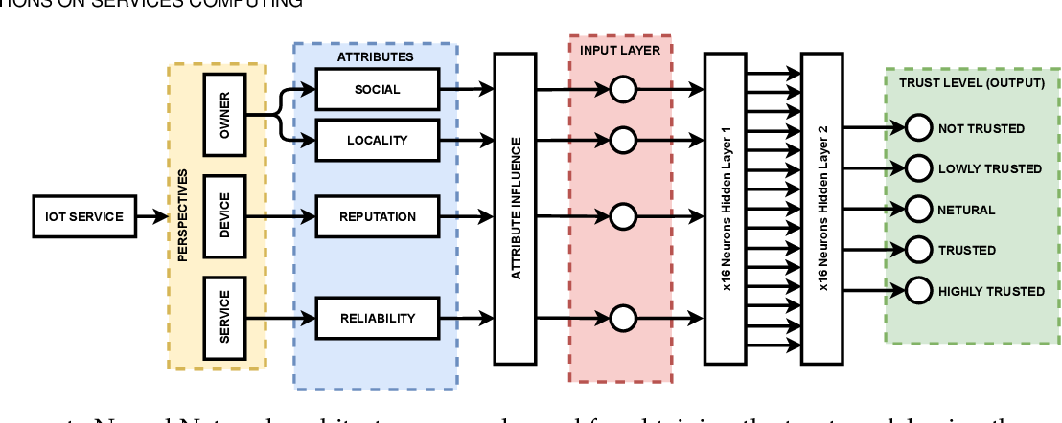
Block Diagram

Slide 10
SOFTWARE REQUIREMENTS:
Operating System : Windows 10
Platform : DOT NET TECHNOLOGY
Front End : ASP.Net 4.0
Back End : SQL SERVER 2014

Slide 11
HARDWARE REQUIREMENTS:
Keyboard
Mouse
Hard disk 500GB
Ram 4 Gb

Slide 12
CONCLUTION
We proposed an IoT trust management framework that tries to ascertain a level of trust between potential providers and consumers. Specifically, our approach measures the trustworthiness of IoT service providers. The framework is based on a multi-perspective trust model. Each perspective in the model contributes to the overall trust. The perspectives are defined by a set of attributes that are extracted from the inherent characteristics of IoT services. We evaluated our approach in terms of the accuracy of detecting trustful and distrustful IoT services. It is worth noting that our proposed approach evaluates the service trustworthiness only (i.e., consumer perspective). Future directions can be investigating the trust level of IoT service consumers. Additionally, our work focused on leveraging trust-related data to evaluate IoT services’ trust, while assuming that the privacy and integrity of the data is protected. Our future work focuses on designing a privacy and integrity-preserving framework for storing and exchanging such data between IoT devices.

Slide 13
REFERENCE
[1] J. Gubbi, R. Buyya, S. Marusic, and M. Palaniswami, “Internet of things (iot): A vision, architectural elements, and future directions,” Future generation computer systems, vol. 29, no. 7, pp. 1645– 1660, 2013.
[2] D. Yang, G. Xue, X. Fang, and J. Tang, “Crowdsourcing to smartphones: Incentive mechanism design for mobile phone sensing,” in Proceedings of the 18th annual international conference on Mobile computing and networking, ACM. New York, NY, USA: ACM, 2012, pp. 173–184.
[3] M.-C. Yuen, I. King, and K.-S. Leung, “A survey of crowdsourcing systems,” in 2011 IEEE Third International Conference on Privacy, Security, Risk and Trust and 2011 IEEE Third International Conference on Social Computing. IEEE, 2011, pp. 766–773.
[4] K. Habak, M. Ammar, K. A. Harras, and E. Zegura, “Femto clouds: Leveraging mobile devices to provide cloud service at the edge,” in 2015 IEEE 8th international conference on cloud computing. IEEE, 2015, pp. 9–16.
[5] E. Bulut, S. Hernandez, A. Dhungana, and B. K. Szymanski, “Is crowdcharging possible?” in 2018 27th International Conference on Computer Communication and Networks (ICCCN). IEEE, 2018, pp. 1–9.

Slide 14
[6] S. D. T. Kelly, N. K. Suryadevara, and S. C. Mukhopadhyay, “Towards the implementation of iot for environmental condition monitoring in homes,” IEEE sensors journal, vol. 13, no. 10, pp. 3846–3853, 2013.
[7] D. Kyriazis and T. Varvarigou, “Smart, autonomous and reliable internet of things,” Procedia Computer Science, vol. 21, pp. 442–448, 2013.
[8] Y. B. Saied, A. Olivereau, D. Zeghlache, and M. Laurent, “Trust management system design for the internet of things: A contextaware and multi-service approach,” Computers & Security, vol. 39, pp. 351–365, 2013.
[9] D. Chen, G. Chang, D. Sun, J. Li, J. Jia, and X. Wang, “Trm-iot: A trust management model based on fuzzy reputation for internet of things,” Computer Science and Information Systems, vol. 8, no. 4, pp. 1207–1228, 2011.
[10] Z. Yan, P. Zhang, and A. V. Vasilakos, “A survey on trust management for internet of things,” Journal of network and computer applications, vol. 42, pp. 120–134, 2014.

