Slide 1
Secure Data Sharing with Flexible User Access Privilege Update in Cloud-assisted IoMT

Slide 2
Abstract
Cloud-assisted Internet of Medical Things (IoMT) is becoming an emerging paradigm in the healthcare domain, which involves collection, storage and usage of the medical data. Considering the confidentiality and accessibility of the outsourced data, secure and fine-grained data sharing is a crucial requirement for the patients. Attribute-based encryption (ABE) is a promising solution to deal with this issue, but considering its property of each attribute sharing with multiple users, how to flexibly and efficiently update access privileges of certain users without affecting others is still a serious challenge.

Slide 3
In this paper, we propose a secure and fine-grained data sharing scheme with flexible user access privilege update in cloud-assisted IoMT environment. Specifically, we take ABE as the basic building block, and utilize proxy re-encryption and key blinding techniques to empower the cloud server to re-encrypt the ciphertext affected by revocation and update keys for unrevoked users. In addition, adding attributes for users to extend their access rights is realized only based on few key components stored in cloud without entirely re-computing and re-issuing keys for them. As a result, the patients are able to flexibly and efficiently share their data and manage users' privileges. Formal proof and detailed performance evaluation demonstrate the security and efficiency of the proposed scheme.

Slide 4
Existing System
In this paper, we focused on a thorough review of current and existing literature on different approaches and mechanisms used in e-Health to deal with security and privacy issues.
Data are exposed to different threats when organizations assume that cloud migration is a “lift-and-shift” endeavor of simply porting their existing IT stack and security controls to a cloud environment.
We have studied the existing PKE, IBE, IBBE, & ABE and then proposed multiple solutions to safeguard cloud-based data in ehealth systems.
This review highlights a comprehensive study of existing cloud-based eHealth solutions that are cryptographic and non-cryptographic methods for protecting the privacy and security of digital data.

Slide 5
Disadvantage of Existing System
The solution of the problem is a degree constraint, that is crucial for realism in both contexts several other greedy heuristics to solve the online problem.
Current hypervisors don’t provide adequate provision because of synchronization problems and soft real-time constraints which result in frequent serious performance degradation and deadline misses.
When there is a new problem based on past experience used CBR to find a solution.
This has increased the vital security problem of how to control and anticipate unapproved access to information stored in the cloud.
The author proposed an algorithm SEQ that tells about resource augmentation to give a solution to Maximize Throughput Bounded Degree (MTBD) problem.

Slide 6
PROPOSED SYSTEM :
An integrated blockchain model of a fully independent blockchain (FPB) and consortium blockchain (CB) was proposed to improve the time taken for data validation.
While considering the future and growth of cloud-based healthcare services, we focused on the security of critical electronic health records (EHRs) and proposed an identity-based secure and encrypted data-sharing technique.
We have studied the existing PKE, IBE, IBBE, & ABE and then proposed multiple solutions to safeguard cloud-based data in ehealth systems.
Specialists have developed a system for IoT-based shrewd well-being systems used in their proposal as an e-Health platform, zeroing in on interoperability, different criteria for creativity, correspondence protocols, and framework prerequisites.

Slide 7
ADVANTAGE
The researchers have been anticipated this is the active load balance strategy has a number of constraints with respect to performance time and memory requirement.
Distribution of cloud environment; dynamic load scheduling module which proposes a hybrid load balance algorithm to realize high performance load balance for cloud center.
Performance analysis and extensive security demonstrate the plans are secure and exceedingly proficient.
Performance assessment of assignment models and Cloud provisioning algorithms in a repeatable way beneath various designs prerequisites is an issue.
The energy is reduced using Energy-Efficient Virtual Machines Scheduling in Multi-Tenant Data Centers.

Slide 8
TITTLE | AUTHOR | DESCRIPTION
GWMEP: Task Manager-as-a-Service in Apache Cloud Stack | Guillermo Indalecio, Fernando Gomez-Folgar, and Antonio J. GarciaLoureiro, | Cloud computing is known for providing on-demand self-service, elasticity, flexibility, and cost reduction.
A Secure Cloud Computing Model Based on Data Classification | Lo, ai Tawalbeh, Nour S. Darwazeh, Raad S. Al-Qassas and Fahd AlDosari, | The proposed model was tested with different encryption algorithms, and the simulation results showed the reliability and efficiency of the proposed framework.

Slide 9
TITTLE | AUTHOR | DESCRIPTION
Information Flow Control for Secure Cloud Computing | Jean Bacon, David Eyers, Thomas F. J. M. Pasquier, Jatinder Singh, Ioannis Papagiannis and Peter Pietzuch, | The earliest IFC models targeted security in a centralised environment, but decentralised forms of IFC have been designed and implemented, often within academic research projects.
Secure Sharing and Searching for Real-Time Video Data in Mobile Cloud | Joseph K. Liu, Man Ho Au,Willy Susilo, Kaitai Liang, Rongxing Lu and Bala Srinivasan, | In this article we propose an infrastructure that allows mobile users to securely share and search for their real-time video data.

Slide 10
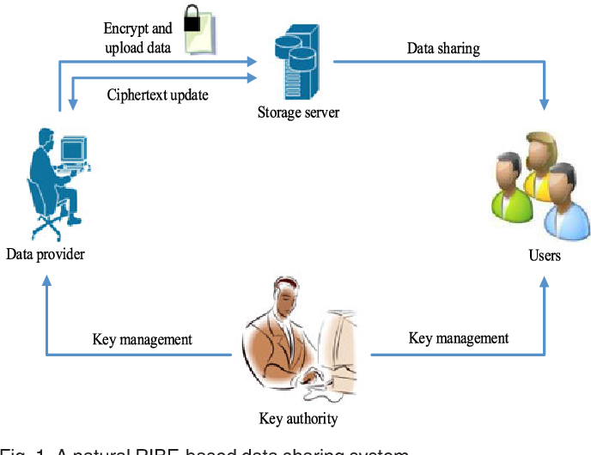
Block Diagram

Slide 11
SOFTWARE REQUIREMENTS:
Operating System : Windows 10
Platform : DOT NET TECHNOLOGY
Front End : ASP.Net 4.0
Back End : SQL SERVER 2014

Slide 12
HARDWARE REQUIREMENTS:
Keyboard
Mouse
Hard disk 500GB
Ram 4 Gb

Slide 13
CONCLUTION
How to protect consumer’s private data in distributed cloud storage is challenging task. To share the personal file from one user to another user is most difficult using the cloud computing. To provide more secure to the data using different schemes. We studied different Cloud Computing concepts like mobile cloud computing, integrity and forward security, social cloud computing, framework, resource allocation, data security, privacy and dynamic, IOT and load balancing schemes. While concerning about the security of data we analyze different issues such as low security, high computational complexity, privacy/public file sharing and improper utilization of resources. There are distinctive scheduling strategies used in multiple federated data centers. Aggregate key provides more secure in sending file between sender and receiver. Forward security encryption and re-encryption techniques are used to provide high security for private data. It gives demonstrating and reproduction of substantial scale distributed computing, including data centers. Virtual Machines (VMs) and Physical Machines (PMs) consumes more power. This is the limitation, due to this, the cost of file transfer is increased. A further enhancement to overcome intruder’s attacks in private data, to provide more security and more sharing of files, effectively utilization of resources and reducing the energy consumption in VMs and PMs.

Slide 14
REFERENCE
[1] Guillermo Indalecio, Fernando Gomez-Folgar, and Antonio J. GarciaLoureiro, “GWMEP: Task Manager-as-a-Service in Apache Cloud Stack”, IEEE Internet Computing, vol. 20, no. 2, pp. 42-49, March/April 2016.
[2] Lo, ai Tawalbeh, Nour S. Darwazeh, Raad S. Al-Qassas and Fahd AlDosari, “A Secure Cloud Computing Model Based on Data Classification”, Elsevier Procedia Computer Science, vol. 52, pp. 1153-1158, 2015.
[3] Jean Bacon, David Eyers, Thomas F. J. M. Pasquier, Jatinder Singh, Ioannis Papagiannis and Peter Pietzuch, “Information Flow Control for Secure Cloud Computing”, IEEE Transactions on Network and Service Management, vol. 11, no. 1, pp. 76-89, March 2014.
[4] Joseph K. Liu, Man Ho Au,Willy Susilo, Kaitai Liang, Rongxing Lu and Bala Srinivasan, “Secure Sharing and Searching for Real-Time Video Data in Mobile Cloud”, IEEE Journal on Network, vol. 29, no. 2, pp. 46-50, 2015.
[5] Ming Li, Shucheng Yu, Yao Zheng, Kui Renand Wenjing Lou, ”Scalable and Secure Sharing of Personal Health Records in Cloud Computing using Attribute-Based Encryption”, IEEE Transactions on Parallel and Distributed Systems, vol. 24, no. 1, pp. 131-143, January 2013.

Slide 15
[6] LI Chaoling, CHEN Yue and ZHOU Yanzhou, “ADataAssuredDeletion Scheme in Cloud Storage”, IEEE China Communications, vol. 11, no. 4, pp. 98-110, April 2014.
[7] Mauro Gaggero and Luca Caviglione, “Predictive Control for EnergyAware Consolidation in Cloud Datacenters”, IEEE Transactions on Control Systems Technology, vol. 24, no. 2, pp. 461-474, 2016.
[8] Mahyar Movahed Nejad, Lena Mashayekhy and Daniel Grosu, “Truthful Greedy Mechanisms for Dynamic Virtual Machine Provisioning and Allocation in Clouds”, IEEE Transactions on Parallel and Distributed Systems, vol. 26, no. 2, pp. 594-603, 2015.
[9] Atta Ur Rehman Khan, Mazliza Othman and Sajjad Ahmad Madani, “Mobile Cloud Computing Application Models”, IEEE Communications Surveys and Tutorials, vol. 16, no. 1, pp. 393-413, 2014.
[10]Ki-Woong Park, Jaesun Han, JaeWoong Chung and Kyu Ho Park, “THEMIS: A Mutually Verifiable Billing System for the Cloud Computing Environment”, IEEE Transactions on Services Computing, vol. 6, no. 3, pp. 300-313, July-September 2013.

