Slide 1
Efficient and Anonymous Authentication for Healthcare Service with Cloud based WBANs

Slide 2
Abstract
As a promising technology in the development of human healthcare services, the wireless body area networks (WBANs) technology has attracted widespread attention in recent years from both industry and academia. However, due to the sensitiveness of the medical system and the capability limitation of the wearable devices, security, privacy, and efficiency of the healthcare services in WBANs are remained as major challenges. Although different authentication mechanisms have been designed to meet the challenges in recent years, most of them suffer from some functional defects or security problems.

Slide 3
In this paper, we firstly provide a review and cryptanalysis on the state-of-theart authentication scheme. In order to meet the challenges and address the drawbacks in previous works, we then propose a new efficient and anonymous authentication scheme for cloud based WBANs. Through the security analysis, we show that our scheme could overcome the weaknesses in previous schemes and meet all the security requirements. Besides, we show the advantages of the proposed scheme through performance evaluation in terms of functionality features, computation overhead, communication overhead and storage overhead, which shows our scheme is more appropriate for practical applications on healthcare services.

Slide 4
Existing System
Most of the existing privacy preserving health care applications provides anonymity from the adversaries.
Same as all existing authentication schemes, our proposed system is vulnerable to DoS attacks due to the requirement for unlinkability.
If requests could be linked, the detection of a DoS attack would be trivial and the future connection attempts from that user could be ignored.
In order to identify an attacker and add them to a revocation list in a scheme providing unlinkability, anonymity must be stripped away from one or more users without being certain that their connection was part of the attack (since they could be legitimately using the service while the attack is taking place).

Slide 5
Disadvantage of Existing System
The identity based authentication systems suffer from the key escrow problem.
This scheme had major drawback that it was impractical due to heavy computational overhead when directly applied to the distributed healthcare systems.
The Certificateless Signature (CLS) scheme is almost used to uniquely meet the security preserving demands in WBAN bycertificateless encryption alsodesigned to eliminate the drawbacks of the PKI based scheme and it does not require identity based encryption and digital certificate, i.e., no key escrow problem.
The scheme also gave big drawback of revocation procedure detailing improperly.

Slide 6
PROPOSED SYSTEM :
In this paper, we have proposed a system which provides complete privacy and anonymity to the users of health care applications from adversaries and the authentication server.
In our proposed authentication scheme, we have utilized rotating group signature scheme based on Elliptic curve cryptography to provide anonymity to the patients.
The proposed scheme can be generalized and applied to other cloud based applications.
Therefore, the proposed scheme is most suitable for scenarios where the specific user cannot be identified by operations over the data.
To minimize the computational requirements, various anonymous authentication schemes based on elliptic curve cryptosystem (ECC) have been proposed, which have better performance because of the smaller key size used in ECC.

Slide 7
ADVANTAGE
The theoretical analysis evaluated schemes’ performance, demonstrating that the scheme provides various security features as well as resistance to several attacks.
While other existing schemes lagging in every other phase to give better performance. Hence our scheme is the best technique among others.
However, those are not efficient to protect users’ private/sensitive data over cloud servrs.
The SAGE has been demonstrated efficient in terms of transmission delay.
This paper propose proposed an efficient authenticated key agreement scheme for WBANs plus to add the key update phase in enhancing the security of the scheme.
The scheme was more efficient based on bilinear pairings but the revocation process was not clearly defined in case of dispute.

Slide 8
TITTLE | AUTHOR | DESCRIPTION
An efficient scheme for anonymous authentication using identity based group signature | S. Kuzhalvaimozhi and G. R. Rao, | In this scheme the size of the group pubic key and the length of signatures are independent on the size of the group.
Sage: A strong privacy-preserving scheme against global eavesdropping for ehealth systems | X. Lin, R. Lu, X. Shen, Y. Nemoto, and N. Kato, | In this paper, we propose a strong privacy-preserving Scheme against Global Eavesdropping, named SAGE, for eHealth systems.

Slide 9
TITTLE | AUTHOR | DESCRIPTION
Anonymous authentication scheme in ehealth cloud environment | A. Djellalbia, N. Badache, S. Benmeziane, and S. Bensimessaoud, | In this paper, we will propose an adaptive and flexible approach to protect the identity privacy of patients in an e-Health Cloud through an anonymous authentication scheme.
Efficient anonymous authenticated key agreement scheme for wireless body area networks | T. Li, Y. Zheng, and T. Zhou, | The sensor nodes in WBANs collect the client’s physiological data and transmit it to the medical center.

Slide 10
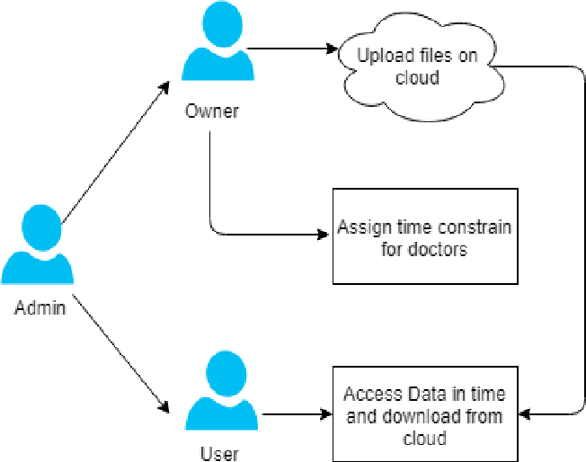
Block Diagram

Slide 11
SOFTWARE REQUIREMENTS:
Operating System : Windows 10
Platform : DOT NET TECHNOLOGY
Front End : ASP.Net 4.0
Back End : SQL SERVER 2014

Slide 12
HARDWARE REQUIREMENTS:
Keyboard
Mouse
Hard disk 500GB
Ram 4 Gb

Slide 13
CONCLUTION
Finally concluded to anonymous authentication scheme for smart cloud based healthcare applications by preserving the privacy of patients when they access the services hosted on the cloud.By utilizing ECC and TOR mechanism,we have proposed a practical system ensures that the patients can consume services without revealing their identity with security from an eavesdropper .

Slide 14
REFERENCE
[1] Abid Mehmood, Iynkaran Natgunanathan, Member, IEEE, Yong Xiang,Senior Member, IEEE, Howard Poston,and Yushu Zhang, Member, IEEE Anonymous Authentication Scheme for Smart Cloud Based Healthcare Applications IEEE Access, DOI 10.1109/ ACCESS.2018 . 2841972
[2] S. Kuzhalvaimozhi and G. R. Rao, “An efficient scheme for anonymous authentication using identity based group signature,” IET, 2012.
[3] X. Lin, R. Lu, X. Shen, Y. Nemoto, and N. Kato, “Sage: A strong privacy-preserving scheme against global eavesdropping for ehealth systems,” IEEE J. on Selected Areas in Commun., vol. 27, no. 4, pp. 365–378, May 2009.
[4] A. Djellalbia, N. Badache, S. Benmeziane, and S. Bensimessaoud,“Anonymous authentication scheme in ehealth cloud environment,” in Proc. 11th Int. Conf. on Internet Technology and Secured Trans., Dec. 2016, pp. 47–52.

Slide 15
[5] T. Li, Y. Zheng, and T. Zhou, “Efficient anonymous authenticated key agreement scheme for wireless body area networks,” Security and Commun. Networks, vol. 2017, Oct. 2017.
[6] J. Liu, Z. Zhang, X. Chen, and K. S. Kwak, “Certificateless remote anonymous authentication schemes for wireless body area networks,” IEEE Trans. on Parallel and Distributed Syst., vol. 25, no. 2, pp. 332– 342, Feb. 2014.
[7] A. Sudarsono and M. U. H. Al Rasyid, “An anonymous authentication system in wireless networks using verifier local revocation group signature scheme,” in Proc. Int. Seminar on Intelligent Technology and Its Applications, Jul. 2016, pp. 49–54.

