Slide 1
A Compressive Integrity Auditing Protocol for Secure Cloud Storage

Slide 2
Abstract
With the widespread application of cloud storage, ensuring the integrity of user outsourced data catches more and more attention. To remotely check the integrity of cloud storage, plenty of protocols have been proposed, implemented by checking the equation constructed by the aggregated blocks, tags, and indices. However, the verifier only has the knowledge of the indices of the audited blocks and tags, which thus requires the cloud to store both data blocks and tags for integrity verification. In this article, we present a compressive secure cloud storage protocol inspired by Goldreich-Goldwasser-Halevi (GGH) cryptosystem.

Slide 3
Since the aggregated blocks can be reconstructed from the aggregated tags without the help of data indices, the cloud can only store data tags for providing the verifiable integrity proof. In this way, communication and storage costs can be hugely reduced and user private information can be hidden from the cloud. Furthermore, the proposed protocol only contains a few basic algebraic operations, making it highly efficient. We also provide formal security proof of the proposed protocol regarding forge, replay and replace attacks. In addition, we explore a new technique to support data dynamics. Furthermore, we establish a generic framework of compressive secure cloud storage protocols. Finally, we provide the theoretical analysis and experimental results, which further validate the effectiveness of the proposed protocol.

Slide 4
Existing System
Existing system has vast storage for storing information and also allows exchange of data between the cloud and user.
To overcome these existing problems this project proposes a system which handles both Integrity auditing and Data Deduplication.
The design of the HMAC specification was motivated by the existence of attacks on more trivial mechanisms for combining a key with a hash function.
To insert a new block or delete an existing block, it must move forward or backward the remaining (n/k − i) blocks of the DCT, which contains (n/k) blocks.
Although cloud storage provides convenient data outsourcing services, an untrusted cloud server frequently threatens the integrity and security of the outsourced data.

Slide 5
Disadvantage of Existing System
The obvious problem of this simple strategy is the huge overheads of computation and communication.
Although it is a strong protocol for data integrity, there is one inevitable problem.
One problem of random sampling schemes is that they cannot assure in 100 % confidence.
However, the major problem of this scheme is the limited number of challenge once the sentinel embedded file is upload to the prover.
This scheme efficiently solves the dynamic operation problem but has the drawback that the messages exchanged between the Client and the Server is proportional to the number of file blocks.

Slide 6
PROPOSED SYSTEM :
The proposed system will achieve both file de-duplication and integrity auditing.
Our proposed system successfully achieved Integrity auditing and secure de-duplication in cloud, which are main factors in achieving security in cloud.
We propose a system for plainly examining integument looking under encoded share of the information.
The proposed architecture of Cloud storage is a layered, cooperative architecture where the key technologies involved are data storage, data migration, data retrieval, data security etc.
Compared with the relevant schemes in the literature, security analysis and performance evaluations show that the proposed scheme gains some advantages in integrity verification and dynamic updating.

Slide 7
ADVANTAGE
The Efficient Provable Data Possession (E-PDP) scheme achieved a higher performance at the cost of a weaker guarantee by eliminating all coefficients aj in the GenProof and CheckProof algorithms.
The overhead of POR mainly includes the storage for error-correcting code and sentinels, as well as computation of error-correcting code and permutation operations. Several optimization can be done to improve POR’s performance.
The extended scheme achieved higher efficiency because it only relied on symmetry-key cryptography.
PDP provides a high probability guarantee that a system possesses a file with high efficiency in computation and communication.
However, there is not sufficient study on efficiency and performance.

Slide 8
TITTLE | AUTHOR | DESCRIPTION
Provable data possession at untrusted stores | Ateniese, G., Burns, R., Curtmola, R., Herring, J., Kissner, L., Peterson, Z., Song, D. | We introduce a model for provable data possession (PDP) that allows a client that has stored data at an untrusted server to verify that the server possesses the original data without retrieving it.
Scalable and efficient provable data possession | Ateniese, G., Di Pietro, R., Mancini, L.V., Tsudik, G. | Storage outsourcing is a rising trend which prompts a number of interesting security issues, many of which have been extensively investigated in the past.

Slide 9
TITTLE | AUTHOR | DESCRIPTION
Proofs of Storage from Homomorphic Identification Protocols | Ateniese, G., Kamara, S., Katz, J. | We provide a framework for building public-key HLAs from any identification protocol satisfying certain homomorphic properties.
Aggregate and verifiably encrypted signatures from bilinear maps | Boneh, D., Gentry, C., Lynn, B., Shacham, H. | In this paper we introduce the concept of an aggregate signature, present security models for such signatures, and give several applications for aggregate signatures.

Slide 10
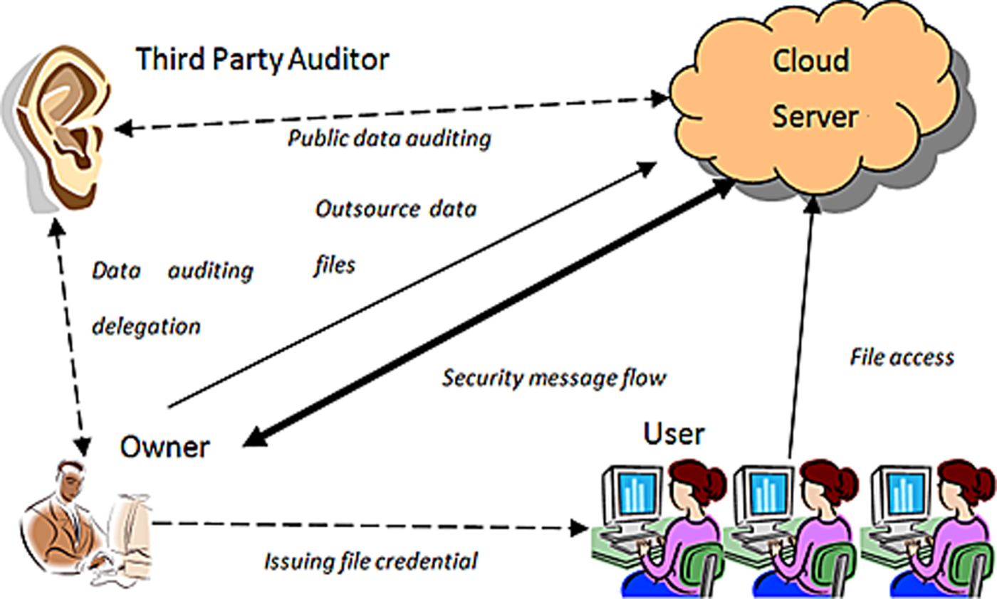
Block Diagram

Slide 11
SOFTWARE REQUIREMENTS:
Operating System : Windows 10
Platform : DOT NET TECHNOLOGY
Front End : ASP.Net 4.0
Back End : SQL SERVER 2014

Slide 12
HARDWARE REQUIREMENTS:
Keyboard
Mouse
Hard disk 500GB
Ram 4 Gb

Slide 13
CONCLUTION
An efficient auditing system is critical to establish accountability for cloud users who do not have physical possession of their data. Existance of a trustworthy third party audits enable users to check the data integrity, track suspicious activities, obtain evidence for forensics, and evaluate service providers’ behaviors when needed. This chapter provides our readers fundamental understanding of cloud auditing technologies. We expect to witness development of standard framework for cloud auditing and efforts at cloud service providers to make their policies and mechanisms more auditable and accountable.

Slide 14
REFERENCE
1. Ateniese, G., Burns, R., Curtmola, R., Herring, J., Kissner, L., Peterson, Z., Song, D.: Provable data possession at untrusted stores. In: Proceedings of the 14th ACM conference on Computer and communications security, CCS ’07, pp. 598–609. ACM, NewYork, NY, USA (2007). DOI 10.1145/1315245.1315318. URL http://doi.acm.org/10.1145/1315245.1315318
2. Ateniese, G., Di Pietro, R., Mancini, L.V., Tsudik, G.: Scalable and efficient provable data possession. In: Proceedings of the 4th international conference on Security and privacy in communication networks, SecureComm ’08, pp. 9:1–9:10. ACM, NewYork, NY, USA (2008). DOI 10.1145/1460877.1460889. URL http://doi.acm.org/10.1145/1460877.1460889
3. Ateniese, G., Kamara, S., Katz, J.: Proofs of Storage from Homomorphic Identification Protocols. In: M. Matsui (ed.) Advances in Cryptology - ASIACRYPT 2009, Lecture Notes in Computer Science, vol. 5912, chap. 19, pp. 319–333. Springer Berlin / Heidelberg, Berlin, Heidelberg (2009). DOI 10.1007/978-3-642-10366-7_19. URL http://dx.doi.org/10.1007/978-3-642-10366-7_19
4. Boneh, D., Gentry, C., Lynn, B., Shacham, H.: Aggregate and verifiably encrypted signatures from bilinear maps. Advances in Cryptology-EUROCRYPT 2003 pp. 641–641 (2003)
5. Boneh, D., Lynn, B., Shacham, H.: Short signatures from the weil pairing. Journal of Cryptology 17, 297–319 (2004). URL http://dx.doi.org/10.1007/s00145-004-0314-9. 10.1007/s00145-004-0314–9

Slide 15
6. Buchanan, S., Gibb, F.: The information audit: Role and scope. International journal of information management 27(3), 159–172 (2007)
7. Erway, C., Küpçü, A., Papamanthou, C., Tamassia, R.: Dynamic provable data possession. In: Proceedings of the 16th ACM conference on Computer and communications security, CCS ’09, pp. 213–222. ACM, New York, NY, USA (2009). DOI 10.1145/1653662.1653688. URL http://doi.acm.org/10.1145/1653662.1653688
8. Feng, J., Chen,Y.: A fair non–repudiation framework for data integrity in cloud storage services. International Journal of Cloud Computing 2(1), 20–47 (2013)
9. Feng, J., Chen, Y., Liu, P.: Bridging the missing link of cloud data storage security in aws. In: Consumer Communications and Networking Conference (CCNC), 2010 7th IEEE, pp. 1–2. IEEE (2010)
10. Feng, J., Chen, Y., Summerville, D., Ku, W.S., Su, Z.: Enhancing cloud storage security against roll-back attacks with a new fair multi-party non-repudiation protocol. In: Consumer Communications and Networking Conference (CCNC), 2011 IEEE, pp. 521–522. IEEE (2011)

