Slide 1
Comments on “Attribute-Based Data Sharing Scheme Revisited in Cloud Computing”

Slide 2
Abstract
In this letter, we discuss the security weakness of Wang et al.'s attribute-based data sharing scheme, in IEEE TRANSACTIONS ON INFORMATION FORENSICS AND SECURITY (TIFS) (DOI: 10.1109/TIFS.2016.2549004). Through designing two concrete attacks, we identify two serious security flaws in their scheme. 1) First, we show that their scheme is insecure because in their scheme any authenticated user can freely tamper with the weight of his own attribute to gain higher level decryption privilege to arbitrarily decrypt the ciphertext belonging to another user with higher weight of attribute. 2) Second, we further demonstrate that their scheme is trivial insecure because in their scheme even any malicious authenticated user's attribute does not match the access policy of a ciphertext, he/she still has the power to decrypt the ciphertext, i.e., the decryption power is independent of attributes, thus, their scheme is not a rigorous attribute-based scheme. The two weaknesses discovered may hinder their scheme infeasible for practical deployment. Accordingly, we present a remedy solution to the issues while preserving all the security features of the original scheme. We hope that our cryptoanalysis and remedy scheme may contribute to avoiding similar design flaws in future designs.

Slide 3
Existing System
Existing system uses the cipher text policies. In which confidentiality of the data are made by using three factors data, encryption algorithm & the size of key.
As well existing concepts third parties are used such as key as well as digital certificate providers & verifiers.
To ensure information protection against untrusted CSPs, existing arrangements apply cryptographic techniques (e.g., encryption mechanisms).challenging issue, particularly when managing dynamic client group.
Besides, most of the existing CP-ABE schemes cannot support attribute with arbitrary 3 state.

Slide 4
Disadvantage of Existing System
Employing a CP-ABE system directly into a cloud application that may yield some open problems.
However, CP-ABE is limited to a potential security risk that is known as key escrow problem, whereby the secret keys of users have to be issued by a trusted key authority.
We propose an improved key issuing protocol to resolve the key escrow problem of CP-ABE in cloud computing.
To solve the key escrow problem, it generates both parts of system parameter and secret key for each user.
In addition, an improved key issuing protocol is proposed to resolve the key escrow problem of CP-ABE in cloud computing.

Slide 5
PROPOSED SYSTEM :
In this paper we proposed a mechanism which deals with revocation and data privacy & make Access Control Policy (ACP) in dynamic user group problem.
In this paper, authors proposed a policy preserving EHR system on the basis of CP-ABE.
The subsequent evaluation of element insert, lookup and recovery shows that their proposed scheme only introduces light-weighted overhead cost.
This proposed scheme not only offer fine-grained authorization of cipher-texts but also protects the identities of users.
In addition, a new computational problem called the twin-decision BDH problem (tDBDH) is proposed in this paper.

Slide 6
ADVANTAGE
The performance analysis and the security proof show that the proposed scheme is able to achieve efficient and secure data sharing in cloud computing.
We presented the performance and security analyses for the proposed scheme, in which the results demonstrate high efficiency and security of our scheme.
The cost is reduced by nearly half in theory which is consistent with the above efficiency analysis.
Accordingly, how to securely and efficiently share user data is one of the toughest challenges in the scenario of cloud computing.
The simulation shows that CP-WABE-RE scheme is efficient both in terms of computation complexity and storage cost.

Slide 7
TITTLE | AUTHOR | DESCRIPTION
A secure cloud computing based framework for big data information management of smart grid | J. Baek, Q. H. Vu, J. K. Liu, X. Huang, and Y. Xiang, | Smart grid is a technological innovation that improves efficiency, reliability, economics, and sustainability of electricity services.
An expressive and provably secure ciphertext-policy attribute-based encryption | A. Balu and K. Kuppusamy, | Ciphertext-Policy Attribute-Based Encryption (CP-ABE) allows to encrypt data under an access policy, specified as a logical combination of attributes.

Slide 8
TITTLE | AUTHOR | DESCRIPTION
Randomizable proofs and delegatable anonymous credentials | M. Belenkiy, J. Camenisch, M. Chase, M. Kohlweiss, A. Lysyanskaya, and H. Shacham, | We revise the entire approach to constructing anonymous credentials and identify randomizable zero-knowledge proof of knowledge systems as the key building block.
Ciphertext-policy attributebased encryption | J. Bethencourt, A. Sahai, and B. Waters, | In several distributed systems a user should only be able to access data if a user posses a certain set of credentials or attributes.

Slide 9
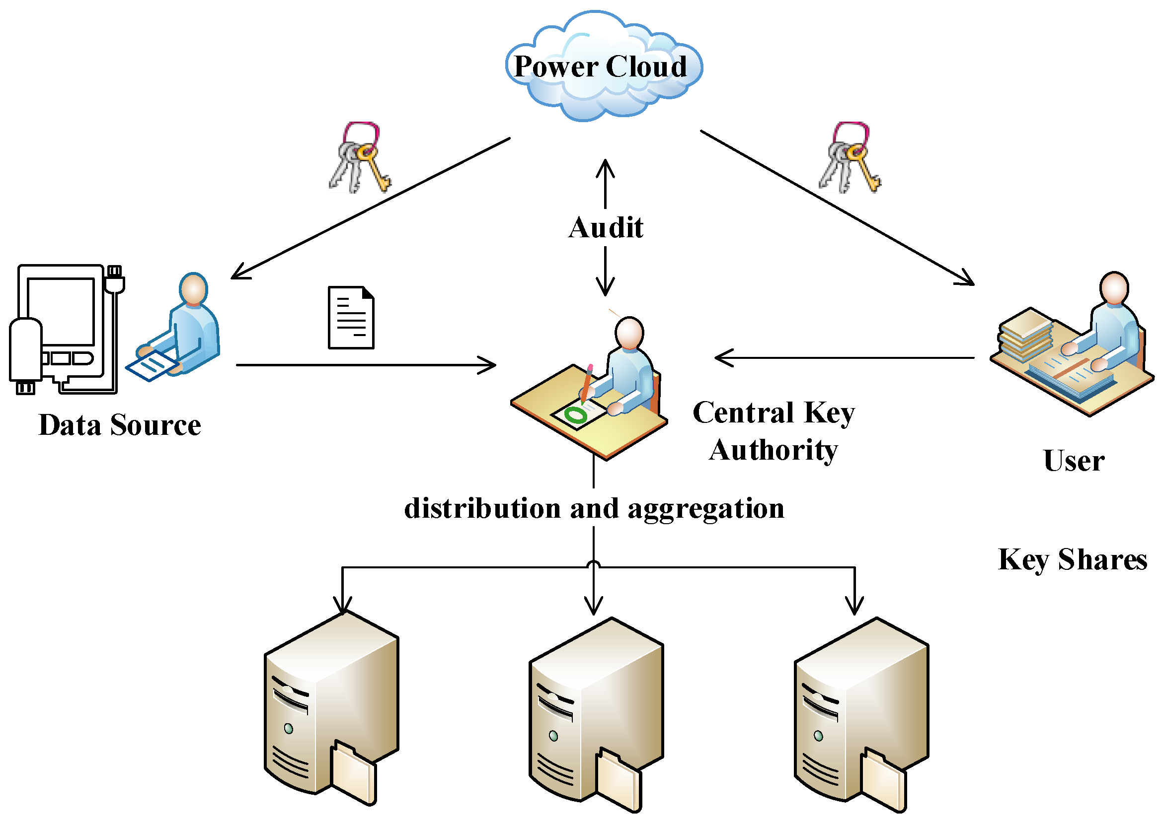
Block Diagram

Slide 10
SOFTWARE REQUIREMENTS:
Operating System : Windows 10
Platform : DOT NET TECHNOLOGY
Front End : ASP.Net 4.0
Back End : SQL SERVER 2014

Slide 11
HARDWARE REQUIREMENTS:
Keyboard
Mouse
Hard disk 500GB
Ram 4 Gb

Slide 12
CONCLUTION
In this paper, we redesigned an attribute-based data sharing scheme in cloud computing. The improved key issuing protocol was presented to resolve the key escrow problem. It enhances data confidentiality and privacy in cloud system against the managers of KA and CSP as well as malicious system outsiders, where KA and CSP are semi-trusted. In addition, the weighted attribute was proposed to improve the expression of attribute, which can not only describe arbitrarystate attributes, but also reduce the complexity of access policy, so that the storage cost of ciphertext and time cost in encryption can be saved. Finally, we presented the performance and security analyses for the proposed scheme, in which the results demonstrate high efficiency and security of our scheme.

Slide 13
REFERENCE
[1] J. Baek, Q. H. Vu, J. K. Liu, X. Huang, and Y. Xiang, “A secure cloud computing based framework for big data information management of smart grid,” IEEE Trans. Cloud Comput., vol. 3, no. 2, pp. 233–244, Apr./Jun. 2015.
[2] A. Balu and K. Kuppusamy, “An expressive and provably secure ciphertext-policy attribute-based encryption,” Inf. Sci., vol. 276, no. 4, pp. 354–362, Aug. 2014.
[3] M. Belenkiy, J. Camenisch, M. Chase, M. Kohlweiss, A. Lysyanskaya, and H. Shacham, “Randomizable proofs and delegatable anonymous credentials,” in Proc. 29th Annu. Int. Cryptol. Conf., 2009, pp. 108–125.
[4] J. Bethencourt, A. Sahai, and B. Waters, “Ciphertext-policy attributebased encryption,” in Proc. IEEE Symp. Secur. Privacy, May 2007, pp. 321–334.
[5] D. Boneh, B. Lynn, and H. Shacham, “Short signatures from the Weil pairing,” J. Cryptol., vol. 17, no. 4, pp. 297–319, 2004.

Slide 14
[6] M. Chase, “Multi-authority attribute based encryption,” in Proc. 4th Conf. Theory Cryptogr., 2007, pp. 515–534.
[7] M. Chase and S. S. M. Chow, “Improving privacy and security in multiauthority attribute-based encryption,” in Proc. 16th ACM Conf. Comput. Commun. Secur., 2009, pp. 121–130.
[8] L. Cheung and C. Newport, “Provably secure ciphertext policy ABE,” in Proc. 14th ACM Conf. Comput. Commun. Secur., 2007, pp. 456–465.
[9] S. S. M. Chow, “Removing escrow from identity-based encryption,” in Proc. 12th Int. Conf. Pract. Theory Public Key Cryptogr., 2009, pp. 256–276.
[10] C.-K. Chu, W.-T. Zhu, J. Han, J.-K. Liu, J. Xu, and J. Zhou, “Security concerns in popular cloud storage services,” IEEE Pervasive Comput., vol. 12, no. 4, pp. 50–57, Oct./Dec. 2013.

