Slide 1
Data Access Control in Cloud Computing Flexible and Receiver Extendable

Slide 2
Abstract
Broadcast encryption provides a promising technique of data access control for specified users in cloud computing. A data uploader can generate a ciphertext for a set of chosen users such that only the intended users are able to learn the data content. However, with the rapidly increasing of collaboration between users, it is desired to extend the receiver set to grant the decryption right for more users. The existing broadcast encryption systems cannot be capable for this scenario. In this paper, we first take this problem into consideration and give a solution. We take the merits of identity-based cryptosystem and propose a notion of EIBBE: a flexible data access control with receiver extendable for cloud computing based on broadcast encryption. It allows the authorized receiver to extend the receiver set S stated in the ciphertext by adding a new receiver set S′ without re-encryption. Both the users in S and S′ can obtain the data successfully. The maximum number of extended receivers is determined by the data uploader. We then give a concrete construction of EIBBE and provide a rigorous security analysis of our proposed scheme. Finally, we demonstrate the scheme's efficiency and feasibility.

Slide 3
Existing System
With the considerable advancements in cloud computing, users and organizations are finding it increasingly appealing to store and share data through cloud services.
This requires the file owner to download the file, re-encrypt the file, and upload it back for the cloud to update the previous encrypted file, incurring prohibitive communication overhead at the file owner side.
Such a design enables the cloud to directly re-encrypt file without decryption.
However, this scheme incurs expensive file read/write overhead as the encryption/decryption operation involves comparable overhead with the public key encryption schemes.

Slide 4
Disadvantage of Existing System
The problem of simultaneously achieving fine-grainedness, scalability, and data confidentiality of access control actually still remains unresolved.
The standard KP-ABE is provably secure under the attribute-based Selective-Set model given the Decisional Bilinear Diffie-Hellman (DBDH) problem is hard.
In some practical application systems, data confidentiality is not only a security/privacy issue, but also of juristic concerns.
One critical issue with this branch of approaches is how to achieve the desired security goals without introducing a high complexity on key management and data encryption.
In this paper, we address this open issue and propose a secure and scalable fine-grained data access control scheme for cloud computing.

Slide 5
PROPOSED SYSTEM :
In response to these security issues, numerous works have been proposed to support access control on untrusted cloud services by leveraging cryptographic primitives.
To simplify the presentation, we term the two revocation schemes proposed in as immediate re-encryption (IMre) and deferred re-encryption (DEre), respectively.
We also term the revocation scheme proposed in as homomorphic reencryption (HOre).
The simulation framework proposed in describes a range of realistic access control scenarios and allows us to investigate various access control actions and cryptographic operations incurred by these actions.

Slide 6
ADVANTAGE
To enforce these access policies, the data owners on one hand would like to take advantage of the abundant resources that the cloud provides for efficiency and economy; on the other hand, they may want to keep the data contents confidential against cloud servers.
All these design goals should be achieved efficiently in the sense that the system is scalable.
Using KP-ABE, we are able to immediately enjoy fine-grained data access control and efficient operations such as file creation/deletion and new user grant.
The complexity of algorithm AM inimalSet is actually mainly contributed by the CNF conversion operation which can be efficiently realized by existing algorithms.

Slide 7
TITTLE | AUTHOR | DESCRIPTION
Above the clouds: A berkeley view of cloud computing | M. Armbrust, A. Fox, R. Griffith, A. D. Joseph, R. H. Katz, A. Konwinski, G. Lee, D. A. Patterson, A. Rabkin, I. Stoica, and M. Zaharia, | Cloud Computing refers to both the applications delivered as services over the Internet and the hardware and systems software in the datacenters that provide those services.
Principles of policy in secure groups | H. Harney, A. Colgrove, and P. D. McDaniel, | Security policy is increasingly being used as a vehicle for specifying complex entity relationships.

Slide 8
TITTLE | AUTHOR | DESCRIPTION
Methods and limitations of security policy reconciliation | P. D. McDaniel and A. Prakash, | The expressiveness of Ismene, and indirectly of our model, is demonstrated through the representation and exposition of policies supported by existing policy languages.
A unified scheme for resource protection in automated trust negotiation | T. Yu and M. Winslett, | In this paper we propose UniPro, a unified scheme to model protection of resources, including policies, in trust negotiation.

Slide 9
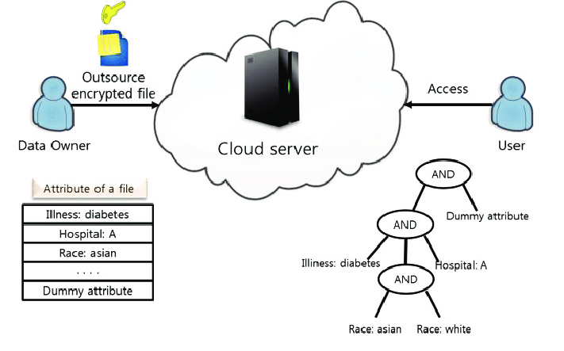
Block Diagram

Slide 10
SOFTWARE REQUIREMENTS:
Operating System : Windows 10
Platform : DOT NET TECHNOLOGY
Front End : ASP.Net 4.0
Back End : SQL SERVER 2014

Slide 11
HARDWARE REQUIREMENTS:
Keyboard
Mouse
Hard disk 500GB
Ram 4 Gb

Slide 12
CONCLUTION
This paper aims at fine-grained data access control in cloud computing. One challenge in this context is to achieve finegrainedness, data confidentiality, and scalability simultaneously, which is not provided by current work. In this paper we propose a scheme to achieve this goal by exploiting KPABE and uniquely combining it with techniques of proxy re-encryption and lazy re-encryption. Moreover, our proposed scheme can enable the data owner to delegate most of computation overhead to powerful cloud servers. Confidentiality of user access privilege and user secret key accountability can be achieved. Formal security proofs show that our proposed scheme is secure under standard cryptographic models.

Slide 13
REFERENCE
[1] M. Armbrust, A. Fox, R. Griffith, A. D. Joseph, R. H. Katz, A. Konwinski, G. Lee, D. A. Patterson, A. Rabkin, I. Stoica, and M. Zaharia, “Above the clouds: A berkeley view of cloud computing,” University of California, Berkeley, Tech. Rep. USB-EECS-2009-28, Feb 2009.
[2] Amazon Web Services (AWS), Online at http://aws. amazon.com.
[3] Google App Engine, Online at http://code.google.com/appengine/.
[4] Microsoft Azure, http://www.microsoft.com/azure/.
104th U[5] nited States Congress, “Health Insurance Portability and Accountability Act of 1996 (HIPPA),” Online at http://aspe.hhs.gov/ admnsimp/pl104191.htm, 1996.

Slide 14
[6] H. Harney, A. Colgrove, and P. D. McDaniel, “Principles of policy in secure groups,” in Proc. of NDSS’01, 2001.
[7] P. D. McDaniel and A. Prakash, “Methods and limitations of security policy reconciliation,” in Proc. of SP’02, 2002.
[8] T. Yu and M. Winslett, “A unified scheme for resource protection in automated trust negotiation,” in Proc. of SP’03, 2003.
[9] J. Li, N. Li, and W. H. Winsborough, “Automated trust negotiation using cryptographic credentials,” in Proc. of CCS’05, 2005.
[10] J. Anderson, “Computer Security Technology Planning Study,” Air Force Electronic Systems Division, Report ESD-TR-73-51, 1972, http: //seclab.cs.ucdavis.edu/projects/history/.

