Slide 1
Topic Modeling of Short Texts A Pseudo-Document View with Word Embedding Enhancement

Slide 2
Abstract
Recent years have witnessed the unprecedented growth of online social media, resulting in short texts being the prevalent format of information on the Internet. Given the sparsity of data, however, short-text topic modeling remains a critical yet much-watched challenge in both academia and industry. Research has been devoted to building different types of probabilistic topic models for short texts, among which self-aggregation methods emerged recently to provide informative cross-text word co-occurrences. However, models along this line are still in their infancy and typically yield overfit results and exhibit high computational costs.

Slide 3
In this paper, we propose a novel model called Pseudo-document-based Topic Model (PTM), which introduces the concept of pseudo-document to implicitly aggregate short texts against data sparsity. By modeling the topic distributions of latent pseudo-documents rather than short texts, PTM yields excellent performance in accuracy and efficiency. A word embedding-enhanced PTM (WE-PTM) is also proposed to leverage pre-trained word embeddings, which is essential to further alleviating data sparsity. Extensive experiments with self-aggregation or word embedding-based baselines on four real-world datasets including two online media short texts, demonstrate the high-quality topics learned by our models. Robustness to limited training samples and the explainable semantics of topics are also investigated.

Slide 4
Existing System
It is also natural to exploit external lexical knowledge to guide the topic inference over short texts. Existing works in this line largely rely on either external thesauri (e.g., WordNet) or lexical knowledge derived from documents in a specific domain.
Compared with existing approaches of incorporating word embeddings in topic model, GPU reduces the computational cost significantly.
Several existing works exploit the GPU model and the external thesauri or domain-specific knowledge for better topic inference of the standard LDA.
The experimental results show that GPU-DMM outperforms existing state-of-the-art alternatives in terms of effectiveness and efficiency.

Slide 5
Disadvantage of Existing System
The problem lies in that auxiliary information is not always available or just too costly for deployment.
The problem of these methods lies in that they bring in little additional word cooccurrence information and therefore still face data sparsity problem.
The second phase means the inference procedure has to estimate the probability distribution of pseudo documents on short texts independently, and the number of parameters thus grows linearly with the size of corpus, which might lead to serious overfitting problem when training samples are in shortage.
PTM and SPTM both reveal topics from P pseudo documents, adjusting P is the key to ease the data sparsity problem faced with by traditional topic models like LDA.

Slide 6
PROPOSED SYSTEM :
Several ingenious strategies have been proposed to deal with the data sparsity problem in short texts. One strategy is to aggregate a subset of short texts to form a longer pesudo-document.
On two real-world short text collections in two languages, we evaluate the proposed GPU-DMM against a few stateof-the-art alternatives for short texts.
We conduct extensive experiments to evaluate the proposed GPU-DMM against the state-of-the-art alternatives.
DMM is based on the assumption made in the mixture of unigrams model proposed by Nigam et al., i.e., each document is sampled from a single latent topic.

Slide 7
ADVANTAGE
The superior performance of our methods as compared to LDA is in accordance with our understanding that learning topics from regular-sized pseudo documents can guarantee the quality of topics.
To compare how the latent semantic representation of documents learned by difference topic models enhances the classification performance when the training data is rare, we conduct this experiment.
By modeling the topic distributions of latent pseudo documents rather than short texts, PTM is expected to gain excellent performance in both accuracy and efficiency.
This demonstrates the outstanding performance of our methods against baselines in learning semantic representations of short texts.

Slide 8
TITTLE | AUTHOR | DESCRIPTION
Probabilistic topic models | D. M. Blei. | Those distributions are called "topics" because, when fit to data, they capture the salient themes that run through the collection.
Latent dirichlet allocation | D. M. Blei, A. Y. Ng, and M. I. Jordan. | We describe latent Dirichlet allocation (LDA), a generative probabilistic model for collections of discrete data such as text corpora.

Slide 9
TITTLE | AUTHOR | DESCRIPTION
Finding scientific topics | T. L. Griffiths and M. Steyvers. | We use this algorithm to analyze abstracts from PNAS by using Bayesian model selection to establish the number of topics.
Empirical study of topic modeling in twitter | L. Hong and B. D. Davison. | We address the problem of using standard topic models in microblogging environments by studying how the models can be trained on the dataset.

Slide 10
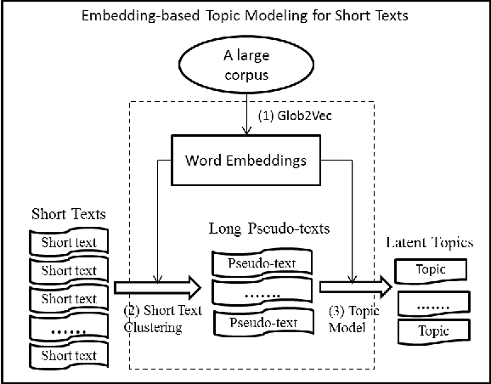
Block Diagram

Slide 11
SOFTWARE REQUIREMENTS:
Operating System : Windows 10
Platform : DOT NET TECHNOLOGY
Front End : ASP.Net 4.0
Back End : SQL SERVER 2014

Slide 12
HARDWARE REQUIREMENTS:
Keyboard
Mouse
Hard disk 500GB
Ram 4 Gb

Slide 13
CONCLUTION
In this paper, we propose a Pseudo-document-based Topic Model (PTM) for short texts. By leveraging much less pseudo documents to self aggregate tremendous short texts, PTM gains advantages in learning topic distributions without using auxiliary contextual information. A sparsified version of PTM (SPTM) is also proposed to improve the topical description of PTM when the pseudo documents is small in number. Extensive experiments on real-world data sets demonstrate the superiority of PTM and SPTM to some state-of-the-art methods. Various interesting observations regarded to the number of pseudo documents and the uniqueness of topic membership of a short text are also carefully touched. To our best knowledge, our work is among the earliest studies in using self aggregation method for short text topic modeling.

Slide 14
REFERENCE
[1] D. M. Blei. Probabilistic topic models. Communications of the ACM, 55(4):77–84, apr 2012.
[2] D. M. Blei, A. Y. Ng, and M. I. Jordan. Latent dirichlet allocation. the Journal of machine Learning research, 3:993–1022, mar 2003.
[3] T. L. Griffiths and M. Steyvers. Finding scientific topics. Proceedings of the National Academy of Sciences, 101:5228–5235, 2004.
[4] T. Hofmann. Probabilistic latent semantic indexing. In Proceedings of the 22nd annual international ACM SIGIR conference on Research and development in information retrieval, pages 50–57, 1999.
[5] L. Hong and B. D. Davison. Empirical study of topic modeling in twitter. In Proceedings of the first workshop on social media analytics, pages 80–88, 2010.

Slide 15
[6] Y. Hu, A. John, F. Wang, and S. Kambhampati. Et-lda: Joint topic modeling for aligning events and their twitter feedback. In AAAI, pages 59–65, 2012.
[7] H. Ishwaran and J. S. Rao. Spike and slab variable selection: frequentist and bayesian strategies. The Annals of Statistics, 33(2):730–773, 2005.
[8] O. Jin, N. N. Liu, K. Zhao, Y. Yu, and Q. Yang. Transferring topical knowledge from auxiliary long texts for short text clustering. In Proceedings of the 20th ACM international conference on Information and knowledge management, pages 775–784, 2011.
[9] A. Q. Li, A. Ahmed, S. Ravi, and A. J. Smola. Reducing the sampling complexity of topic models. In Proceedings of the 20th ACM SIGKDD international conference on Knowledge discovery and data mining, pages 891–900, 2014.
[10] W. Li and A. McCallum. Pachinko allocation: Dag-structured mixture models of topic correlations. In Proceedings of the 23rd international conference on Machine learning, pages 577–584, 2006.

